Slide 1
Chapter 2
And Then There
Was JavaScript

Slide 2
The Big Bang
The Dawn of Man
JavaScript

Slide 3
The First Important Discovery of the 21st Century
JavaScript has good parts.

Slide 4
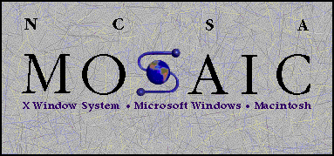

Slide 5


Slide 6
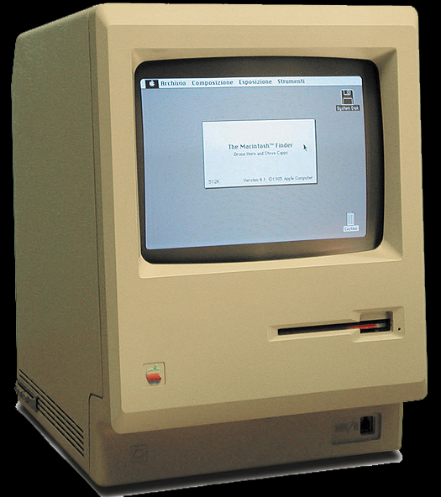

Slide 7
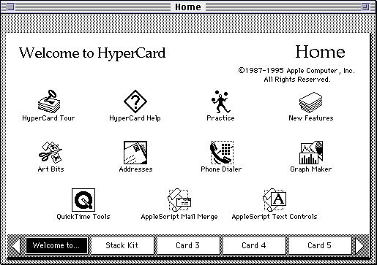

Slide 8
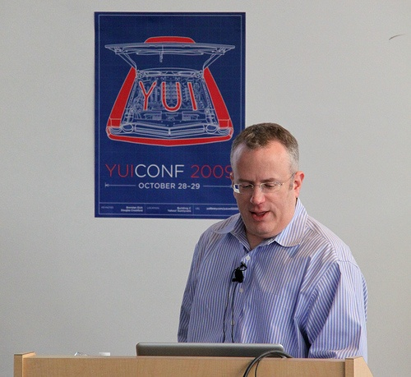

Slide 9
Java
Scheme
Self
LiveScript
JavaScript
JScript
ECMAScript

Slide 10
Java
Scheme
Self
LiveScript
JavaScript
JScript
ECMAScript

Slide 11
Java
Scheme
Self
LiveScript
JavaScript
JScript
ECMAScript

Slide 12
Java
Scheme
Self
LiveScript
JavaScript
JScript
ECMAScript

Slide 13
Where do Bad Parts come from?
Legacy
Good Intentions
Haste
For the most part, the bad parts can be avoided.
The problem with the bad parts isn’t that they are useless.

Slide 14
Objects

Slide 15
An object is a dynamic collection of properties.
Every property has a key string that is unique within that object.

Slide 16
Get, set, and delete
get
  object.name
  object[expression]
set
  object.name = value;
  object[expression] = value;
delete
  delete object.name
  delete object[expression]

Slide 17
[keys] must be strings
Automatic type coercion.

Slide 18
Object literals
An expressive notation for creating objects.
var my_object = {
foo: bar,
name: "value",
"@#$%*": "grawlix"
};

Slide 19
Classes v Prototypes

Slide 20
Working with prototypes
Make an object that you like.
Create new instances that inherit from that object.
Customize the new objects.
Classification and taxonomy are not necessary.

Slide 21
Delegation
Differential Inheritance

Slide 22
Object.create(prototype)
Prototypal Inheritance

Slide 23
var mother = {
a: 1,
b: 2
};
mother
Object.prototype
a | 1
b | 2

Slide 24
var mother = {
a: 1,
b: 2
};
var daughter = Object.create(mother);
daughter
mother
Object.prototype
a | 1
b | 2

Slide 25
var mother = {
a: 1,
b: 2
};
var daughter = Object.create(mother);
daughter.b += 3;
daughter
mother
Object.prototype
b | 5
a | 1
b | 2

Slide 26
var mother = {
a: 1,
b: 2
};
var daughter = Object.create(mother);
daughter.b += 3;
daughter.c = 9;
daughter
mother
Object.prototype
b | 5
c | 9
a | 1
b | 2

Slide 27
Object.create(null)
Creates an object
that inherits nothing.

Slide 28
Object.freeze(object)
Immutable

Slide 29
Object and …
Number
Boolean
String
Array
Date
RegExp
Function

Slide 30
Number

Slide 31
Number literals
.01024e4
1.024e+3
10.24E2
102.4E+1
1024.e0
1024.00
1024
10240e-1

Slide 32
Numbers
Only one number type
  No integer types
64-bit binary floating point
IEEE-754 (aka Double)

Slide 33
Good that we don’t have int
a > 0
b > 0
c = a + b;
Possible results:
c < a
c < b

Slide 34
Associative Law does not hold
(a + b) + c === a + (b + c)
Produces false for some values of a, b, c.
Integers under 9007199254740992
(9 quadrillion) are ok.
9007199254740992 === 9007199254740992 + 1

Slide 35
(a + 1) – 1 === a
Can be false.

Slide 36
Decimal fractions are approximations
a = 0.10;
b = 0.20;
c = 0.30;
a + b === c
false
(a + b) + c === a + (b + c)
false

Slide 37
Number methods
toExponential
toFixed
toLocaleString
toPrecision
toString
valueOf

Slide 38
Number methods
if (!Number.prototype.trunc) {
Number.prototype.trunc =
function trunc(number) {
return (
(number >= 0)
? Math.floor(number)
: Math.ceil(number)
);
};
}

Slide 39
Numbers are first class objects
A number can be stored in a variable.
A number can be passed as a parameter.
A number can be returned from a function.
A number can be stored in an object.
A number can have methods.

Slide 40
NaN
Special number: Not a Number
Result of undefined or erroneous operations
Toxic: any arithmetic operation with NaN as an input will have NaN as a result
NaN is not equal to anything, including NaN
NaN === NaN // false
NaN !== NaN // true
Number.isNaN(NaN) // true

Slide 41
Number Quality
typeof value === "number"
Number.isFinite(value)
Number.isInteger(value)
Number.isSafeInteger(value)

Slide 42
Math object
abs
acos
asin
atan
atan2
ceil
cos
exp
floor
log
max
min
pow
random
round
sin
sqrt
tan

Slide 43
Math object
E
LN10
LN2
LOG10E
LOG2E
PI
SQRT1_2
SQRT2
function log2(x) {
return Math.LOG2E
* Math.log(x);
}

Slide 44
x = x + 1
Mathematical nonsense.

Slide 45
x = x + 1
Infinity

Slide 46
x = x + 1
Infinity
Number.MAX_VALUE
1.7976931348623157e+308

Slide 47
x = x + 1
Infinity
Number.MAX_VALUE
9007199254740992

Slide 48
x = x + 1
But not NaN
because NaN === NaN is false

Slide 49
x = x + 1
But not NaN
because NaN === NaN is false
NaN !== NaN is true!

Slide 50
Boolean
true
false

Slide 51
String

Slide 52
Strings
A sequence of 0 or more 16-bit Unicode characters
  UCS-2, not quite UTF-16
  No awareness of surrogate pairs
No separate character type
  Characters are represented as strings with length of 1
Strings are immutable
Similar strings are equal ( === )
String literals can use single or double quotes with \ escapement.
Single quote literals are unnecessary.
ES6 adds ` quasiliterals.

Slide 53
Convert a number to a string
Use number’s method (toString)
Use String function
str = num.toString();
str = String(num);

Slide 54
Convert a string to a number
Use the Number function. (recommended)
Use the + prefix operator.
Use the parseInt function.
num = Number(str);

Slide 55
parseInt function
parseInt(str, 10)
Converts the value into a number.
It stops at the first non-digit character.
parseInt("12em") === 12
The radix (10) should always be used.
parseInt("08") === 0
parseInt("08", 10) === 8

Slide 56
String length
string.length
The length property determines the number of 16-bit characters in a string.
Extended characters are counted as 2.

Slide 57
String methods
charAt
charCodeAt
compareLocale
concat
indexOf
lastIndexOf
localeCompare
match
replace
search
slice
split
substring
toLocaleLowerCase
toLocaleUpperCase
toLowerCase
toString
toUpperCase
trim
valueOf

Slide 58
trim
if (typeof String.prototype.trim !== "function") {
String.prototype.trim = function () {
return this.replace(
/^\s*(\S*(\s+\S+)*)\s*$/,
"$1"
);
};
}

Slide 59
Array

Slide 60
Arrays
Array inherits from Object.
Indexes are converted to strings and used as names for retrieving values.
Very efficient for sparse arrays.
Not very efficient in most other cases.
One advantage: No need to provide a length or type when creating an array.

Slide 61
length
Arrays, unlike objects, have a special length property.
It is always 1 larger than the highest integer subscript.

Slide 62
Array Literals
An array literal uses []
It can contain any number of expressions, separated by commas
  myList = ["oats", "peas", "beans"];
New items can be appended
  myList[myList.length] = "barley";
The dot notation should not be used with arrays.

Slide 63
Array methods
concat
every
filter
forEach
indexOf
join
lastIndexOf
map
pop
push
reduce
reduceRight
reverse
shift
slice
some
splice
toLocaleString
toString
unshift

Slide 64
sort
var n = [4, 8, 15, 16, 23, 42];
n.sort();
// n is [15, 16, 23, 4, 42, 8]

Slide 65
sort
var n = [4, 8, 15, 16, 23, 42];
n.sort();
// n is [15, 16, 23, 4, 42, 8]
n.sort(function (a, b)) {
return a - b;
};
// n is [4, 8, 15, 16, 23, 42]

Slide 66
Deleting Elements
delete array[number]
Removes the element, but leaves a hole in the numbering.
array.splice(number, 1)
Removes the element and renumbers all the following elements.

Slide 67
Deleting Elements
myArray = ["a", "b", "c", "d"];
delete myArray[1];
// ["a", undefined, "c", "d"]
myArray.splice(1, 1);
// ["a", "c", "d"]

Slide 68
Arrays v Objects
Use objects when the names are arbitrary strings.
Use arrays when the names are sequential integers.
Don't get confused by the term Associative Array.

Slide 69
Date
The Date function is based on Java's Date class.
It was not Y2K ready.

Slide 70
RegExp
  /\/(\\[^\x00-\x1f]|\[(\\[^\x00-\x1f]|[^\x00-\x1f\\\/])*\]|[^\x00-\x1f\\\/\[])+\/[gim]*/
  http://jex.im/regulex/

Slide 71
Function

Slide 72
All values are objects
Except null and undefined.

Slide 73
null undefined
A values that are not objects.

Slide 74
undefined
The default value for variables and parameters.
The value of missing members in objects and arrays.

Slide 75
typeof
The typeof prefix operator returns a string identifying the type of a value.
type | typeof
object | "object"
function | "function"
array | "object"
number | "number"
string | "string"
boolean | "boolean"
null | "object"
undefined | "undefined"

Slide 76
Array.isArray
Array.isArray([]) // true

Slide 77
Falsy values
false
null
undefined
"" (empty string)
0
NaN
All other values (including all objects) are truthy.
"0" "false"
All values can be said to be boolish.

Slide 78
Loosely Typed
Any of these types can be stored in an variable, or passed as a parameter to any function.
The language is not untyped.
This is a good part.

Slide 79
Reference
Objects can be passed as arguments to functions, and can be returned by functions
  Objects are passed by reference.
  Objects are not passed by value.
The === operator compares object references, not values
  true only if both operands are the same object

Slide 80
C
JavaScript is syntactically a C family language
It differs from C mainly in its type system, which allows functions to be values

Slide 81
Identifiers
Starts with a letter or _ or $
Followed by zero or more letters, digits, _ or $
By convention, all variables, parameters, members, and function names start with lower case
Except for constructor functions which start with upper case
Initial _ should be reserved for implementations
$ should be reserved for machines.

Slide 82
Comments
  // slashslash line comment (recommended)
  /*
  slashstar
  block
  comment
  */

Slide 83
Operators
Arithmetic
  + - * / %
Comparison
  == != < > <= >=
Logical
  && || !
Bitwise
  & | ^ >> >>> <<
Ternary
  ?:

Slide 84
+
Addition and concatenation
If both operands are numbers,
  then
    add them
  else
    convert them both to strings
    concatenate them
"$" + 3 + 4 = "$34"

Slide 85
/
Division of two integers can produce a non-integer result
  10 / 3 3.3333333333333335

Slide 86
%
The remainder operator, not the modulo operator.
-1 % 8 // -1, not 7

Slide 87
== !=
Equal and not equal
These operators can do type coercion
It is always better to use === and !==, which do not do type coercion.

Slide 88
Evils of type coercion
"" == "0" // false
0 == "" // true
0 == "0" // true
false == "false" // false
false == "0" // true
false == undefined // false
false == null // false
null == undefined // true
" \t\r\n " == 0 // true
1 == [1] // true
true == [1] // true
true == [true] // false

Slide 89
&&
logical and
If first operand is truthy
  then result is second operand
  else result is first operand

Slide 90
||
logical or
If first operand is truthy
  then result is first operand
  else result is second operand

Slide 91
!
Prefix logical not operator.
If the operand is truthy, the result is false. Otherwise, the result is true.

Slide 92
Bitwise
  & | ^ >> >>> <<
The bitwise operators convert the operand to a 32-bit signed integer, and turn the result back into 64-bit floating point.

Slide 93
Statements
expression
if
switch
while
do
for
break
continue
return
try/throw

Slide 94
Break statement
Statements can have labels. (not recommended)
Break statements can refer to those labels.
  loop: while (true) {
    ...
      if (...) {
        break loop;
      }
    ...
  }

Slide 95
For statement
Iterate through all of the elements of an array.
(not recommended)
for (i = 0; i < array.length; i += 1) {
  ...
}
Use the forEach or map method instead.

Slide 96
Switch statement
Multiway branch.
The switch value does not need to a number. It can be a string.
The case values can be expressions.
Danger: Cases fall through to the next case unless a disruptive statement like break ends the case.
Use if instead.

Slide 97
Throw statement
throw new Error(reason);
throw {
name: exceptionName,
message: reason
};

Slide 98
Try statement
  try {
  plan_a();
  } catch (ignore) {
  plan_b();
  }

Slide 99
Next:
Act III
Function the Ultimate

