Slide 1
Part 5
The End of All Things

Slide 2
I believe that children are our future.

Slide 3
I believe that children are our future.
And also robots.
Children and robots.

Slide 4
The Browser and Security
XSS and Beyond

Slide 5
What can an attacker do if he gets some script into your page?

Slide 6
An attacker can request additional scripts from any server in the world.
Once it gets a foothold, it can obtain all of the scripts it needs.

Slide 7
An attacker can read the document.
The attacker can see everything the user sees.

Slide 8
An attacker can make requests of your server.
Your server cannot detect that the request did not originate with your application.

Slide 9
If your server accepts SQL queries, then the attacker gets access to your database.
SQL was optimized for
SQL Injection Attacks

Slide 10
An attacker has control over the display and can request information from the user.
The user cannot detect that the request did not originate with your application.

Slide 11
An attacker can send information to servers anywhere in the world.

Slide 12
The browser does not prevent any of these.
Web standards require these weaknesses.

Slide 13
The consequences of a successful attack are horrible.
Harm to customers.
Loss of trust.
Legal liabilities.

Slide 14
HTML5
A big step in the wrong direction.™

Slide 15
Cross site scripting attacks were invented in 1995.
We made no progress on the fundamental problems except for a baby step in December 2009.

Slide 16
Why is there XSS?
The web stack is too complicated.
  Too many languages, each with its own encoding, quoting, commenting, and escapement conventions.
  Each can be nested inside of each other.
  Browsers do heroic things to make sense of malformed content.
Template-based web frameworks are optimized for XSS injection.

Slide 17
Why is there XSS?
The JavaScript global object gives every scrap of script the same set of powerful capabilities.
As bad as it is at security, the browser is a vast improvement over everything else.
The browser does distinguish between the interests of the user and the interests of the site.
The browser failed to anticipate that there could be additional interests.

Slide 18
And then there is the Mashup Problem
A mashup is the combining of programs representing multiple interests.
The browser confuses those interests.
So an advertiser on a page gets the same privileges as an Ajax library or an analytics files, which is the same as the main applications, which is the same as any XSS code that falls into the page.
Advertising is a self-inflicted XSS attack.

Slide 19


Safe JavaScript Subsets
Deny access to the global object and the DOM.
Caja. http://code.google.com/p/google-caja/
ADsafe. http://www.ADsafe.org/

Slide 20
Many popular approaches to security fail.
Security by inconvenience. (TSA)
Security by obscurity.
Security as identity.
Security by vigilance.

Slide 21
Working with the grain.

Slide 22
Pass By Reference
When values are immutable,
Pass By Reference looks like
Pass By Value

Slide 23
By reference
variable = {};
a = variable;
b = variable;
alert(a === b);

Slide 24
Don’t confuse values with variables.

Slide 25
Quiz 1
function funky(o) {
o = null;
}
var x = [];
funky(x);
alert(x);
null
[]
undefined
throw

Slide 26
Quiz 2
function swap(a, b) {
var temp = a;
a = b;
b = temp
}
var x = 1, y = 2;
swap(x, y);
alert(x);
1
2
undefined
throw

Slide 27
Make a function that puts a value in a variable when it is finished.

Slide 28
Pass the name of the variable.
function do_it(inputs, name) {
...
eval(name + ' = ' + result);
window[name] = result;
}
Not only bad practice, but illegal in ES5/strict.

Slide 29
Pass an object and a name.
function do_it(inputs, obj, name) {
...
obj[name] = result;
}
Gives do-it too much authority.

Slide 30
Pass a function.
function do_it(inputs, func) {
...
func(result);
}
We pass a function to do_it.
do_it cannot abuse the function.
The function cannot abuse do_it.
func is a callback.

Slide 31
Callbacks
Temporal isolation.
Event handlers.
Timers.
Lightweight, powerful, expressive.

Slide 32
function do_it(inputs, callback) {
...
callback(result);
}
do_it(my_inputs, function (result) {
my_object.blah = result;
});

Slide 33
Generalize.
function storer(obj, name) {
return function (result) {
obj[name] = result;
};
}
do_it(inputs,
storer(my_object, 'blah'));

Slide 34
function storer_maker(obj) {
return function(name) {
return function (result) {
obj[name] = result;
};
};
}
my_storer = storer_maker(my_object);
do_it(my_inputs, my_storer('blah'));

Slide 35
function once(func) {
return function () {
var f = func;
func = null;
return f.apply(this, arguments);
};
}
do_it(my_inputs,
once(storer(my_object, 'blah')));

Slide 36
function sequence() {
var functions = Array.prototype.slice
.call(arguments, 0);
return function () {
var args = Array.prototype.slice
.call(arguments, 0);
functions.forEach(function (func) {
func.apply(null, args);
});
};
}

Slide 37
do_it(my_inputs, once(sequence(
storer(my_object, 'blah'),
storer(other_object, 'wow'),
alert
)));

Slide 38
function revoker(func) {
return {
revocable: function () {
return func.apply(this,
arguments);
},
revoke: function () {
func = null;
}
};
}

Slide 39
Information Hiding
Need to know
David Parnas
On the Criteria to Be Used in Decomposing Systems into Modules. (1972)

Slide 40
Information Hiding
Need to know
A reference is a capability.
Capability Hiding
Need to do

Slide 41
There are exactly three ways to obtain a reference in an object capability security system.
By Creation.
By Construction.
By Introduction.

Slide 42
1. By Creation
If a function creates an object, it gets a reference to that object.

Slide 43
2. By Construction
An object may be endowed by its constructor with references.
This can include references in the constructor’s context and inherited references.

Slide 44
3. By Introduction
A has a references to B and C.
B has no references, so it cannot communicate with A or C.
C has no references, so it cannot communicate with A or B.

Slide 45
3. By Introduction
A calls B, passing a reference to C.

Slide 46
3. By Introduction
B is now able to communicate with C.
It has the capability.

Slide 47
If references can only be obtained by Creation, Construction, or Introduction, then you may have a safe system.

Slide 48
If references can be obtained in any other way, you do not have a safe system.

Slide 49
The Lazy Programmer’s Guide to Secure Computing
Marc Stiegler
http://www.youtube.com/watch?
v=eL5o4PFuxTY

Slide 50
Performance

Slide 51
Optimize your optimizing.
"Every microsecond saved counts"
FALSE

Slide 52
t = c * n
t total time
c cost per iteration
n number of iterations

Slide 53
Big O Notation
O (1) Constant
O (log n) Logarithmic
O (n) Linear
O (n log n) Loglinear
O (n²) Exponential
O (n!) Factorial

Slide 54
t = c * n²
Improvements in c are insignificant for large n.

Slide 55
Performance Threshold
Distraction.
Frustration.
Session failure.
Impractical.
Infeasible.
Impossible.

Slide 56
To get under the Distraction limit, it is necessary to give immediate feedback.

Slide 57
To get under the Frustration limit, it is necessary to keep n small.
Just in time data delivery.

Slide 58
Don’t fiddle.
Find where the time is being spent. It is counter productive to speed up the places where time is not being spent.

Slide 59
Every bit of waste you squeeze out helps performance.
Surprisingly, this is not true.

Slide 60
Arrays
Should be O(1).
Can be O(log n) or O(n).
A loop that should be O(n) can be O(n²)

Slide 61
Wow!
Just say no.

Slide 62
Don’t Tune For Quirks
Some browsers have surprising inefficiencies.
A trick that is faster on Browser A might be slower on Browser B.
The performance characteristics of the next generation may be significantly different.
Avoid short-term optimizations.

Slide 63
Don’t Optimize Without Measuring
Intuitions are often wrong.
  start_time = Date.now();
  code_to_measured();
  end_time = Date.now();
  elapsed_time = end_time - start_time;
A single trial is unreliable. Timers can be off by as much as 15 msec.
Even accurate measurements can lead to wrong conclusions.

Slide 64
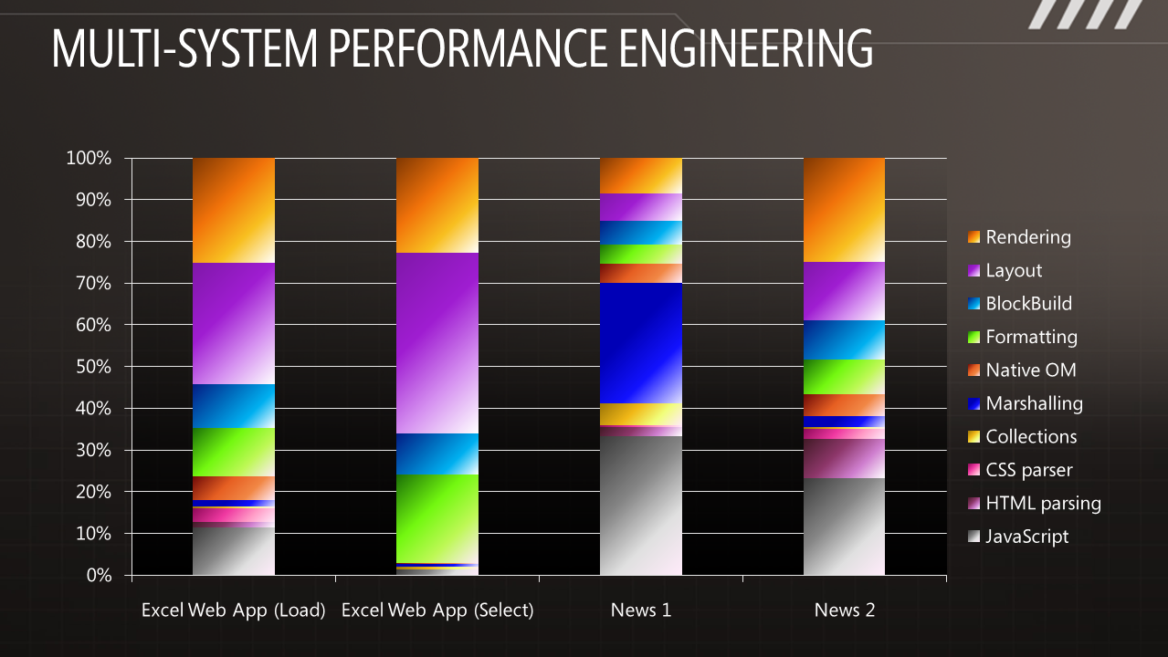

Slide 65
Speed Tracer
Google Chrome Extension

Slide 66
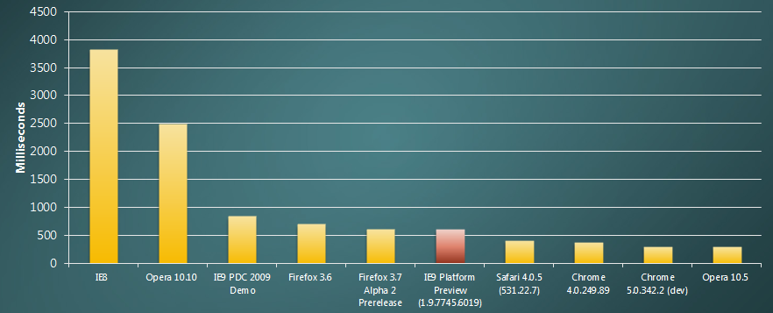
Lies, damn lies, and benchmarks.

Slide 67
Clean, elegant code.

Slide 68
I have been writing JavaScript for 11 years.

Slide 69
I have learned some things.
I have made every mistake that can be made.
Mistake #1, I didn’t bother to learn the language first.
I tried to write in a Java style, even knowing that it wasn’t Java.
It roundhouse kicked me in the head.

Slide 70
After a lot of struggle, I eventually figured out that it was a functional language, and then I stopped fighting it.
We delivered on time and under budget.

Slide 71
JSLint.com

Slide 72
I hung out on comp.lang.javascript.
“Help me.”
Could JSLint have caught that mistake?
Yes, but it requires discipline:
Avoid forms that look like errors.

Slide 73
with statement
It can be extremely useful.
It can also mask terrible errors.
Is it possible in static analysis to distinguish the useful cases from the terrible errors?
No.
Is it really that useful?
Can we live without it?

Slide 74
with statement
Then it is a Bad Part. Get rid of it.
Remove all of the nonessential features and forms that cannot be distinguished from common errors.
Look at what is left. Is it a complete language?

Slide 75
JavaScript (without the bad parts) isn't just an adequate language.
It is a superior language.

Slide 76
Left or Right?
block
{
....
}
Might work well in other languages
block {
....
}
Works well in JavaScript

Slide 77
Left or Right?
return
{
ok: false
};
SILENT ERROR!
return {
ok: true
};
Works well in JavaScript

Slide 78
var a = b = 0;

Slide 79
var a = b = 0;
var a = 0, b = 0;
var a = (b = 0);

Slide 80
if (a) b(); c();

Slide 81
if (a) b(); c();
if (a) {b(); c();}
if (a) {b();} c();

Slide 82
It should be clear from reading a program what it actually does.
Avoid forms that are difficult to distinguish from common errors.

Slide 83
++

Slide 84
++
x += 1

Slide 85
++
x += 1
x++

Slide 86
++
x += 1
x++
++x

Slide 87
Running with scissors

Slide 88
“That hardly ever happens”
is another way of saying
“It happens”.

Slide 89
There will be bugs.
Do what you can to move the odds to your favor.

Slide 90
JSLint
JSLint defines a professional subset of JavaScript.
Just the good parts.
Avoid the bad parts.
http://www.JSLint.com/

Slide 91
WARNING!
JSLint will hurt your feelings.

Slide 92
Unlearning Is
Really Hard
Perfectly Fine == Faulty

Slide 93
Language Subsetting
Only a madman would use all of C++.

Slide 94
The ECMAScript Technical Committee (ECMA TC39) is constrained in its ability to remove or repair the bad features of the language.
Dangerous, not useless.
The web is a weirdly fragile thing.
But you can remove bad features simply by refusing to use them.

Slide 95
(global) Object
The object that dares not speak its name.
It is the container for all global variables and all built-in objects.
On browsers, window is the global object.
We need to tame or eliminate the global object.

Slide 96
Implied Global
Any variable that is not properly declared is assumed to be global by default.
This makes it easy for people who do not know or care about encapsulation to be productive, but it makes applications less reliable.
Never use implied global variables.
Rarely use any global variables.

Slide 97
Global variables should be as rare as hen’s teeth, and should stick out like a sore thumb.
ALLCAPS

Slide 98
We make tradeoffs.

Slide 99
Bugs are an inevitable hazard.
We should shift the odds in our favor.

Slide 100
Programming style should be conventions that promote good tradeoffs.
Avoidance of ambiguity, confusion, potential errors.

Slide 101
JSLint is my proofreader.
JSLint makes it easier for me to write good code.

Slide 102
The End of All Things

