Slide 1
Scene 6
Loopage
Notes:
I recently read a paper in which Garbage Collection is a Programmer Convenience. In comparing C++ and Java productivity, they determined that GC added little value. The conclusion was that C++ programmers who do not understand Java can feel good about being ignorant.
But GC is not for convenience. It is reliability. Having GC and language-based memory management eliminates an important and difficult class of errors.
A recurring theme in this series is that people in general, and programmers in particular, like to feel good about being ignorant. We'll see more examples of that tonight.
Programmers are lazy. If we weren't lazy, we would never get anything finished. It is one thing to be smart and lazy, it is another thing to be dumb and lazy. To be lazy and productive, you must be willing to learn.

Slide 2
JavaScript
Loops

Slide 3
Java
Scheme
Self
JavaScript

Slide 4
loop {
…
}

Slide 5
while (<condition>) {
<body>
}
loop {
if (!(<condition>)) {
break;
}
<body>
}

Slide 6
do {
<body>
} while (<condition>);
loop {
<body>
if (!(<condition>)) {
break;
}
}

Slide 7
for (<initialize>; <condition>; <increment>) {
<body>
}
<initialize>;
loop {
if (!(<condition>)) {
break;
}
<body>
<increment>;
}

Slide 8
while (<condition>) {
<body>
}
(function whiler() {
if (<condition>) {
<body>
return whiler();
}
}());
Notes:
Depends on tail recursion optimization.

Slide 9
Browser Event Loop
Event queue containing callback functions. (timer, ui, network)
Turn: Remove one callback from the queue. It runs to completion.
The Law of Turns:
Never block. Never wait. Finish fast.
The Event Loop is one of the best parts of the browser.
Avoid: alert, confirm , prompt, XHR synchronous.

Slide 10
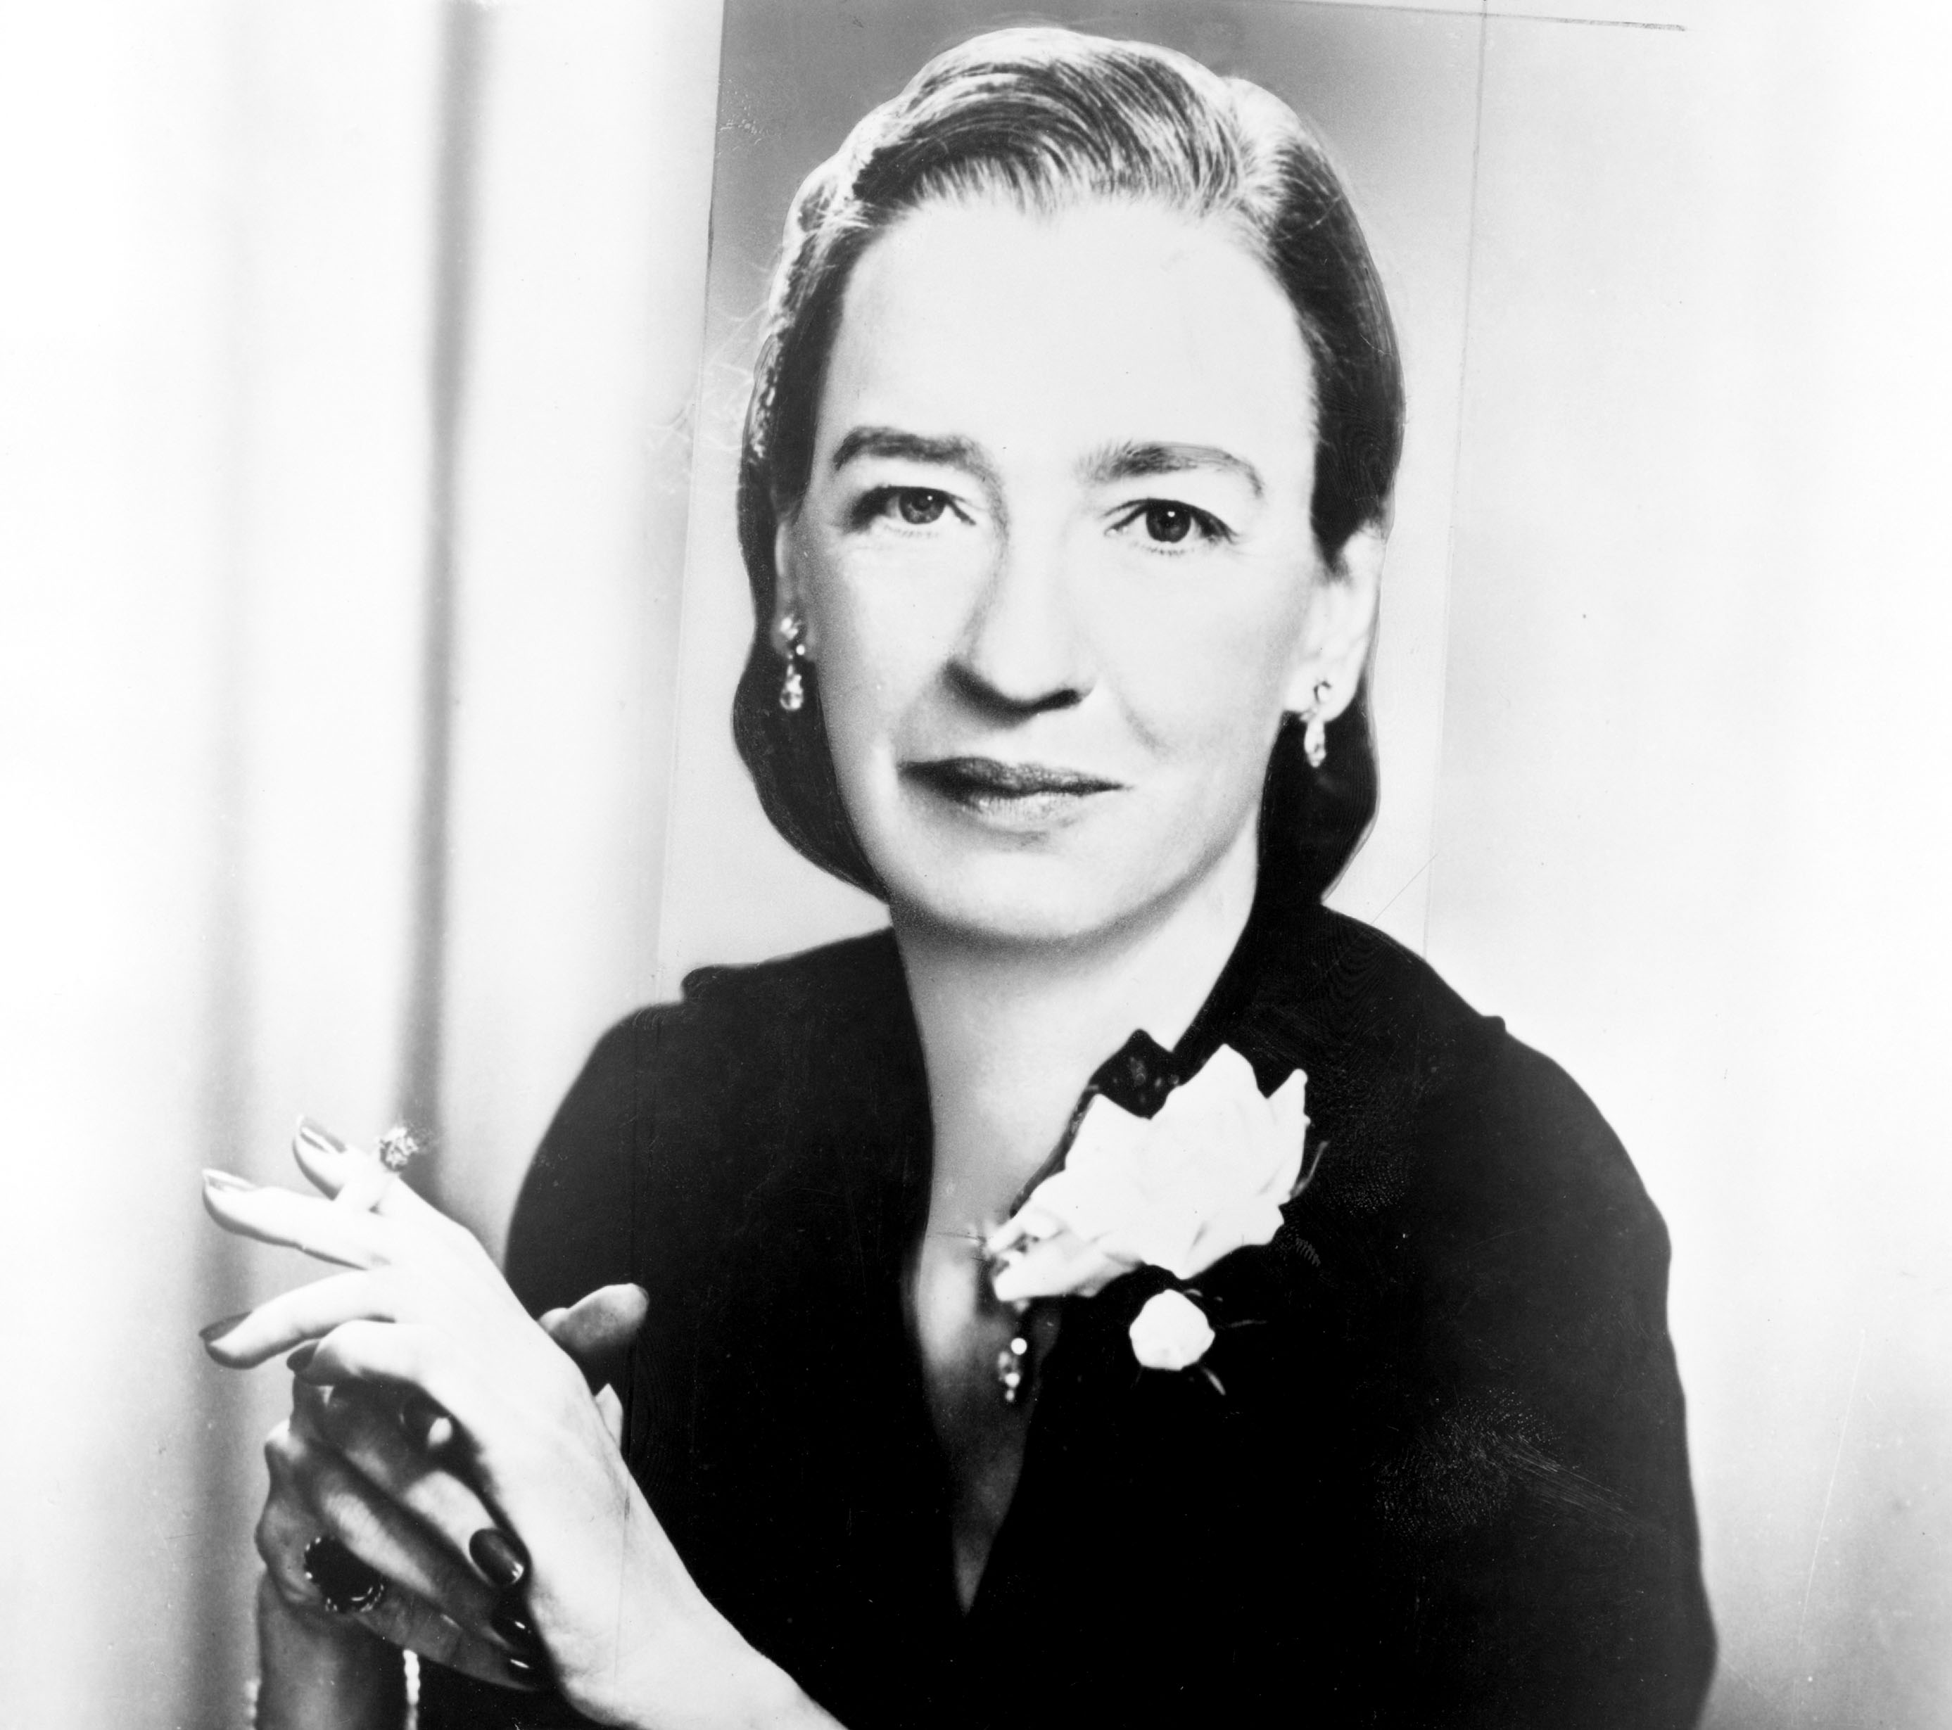
Grace Murray Hopper
Courtesy WGBH
Notes:
Grace Murray Hopper.
One of the first woman to receive a PhD in Mathematics at Yale.
Tenured professor at Vassar.
Her husband, brother, many cousins joined the military.
On the eve of her 37th birthday, reported to US Naval Reserve Midshipman's School.

Slide 11
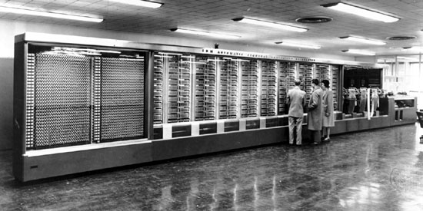
IBM Automatic Sequence Controlled Calculator
Notes:
Mark I
Assigned to LtCom Howard Aiken, Automatic Sequence Controlled Calculator at Harvard.

Slide 12
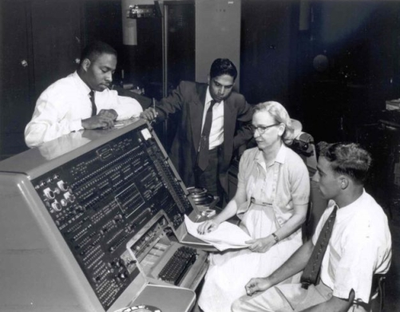

Slide 13
A-0
The first compiler.
Compiled a set of subroutines from a tape library.
Each subroutine had a call number.
Subroutines can be open (include) or closed (function).
In modern terms, it was more of a linker or loader.

Slide 14
A-2
The first open source project.
It was shared with people who bought Univac machines, and they contributed changes and suggestions.
Lead to A-3, AT-3, and MATH-MATIC.
IBM’s FORTRAN.
Some of the best programmers of the day rejected this approach.

Slide 15
Programming took too much creativity and dexterity for the human being to be replaced by the very machine we are manipulating. Waa.
The people who should be the first to recognize the value of an innovation are often the last.

Slide 16
READ / WRITE
Stop until the I/O operation is completed.

Slide 17
Black Box
INPUT
PROCESS
OUTPUT

Slide 18
Timesharing
Interactive programs are highly modal.
The user can only enter what the program is expecting.
The flow of the dialog is dictated by the program, not by the user.
Timesharing depended on blocking READ.
While one program is blocked, another may run.

Slide 19
Virtually all programming languages have blocking I/O.
READ / WRITE
unto every generation.

Slide 20
Except C, which has no I/O at all.
Unfortunately, it has stdio,
and stdio is blocking.

Slide 21
Meanwhile
Research, editors, and games.

Slide 22
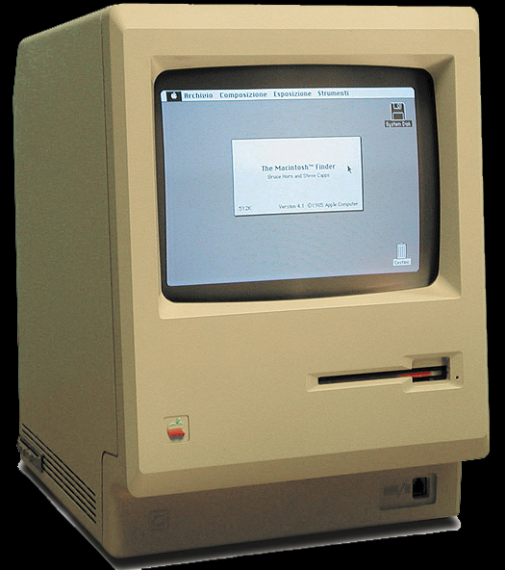

Slide 23
You have to write the programs inside out! Waa!
Let’s go back to the command line.

Slide 24
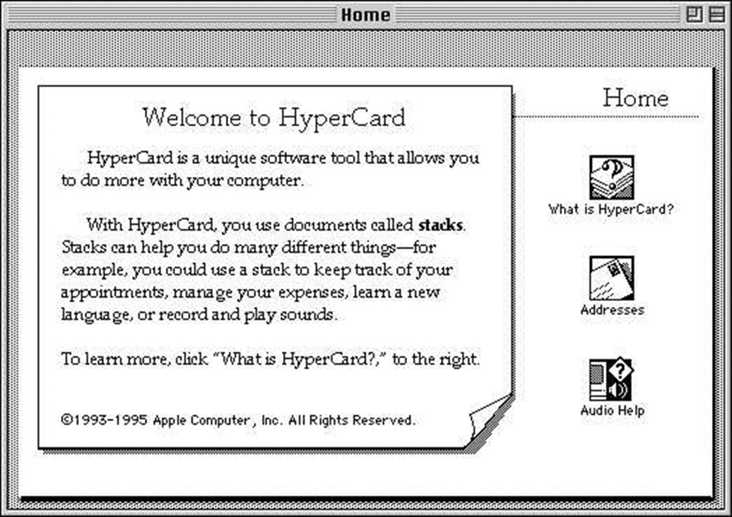
Notes:
Multi-plane b/w bitmap editor with a scripting language.
Non-programmers were amazingly productive with it.

Slide 25
Non-programmers were incredibly productive with HyperCard.
Suddenly, professional programmers got smarter and there was an explosion of Mac and Windows applications.

Slide 26
HyperCard was all about events
Programs (aka stacks) were written as a collection of event handlers attached to visible objects.
Events bubble up.
  on mouseUp
  on keyDown
  on cardEnter
  on idle
If you don’t provide a right way, the street will find its own way.

Slide 27
HyperCard had a big impact on the evolution of the browser.
JavaScript is well suited for this model.
As awful as the DOM is, JavaScript+DOM is effective.
JavaScript+YUI3 is really effective.

Slide 28
JavaScript does not have READ.
That has always been seen as a huge disadvantage, but it is actually a wonderful thing.

Slide 29
READ blocks, and blocking is bad for event loops.
JavaScript programmers are smarter about using event loops than programmers of other languages.

Slide 30
Event loop is just one approach to concurrency.
The most popular approach is threading.

Slide 31
Threading
Pro
Con
No rethinking is necessary.
Blocking programs are ok.
Execution continues as long as any thread is not blocked.
Stack memory per thread.
If two threads use the same memory, a race may occur.
To be continued…

Slide 32
Two threads
my_array[my_array.length] = 'a';
my_array[my_array.length] = 'b';
['a', 'b']
['b', 'a']

Slide 33
Two threads
my_array[my_array.length] = 'a';
my_array[my_array.length] = 'b';
['a', 'b']
['b', 'a']
['a']
['b']

Slide 34
my_array[my_array.length] = 'a';
length_a = my_array.length;
my_array[length_a] = 'a';
if (length_a >= my_array.length) {
my_array.length = length_a + 1;
}

Slide 35
my_array[my_array.length] = 'a'; my_array[my_array.length] = 'b';
length_a = my_array.length;
length_b = my_array.length;
my_array[length_a] = 'a';
if (length_a >= my_array.length) {
my_array[length_b] = 'b';
my_array.length = length_a + 1;
}
if (length_b >= my_array.length) {
my_array.length = length_b + 1;
}

Slide 36
It is impossible to have application integrity when subject to race conditions.

Slide 37
Mutual Exclusion
semaphore
monitor
rendezvous
synchronization
This used to be operating system stuff.
It has leaked into applications because of networking and the multi-core problem.

Slide 38
Mutual Exclusion
Only one thread can be executing on a critical section at a time.
All other threads wanting to execute the critical section are blocked.
If threads don’t interact, then the program runs at full speed.
If they do interact, then races will occur unless mutual exclusion is employed.

Slide 39
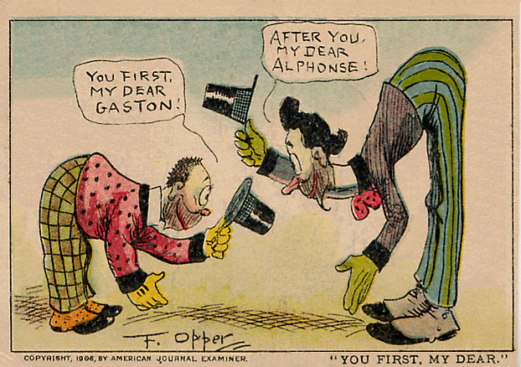
Deadlock

Slide 40
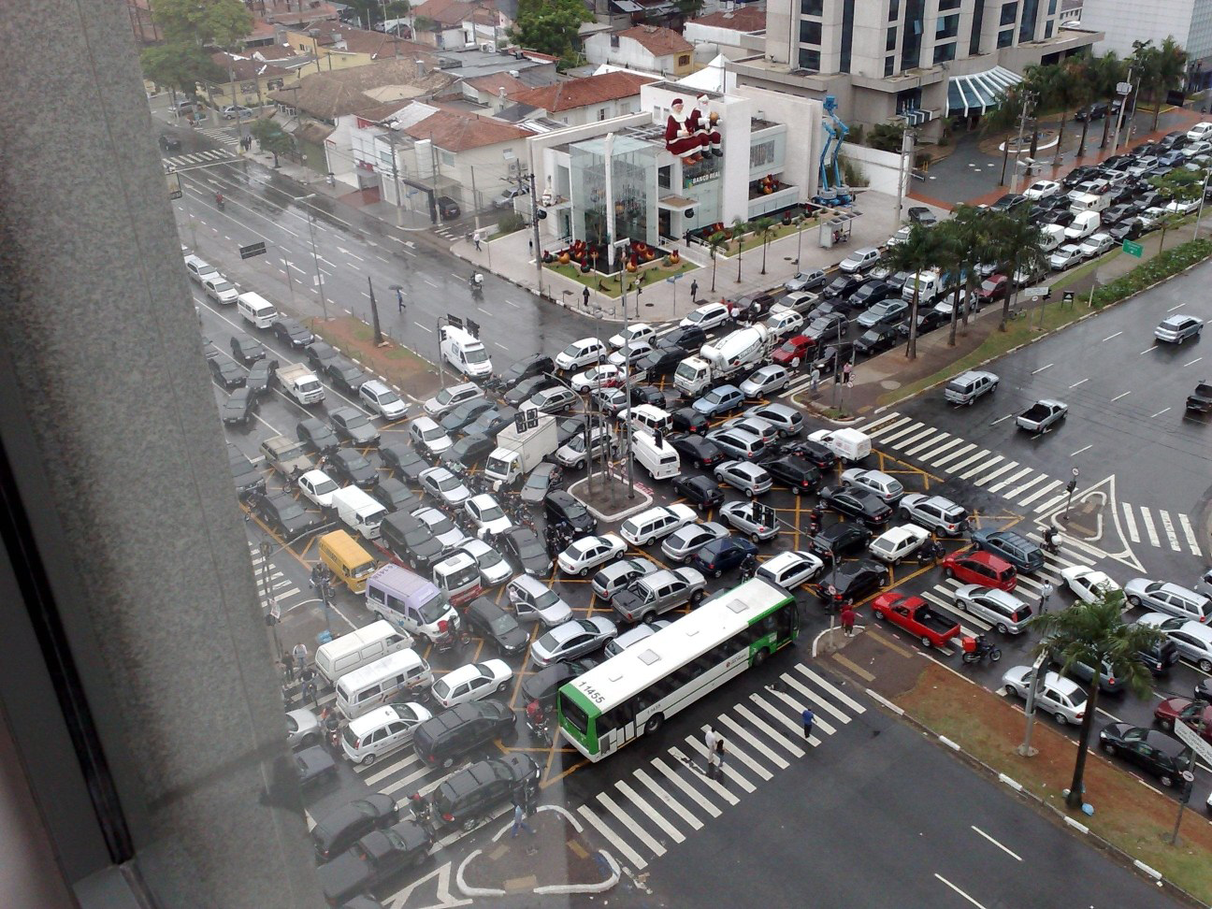
Deadlock

Slide 41
Deadlock
Deadlock occurs when threads are waiting on each other.
Races and deadlocks are difficult to reason about.
They are the most difficult problems to identify, debug and correct.
They are often unobservable during testing.
Managing sequential logic is hard. Managing temporal logic is really, really hard.

Slide 42
Threading
Pro
Con
No rethinking is necessary.
Blocking programs are ok.
Execution continues as long as any thread is not blocked.
Stack memory per thread.
If two threads use the same memory, a race may occur.
Overhead.
Deadlock.
Thinking about reliability is extremely difficult.
System/Application confusion.

Slide 43
Fortunately, there is a model that completely avoids all of the reliability hazards of threads.

Slide 44
The Event Loop!

Slide 45
Event Loop
Pro
Con
Completely free of races and deadlocks.
Only one stack.
Very low overhead.
Resilient. If a turn fails, the program can still go on.
Programs must never block.
Programs are inside out! Waa!
Turns must finish quickly.

Slide 46
Long running tasks
Two solutions for long running programs:
Eteration: Break the task into multiple turns.
Move the task into a separate process (workers).

Slide 47
Remote Procedure Call
Combines two great ideas, functions and networking, producing a really bad idea.
Like READ, attempts to isolate programs from time. The program blacks out.
In reading the program, it is by design difficult to see where time is lost.
This can result in a terrible experience for the user. Lost time === annoying delays.
Keeping the user waiting without warning is disrespectful and rude.

Slide 48
Latency Compensation
At a minimum, acknowledge user’s input immediately.
Don’t lock up the interaction while waiting for the server’s response.
In some applications, it is reasonable to predict the server’s response and display it immediately. Later display a correction if the prediction was wrong.

Slide 49
XSS

Slide 50
The browser is a loaded gun pointed at your head.
This pulls the trigger:
<?= "bang" ?>

Slide 51
Page Templates
The page template systems (PHP, ASP, JSP…) are not a good match for the way we build modern sites.
A template is too rigid a framework.
It is too easy to insert text into a context where it can be misinterpreted and executed, completing an XSS attack.

Slide 52
Can we do better by using JavaScript on the server?
There are some obvious advantages:
We can take advantage of our new understanding of JavaScript.

Slide 53
Server Side JavaScript
This is not a new idea.
Netscape offered an SSJS product in 1996.
It was a page template system using a <server> tag and a write function to insert matter in the output stream.
It had all of the disadvantages of the other page template systems.

Slide 54
What about Server Side JavaScript with an Event Loop?

Slide 55
node.js
node.js implements a web server in a JavaScript event loop.
It is a high-performance event pump.
fs.readFile(filename, encoding,
function (err, data) {...})
Everything is (or can be) non-blocking.
Except:
  some synchronous functions
  require

Slide 56
Your stuff runs on both sides
Your stuff
Your stuff
YUI3
YUI3
DOM
node.js
DOM
JS
JS/V8
Browser

Slide 57
Dual Endpoint Libraries
Mojito Yahoo
Liberated Umass Lowell

Slide 58
Server programming can be more complicated.
Call 20 services, each contributing material for the page, wait until all respond, then assemble the result.
Call a service, use its result to call another service.

Slide 59
Requestor
function requestor(sync) {
service_request(param,
function (result, error) {
sync(result, error);
});
}

Slide 60
Requestor maker
function request_maker(param) {
return function (sync) {
service_request(param,
function (result, error) {
sync(result, error);
});
};
}

Slide 61
Composition
par([requestor…], sync, timeout);
seq([requestor…], sync, timeout);
map([requestor…], sync, timeout);

Slide 62
Composition function makers
paror([requestor…], timeout)
seqor([requestor…], timeout)
mapor([requestor…], timeout)

Slide 63
Future
function make_future() {
var args, queue = [];
return {
future: function future(callback) {
if (queue) {
queue.push(callback);
} else {
callback.apply(null, args);
}
return future;
},
resolver: function resolver() {
if (queue) {
args = arguments;
queue.forEach(function (callback) {
try {
callback.apply(null, args);
} catch (ignore) {}
});
queue = null;
} else {
throw new Error(
"Future already resolved."
);
}
}
};
}

Slide 64
Also see
Promises
http://documentup.com/kriskowal/q/
Directing JavaScript with Arrows
www.cs.umd.edu/~mwh/papers/jsarrows.pdf
Reactive Extensions for JavaScript
http://blogs.msdn.com/b/rxteam/archive/
2010/03/17/reactive-extensions-for-javascript.aspx
(fab)
https://github.com/jed/fab

Slide 65
Courtesy WGBH
Notes:
Grace Murray Hopper.
First woman to receive a PhD in Mathematics at Yale.
Tenured professor at Vassar.
Her husband, brother, many cousins joined the military.
On the eve of her 37th birthday, reported to US Naval Reserve Midshipman's School.
Assigned to LtCom Howard Aiken, Automatic Sequence Controlled Calculator at Harvard.

Slide 66
Thank you and good night.

