Slide 1
Effective JavaScript:
Three Days of the Good Parts
Douglas Crockford

Slide 2
The First Day
Programming Style and Your Brain
And Then There Was JavaScript
Function the Ultimate
The Metamorphosis of Ajax
The Second Day
Fun with Functions
The Third Day
Fun with Functions
Principles of Security
Managing Eventuality
The Better Parts

Slide 3
Programming Style
&
Your Brain
Douglas Crockford

Slide 4
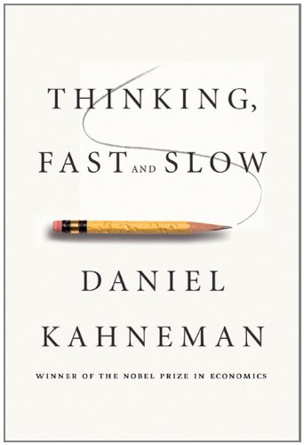

Slide 5
System Two: Head
System One: Gut

Slide 6
Visual Processing.
An analogy.

Slide 7
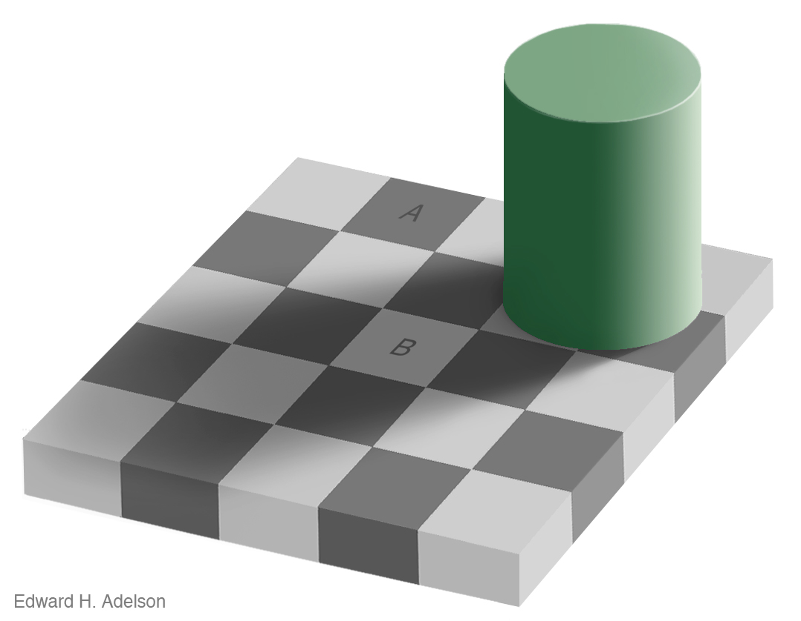

Slide 10
Advertising.

Slide 11
Tobacco.

Slide 12
Computer Programs.
The most complicated things people make.

Slide 13
Artificial Intelligence.

Slide 14
Programming Language.

Slide 15
Perfection.

Slide 16
Hunters and Gatherers.

Slide 17
Programming uses
Head and Gut.
Tradeoffs.

Slide 18
JavaScript.
Good Parts.
Bad Parts.

Slide 19
JSLint.
JSLint defines a professional subset of JavaScript.
http://www.JSLint.com/

Slide 20
WARNING!
JSLint will hurt your feelings.

Slide 21
Left or Right?
block
{
....
}
block {
....
}

Slide 22
Left or Right?
block
{
....
}
Be consistent.
block {
....
}
Everyone should do it like I do.

Slide 23
Left or Right?
return
{
ok: false
};
SILENT ERROR!
return {
ok: true
};
Works well in JavaScript.

Slide 24
return
{
ok: false
};

Slide 25
return; // semicolon insertion
{
ok: false
};

Slide 26
return;
{ // block
ok: false
};

Slide 27
return;
{
ok: false // label
};

Slide 28
return;
{ // useless
ok: false // expression
}; // statement

Slide 29
return;
{
ok: false; // semicolon
}; // insertion

Slide 30
return;
{
ok: false;
}; // empty statement

Slide 31
return;
{ // unreachable statement
ok: false;
}

Slide 32
return
{
ok: false
};
return;
false;

Slide 33
Prefer forms that are error resistant.

Slide 34
switch statement.
The fallthrough hazard.

Slide 35
“That hardly ever happens”
is another way of saying
“It happens”.

Slide 36
A good style can help produce better programs.
Style should not be about personal preference and self-expression.

Slide 37
THEROMANSWROTELATIN
ALLINUPPERCASEWITH
NOWORDBREAKS
ORPUNCTUATION

Slide 38
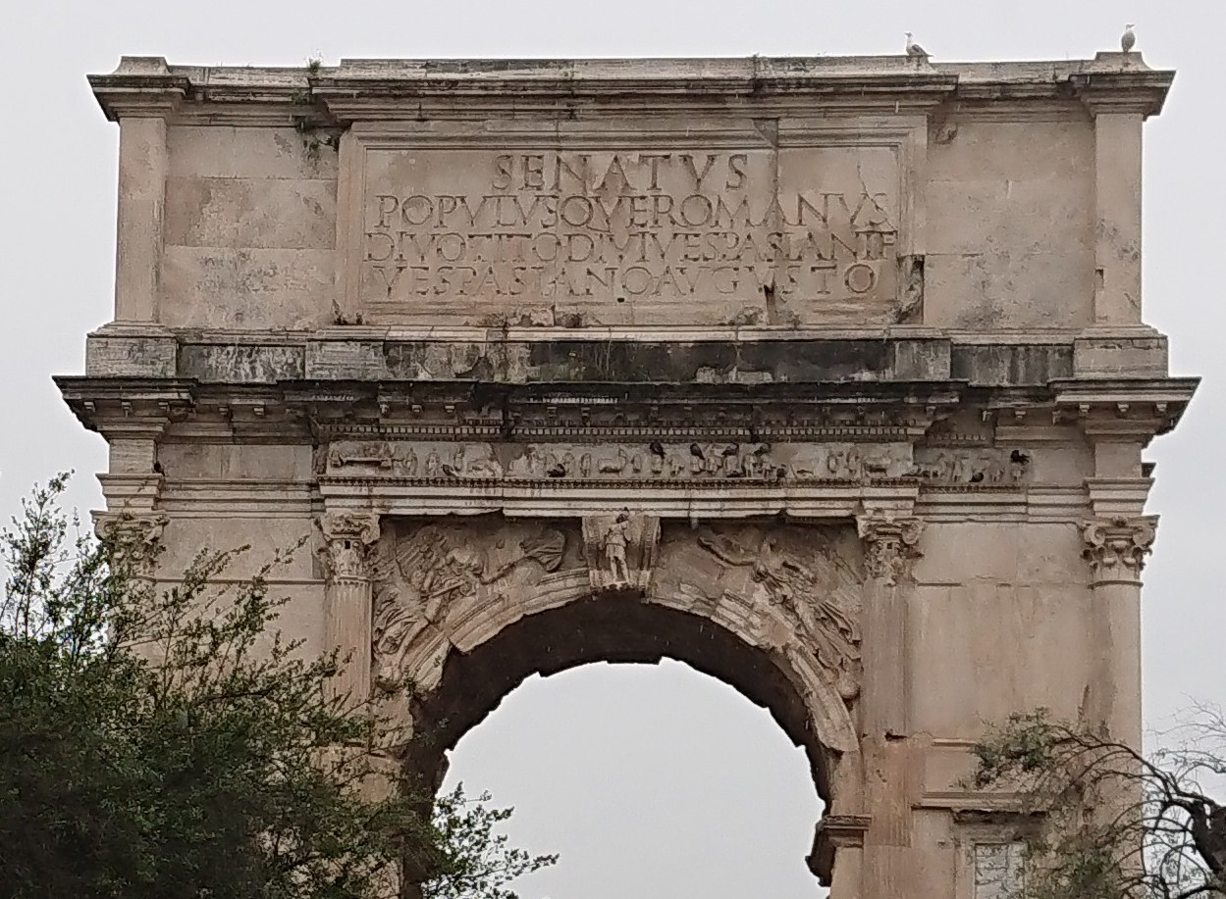

Slide 39
Medieval copyists introduced lowercase, word breaks, and punctuation.
These innovations helped reduce the error rate.

Slide 40
Good use of style can help reduce the occurrence of errors.

Slide 41
The Elements of Style
William Strunk
http://www.crockford.com/wrrrld/style.html

Slide 42
Programs must communicate clearly to people.

Slide 43
Use elements of good composition where applicable.
For example, use a space after a comma, not before.

Slide 44
Use spaces to disambiguate parens.
No space between a function name and (.
One space between all other names and (.
Wrong:
  foo (bar);
  return(a+b);
  if(a===0) {…}
  function foo (b) {…}
  function(x) {…}

Slide 45
Immediately Invocable Function Expressions
function () {
...
}(); // Syntax error!

Slide 46
Immediately Invocable Function Expressions
(function () {
...
})();

Slide 47
Immediately Invocable Function Expressions
(function () {
...
}()); // Neatness counts.

Slide 48
The Heartbreak of Automatic Semicolon Insertion
x = y // <-- Missing semicolon
(function () {
...
}());
Never rely on automatic semicolon insertion!

Slide 49
with statement.
with (o) {
foo = koda;
}
o.foo = koda;
o.foo = o.koda;
foo = koda;
foo = o.koda;

Slide 50
with statement.
with (o) {
foo = koda;
}
o.foo = koda;
o.foo = o.koda;
foo = koda;
foo = o.koda;
I am not saying that it isn’t useful.
I am saying that there is never a case where it isn’t confusing.

Slide 51
Confusion must be avoided.

Slide 52
Transitivity? What's That?
0 == "" // true
0 == "0" // true
"" == "0" // false
false == "false" // false
false == "0" // true
" \t\r\n " == 0 // true
Always use ===, never ==.

Slide 53
If there is a feature of a language that is sometimes problematic, and if it can be replaced with another feature that is more reliable, then always use the more reliable feature.

Slide 54
Multiline string literals
var long_line_1 = "This is a \
long line"; // ok
var long_line_2 = "This is a \
long line"; // syntax error

Slide 55
Avoid forms that are difficult to distinguish from common errors.

Slide 56
if (a = b) {…}
a = b;
if (a) {…}
if (a === b) {…}

Slide 57
Make your programs look like what they do.

Slide 58
var a = b = 0;
var a = 0;
var b = 0;
b = 0;
var a = b;

Slide 59
Write in a way that clearly communicates your intent.

Slide 60
if (a) b(); c();

Slide 61
if (a) b(); c();
if (a) {b(); c();}
if (a) {b();} c();

Slide 62
As our processes become more agile, our coding must be more resilient.

Slide 63
++

Slide 64
++
x += 1

Slide 65
++
x += 1
x++

Slide 66
++
x += 1
x++
++x

Slide 67
++x;
++x;
x += 2;

Slide 68
For no cost, by adopting a more rigorous style, many classes of errors can be automatically avoided.

Slide 69
Bad stylists
Under educated.
Old school.
Thrill seeker.
Exhibitionist.

Slide 70
“That was intentional.”
“I know what I’m doing.”

Slide 71
Performance.
Performance specific code is usually crufty.
Clean code is easier to reason about.
Premature optimization is the root of all evil. Donald Knuth
Most of the code has a negligible impact on performance. Only optimize the code that is taking the time.
Algorithm replacement is vastly more effective than code fiddling.

Slide 72
Programming is the most complicated thing that humans do.
Computer programs must be perfect.
Humans are not good at perfect.

Slide 73
Designing a programming style demands discipline.
It is not selecting features because they are liked, or pretty, or familiar.

Slide 74
The Abyss

Slide 75
The JSLint style was driven by the need to automatically detect defects.
Forms that can hide defects are considered defective.

Slide 76
Language Subsetting.
Only a madman would use all of C++.

Slide 77
There will be bugs.
Do what you can to move the odds to your favor.

Slide 78
Next
Chapter 2:
Then There Was JavaScript

