Slide 1
The Best Part

Slide 2
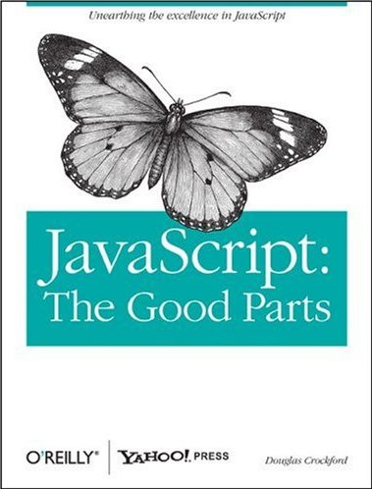

Slide 3
Functions are first class!
Functions may be nested.
Functions may be stored in variables. [function statement]
Functions may be stored in objects. [methods]
Functions may be passed as arguments. [event handlers, array methods, callbacks]
Functions may be returned as results from functions.
A new function retains access to the scope of the function that created it. [closure]

Slide 4
Block
{
let a;
... a ...
}

Slide 5
Immediately Invoked Function Expression
{
let a;
... a ...
}
(function () {
let a;
... a ...
}());

Slide 6
Immediately Invoked Function Expression
{
let a;
... a ...
}
(function () {
let a;
... a ...
}());

Slide 7
Immediately Invoked Function Expression
{
let a;
... a ...
}
(function () {
let a;
... a ...
}());
break;
return;

Slide 8
Nested Blocks
{
let a;
{
let b;
... a ...
... b ...
}
... a ...
}

Slide 9
Nested Functions
{
let a;
{
let b;
... a ...
... b ...
}
... a ...
}
(function () {
let a;
(function () {
let b;
... a ...
... b ...
}());
... a ...
}());

Slide 10
Functions are first class.
function outer() {
let a;
return function () {
let b;
... a ...
... b ...
};
... a ...
}
b

Slide 11
  Functions may be nested.
function outer() {
let a;
return function () {
let b;
... a ...
... b ...
};
... a ...
};
b

Slide 12
Functions may be stored in variables.
function outer() {
let a;
return function () {
let b;
... a ...
... b ...
};
... a ...
};
b

Slide 13
  Functions may be returned as results.
function outer() {
let a;
return function () {
let b;
... a ...
... b ...
};
... a ...
};
b

Slide 14
  A new function retains access to the scope of the function that created it.
function outer() {
let a;
return function () {
let b;
... a ...
... b ...
};
... a ...
};
b

Slide 15
  A new function retains access to the scope of the function that created it.
function outer() {
let a;
return function () {
let b;
... a ...
... b ...
};
... a ...
};
b

Slide 16
  Context Coloring
function outer() {
let a;
return function () {
let b;
... a ...
... b ...
};
... a ...
};
b

Slide 17
First Class Uses
Generators
Higher order functions
Testing
Concurrency/Parallelism
Object Oriented Programming
And many more...

Slide 18
Generators

Slide 19
Generators
function* counter() {
let count = 0;
while (true) {
count += 1;
yield count;
}
}
function counter() {
let index = 0;
return function () {
index += 1;
return index;
};
}
const gen = counter();
gen() // 1
gen() // 2
gen() // 3

Slide 20
Generators
function* counter() {
let count = 0;
while (true) {
count += 1;
yield count;
}
}
const gen = counter();
gen.next().value // 1
gen.next().value // 2
gen.next().value // 3
function counter() {
let index = 0;
return function () {
index += 1;
return index;
};
}
const gen = counter();
gen() // 1
gen() // 2
gen() // 3

Slide 21
Generators
function* counter() {
let count = 0;
while (true) {
count += 1;
yield count;
}
}
const gen = counter();
gen.next().value // 1
gen.next().value // 2
gen.next().value // 3
function counter() {
let count = 0;
return function () {
count += 1;
return count;
};
}
const gen = counter();
gen() // 1
gen() // 2
gen() // 3

Slide 22
function element(array) { const next = counter(); if (Array.isArray(array)) { return function element_generator() { return array[next()];
};
} else { return array;
}
}

Slide 23
Functions that manipulate functions
Higher Order Functions

Slide 24
Higher Order Functions
The Crockford Principle:
If there are two ways of doing something, some people will do it one way, other people will do it the other way, and they will argue about it.
Callback Parameters

Slide 25
function callback_first(wrong_way_function) {
return function right_way_function(...args) {
return wrong_way_function(
...args.slice(1),
args[0]
);
};
}

Slide 26
function reduce(array, binary_function, optional_initial) {
const next = element(array);
return (function repeat(left) {
let right = next();
if (right === undefined) {
return left;
}
return repeat(binary_function(left, right));
}(
optional_initial !== undefined
? optional_initial
: next()
));
}

Slide 27
function reduce(array, binary_function, optional_initial) {
const next = element(array);
return (function repeat(left) {
let right = next();
if (right === undefined) {
return left;
}
return repeat(binary_function(left, right));
}(
optional_initial !== undefined
? optional_initial
: next()
));
}

Slide 28
function reduce(array, binary_function, optional_initial) {
const next = element(array);
return (function repeat(left) {
let right = next();
if (right === undefined) {
return left;
}
return repeat(binary_function(left, right));
}(
optional_initial !== undefined
? optional_initial
: next()
));
}

Slide 29
function reduce(array, binary_function, optional_initial) {
const next = element(array);
return (function repeat(left) {
let right = next();
if (right === undefined) {
return left;
}
return repeat(binary_function(left, right));
}(
optional_initial !== undefined
? optional_initial
: next()
));
}

Slide 30
function reduce(array, binary_function, optional_initial) {
const next = element(array);
return (function repeat(left) {
let right = next();
if (right === undefined) {
return left;
}
return repeat(binary_function(left, right));
}(
optional_initial !== undefined
? optional_initial
: next()
));
}

Slide 31
function reduce(array, binary_function, optional_initial) {
const next = element(array);
return (function repeat(left) {
let right = next();
if (right === undefined) {
return left;
}
return repeat(binary_function(left, right));
}(
optional_initial !== undefined
? optional_initial
: next()
));
}

Slide 32
function revocable(any_function) {
return {
invoke: function (...args) {
return any_function(...args);
},
revoke: function () {
any_function = undefined;
}
};
}

Slide 33
function revocable(any_function) {
return {
invoke: function (...args) {
return any_function(...args);
},
revoke: function () {
any_function = undefined;
}
};
}

Slide 34
assertEquals(message, expected, actual) not good
Testing

Slide 35
jscheck.js
Case generation
Testing over turns
jsc.claim(name, predicate, signature)
jsc.check(milliseconds)
jsc.on_report(callback)
jsc.on_error(callback)

Slide 36
jsc.claim(name, predicate, signature)
name is a string
function predicate(verdict, test_parameters…)
signature is an array of specifications,
one per test_parameter…
jsc.claim(
"Compare the old code with the new code",
function predicate(verdict, a) {
verdict(oldCode(a) === newCode(a));
},
[jsc.integer()]
);

Slide 37
Specifiers
jsc.any()
jsc.array()
jsc.boolean()
jsc.character()
jsc.falsy()
jsc.integer()
jsc.literal()
jsc.number()
jsc.object()
jsc.one_of()
jsc.sequence()
jsc.string()

Slide 38
jsc.string(
3, jsc.character("0", "9"),
1, "-",
2, jsc.character("0", "9"),
1, "-",
4, jsc.character("0", "9")
)
"094-55-0695"
"571-63-9387"
"130-08-5751"
"296-55-3384"
"976-55-3359"

Slide 39
jsc.array([
jsc.integer(),
jsc.number(100),
jsc.string(8, jsc.character("A", "Z"))
])
[3, 21.228644298389554, "TJFJPLQA"]
[5, 57.05485427752137, "CWQDVXWY"]
[7, 91.98980208020657, "QVMGNVXK"]
[11, 87.07735128700733, "GXBSVLKJ"]

Slide 40
jsc.object({
left: jsc.integer(1920),
top: jsc.integer(1080),
color: jsc.one_of([
"black", "white", "red",
"blue", "green", "gray"
])
})
{"left":1104, "top":139, "color":"gray"}
{"left":62, "top":596, "color":"white"}
{"left":501, "top":164, "color":"red"}
{"left":584, "top":785, "color":"white"}

Slide 41
jsc.object(
jsc.array(
jsc.integer(3, 6),
jsc.string(4, jsc.character("a", "z"))
),
jsc.boolean()
)
{"jodo":true, "zhzm":false, "rcqz":true}
{"odcr":true, "azax":true, "bnfx":true, "hmmc":false}
{"qtbo":false, "vqzc":false, "zpij":true,
"ogss":false, "lxnp":false}

Slide 42
Concurrency/Parallelism

Slide 43
Turns
In event loop systems, programs run in turns.
Sometimes work requires several turns.
Remote procedure calls
Nested event handlers
Promises
Async/await
536385

Slide 44
Embrace Eventuality
Clearly uncouple logic from flow control.
Make a function for each processing step.
Make a function that calls each of the processing step functions.

Slide 45
function factory(parameters) { return function requestor(callback, value) {
// Send a message to another process
// using the value and the parameters.
// Report the result with the callback. return callback(result, reason);
};
}

Slide 46
function work(uri) { return function step(callback, value) { let the_worker = new Worker(uri); the_worker.onmessage = function (message) { the_worker.terminate(); return callback(message.data);
}; the_worker.onError = function (error) { the_worker.terminate(); return callback(undefined, error.message);
}; the_worker.postMessage(value); return function cancel(reason) { the_worker.terminate();
};
};
}

Slide 47
function work(uri) { return function step(callback, value) { let the_worker = new Worker(uri); the_worker.onmessage = function (message) { the_worker.terminate(); return callback(message.data);
}; the_worker.onError = function (error) { the_worker.terminate(); return callback(undefined, error.message);
}; the_worker.postMessage(value); return function cancel(reason) { the_worker.terminate();
};
};
}

Slide 48
function work(uri) { return function step(callback, value) { let the_worker = new Worker(uri); the_worker.onmessage = function (message) { the_worker.terminate(); return callback(message.data);
}; the_worker.onError = function (error) { the_worker.terminate(); return callback(undefined, error.message);
}; the_worker.postMessage(value); return function cancel(reason) { the_worker.terminate();
};
};
}

Slide 49
function work(uri) { return function step(callback, value) { let the_worker = new Worker(uri); the_worker.onmessage = function (message) { the_worker.terminate(); return callback(message.data);
}; the_worker.onError = function (error) { the_worker.terminate(); return callback(undefined, error.message);
}; the_worker.postMessage(value); return function cancel(reason) { the_worker.terminate();
};
};
}

Slide 50
function read_file(directory, encoding = "utf-8") {
return function read_file_requestor(callback, value) {
return fs.readFile(
directory + value,
encoding,
function (err, data) {
return (
err
? callback(undefined, err)
: callback(data)
);
}
);
};
}

Slide 51
function requestorize(unary_function) {
return function requestor(callback, value) {
try {
return callback(unary_function(value));
} catch (exception) {
return callback(undefined, exception);
}
};
}

Slide 52
pronto.js
Eventual control flow
Take an array of requestors, and execute them over many turns.
race
fallback
parallel
sequence

Slide 53
let get_ads = pronto.race([
getAd(adnet.klikHaus),
getAd(adnet.inUface),
getAd(adnet.trackPipe)
]);

Slide 54
let get_ads = pronto.race([getAd(adnet.klikHaus), ...
let get_weather = pronto.fallback([
fetch("weather", localCache),
fetch("weather", localDB),
fetch("weather", remoteDB)
]);

Slide 55
let get_ads = pronto.race([getAd(adnet.klikHaus), ...
let get_weather = pronto.fallback([fetch("weather",... let get_stuff = pronto.parallel([
get_nav,
get_ads,
get_message_of_the_day,
get_weather,
get_horoscope,
get_gossip
]);

Slide 56
let get_ads = pronto.race([getAd(adnet.klikHaus), ...
let get_weather = pronto.fallback([fetch("weather",... let get_stuff = pronto.parallel([get_nav, get_ads,...
let get_it_done = pronto.sequence([
read_file(userDB),
requestorize(JSON.parse),
get_stuff,
assemble,
reply
]);

Slide 57
let get_ads = pronto.race([getAd(adnet.klikHaus), ...
let get_weather = pronto.fallback([fetch("weather",... let get_stuff = pronto.parallel([get_nav, get_ads,...
let get_it_done = pronto.sequence([read_file(userDB) ...
pronto.time_limit(get_it_done, 200)(tasker, userID)

Slide 58
Object Oriented Programming

Slide 59
function constructor(spec) {
let {member} = spec;
const {other} = other_constructor(spec);
let method = function () {
// member, other, method, spec
};
return Object.freeze({
method,
other
});
}

Slide 60
function constructor(spec) {
let {member} = spec;
const {other} = other_constructor(spec);
let method = function () {
// member, other, method, spec
};
return Object.freeze({
method,
other
});
}

Slide 61
function constructor(spec) {
let {member} = spec;
const {other} = other_constructor(spec);
let method = function () {
// member, other, method, spec
};
return Object.freeze({
method,
other
});
}

Slide 62
Function Object Properties
name
length should be known as arity
prototype new

Slide 63
Function Object Properties
name
length
prototype
[[Prototype]] Function.prototype
[[Code]]
[[Scope]]

Slide 64
Function Object Properties
name
length
prototype
[[Prototype]]
[[Code]]
[[Scope]]
The Best Part!

Slide 65
Write programs that work well
and are free of error.
That's the job.

Slide 66
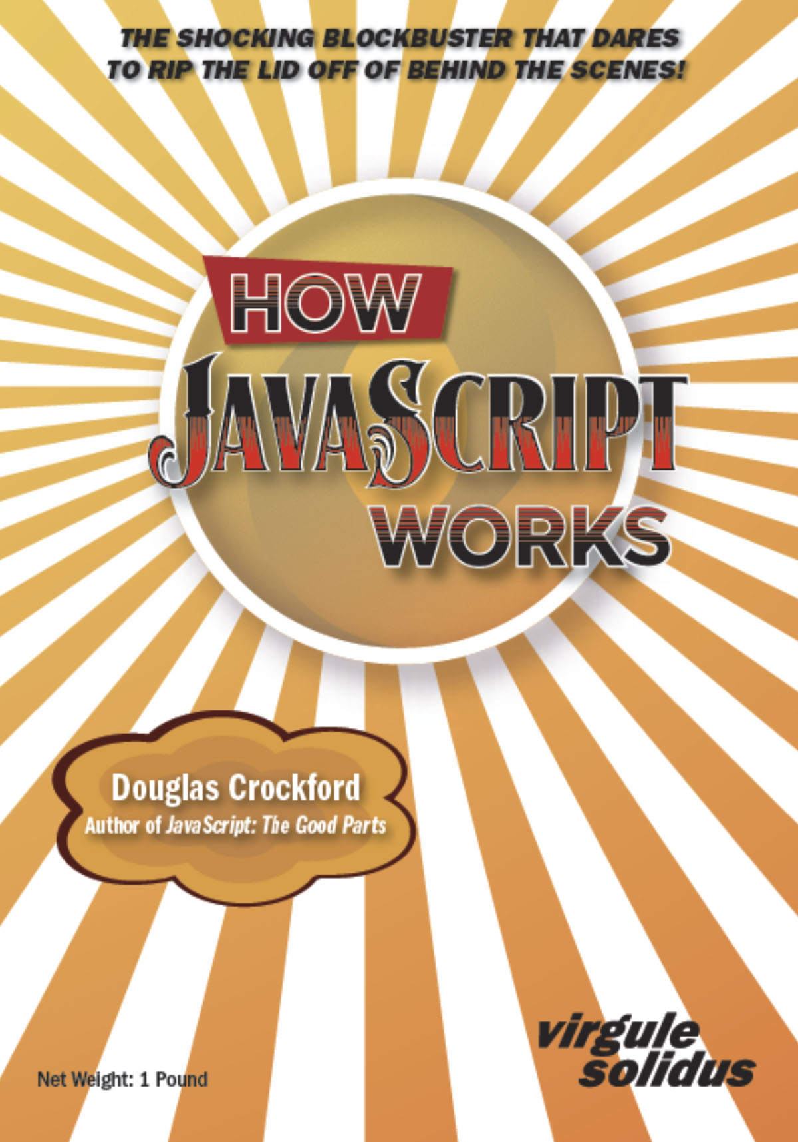

Slide 67
Linkage
https://www.crockford.com/books.html
https://www.crockford.com/jscheck.html
https://www.crockford.com/pronto.html
https://www.crockford.com/javascript/private.html

Slide 68
And finally,
one piece of advice:
Don’t make bugs.

Slide 69

Thank you and good night.

