Slide 1
Actors
The Next Big Thing
Douglas Crockford

Slide 2
The Great Leaps
Theory of Progress

Slide 3
The Great Leaps
Von Neumann architecture machine code

Slide 4
The Great Leaps
Von Neumann architecture machine code
Symbolic assembly words instead of numbers

Slide 5
The Great Leaps
Von Neumann architecture machine code
Symbolic assembly words instead of numbers
High level language subroutines/statements/expressions

Slide 6
The Great Leaps
Von Neumann architecture machine code
Symbolic assembly words instead of numbers
High level language subroutines/statements/expressions
Structured programming else instead of goto

Slide 7
The Great Leaps
Von Neumann architecture machine code
Symbolic assembly words instead of numbers
High level language subroutines/statements/expressions
Structured programming else instead of goto
Object oriented objects have subroutines in them

Slide 8
The Great Leaps
Von Neumann architecture machine code
Symbolic assembly words instead of numbers
High level language subroutines/statements/expressions
Structured programming else instead of goto
Object oriented objects have subroutines in them
Functional programming functions are first class

Slide 9
The Great Leaps
Von Neumann architecture machine code
Symbolic assembly words instead of numbers
High level language subroutines/statements/expressions
Structured programming else instead of goto
Object oriented objects have subroutines in them
Functional programming functions are first class
The program runs in a single machine.

Slide 10
Our World Now
Machines are very fast.
Machines have very large memories.
Many processes per machine.
Many machines interconnected.
Reliability requirements get increasing strict.
Insecurity is our biggest problem.
We need a programming paradigm
that fits our distributed world.

Slide 11
The Great Leaps
Von Neumann architecture machine code
Symbolic assembly words instead of numbers
High level language subroutines/statements/expressions
Structured programming else instead of goto
Object oriented objects have subroutines in them
Functional programming functions are first class
Actor model message passing

Slide 12
The Actor Model

Slide 14
Actor
Correspondent
Clerk
Reactor
Process

Slide 15
A single mechanism provides concurrency, communication, and security.
Message passing.

Slide 16
The Actor Model Requirements

Slide 17
The Actor Model Requirements
An actor is a program running in a machine.
An actor communicates with other actors only by message passing.
There is no memory sharing, even between actors in the same machine.
An actor can create new actors in its own machine.

Slide 18
The Actor Model Requirements
Every actor has a private address.
If you have an actor’s private address, you can send messages to that actor.
Messages can contain private addresses.
Actors can have state, which can change based on received messages.

Slide 19
Actor Model Recommendations
Incoming messages are queued if necessary, delivered in arrival order.
An actor gets a turn to run when it has a new message.
An actor will not be given another message until the turn is done.
Messages sent by an actor will be held until the turn is done.
An actor’s turn may be timesliced.

Slide 20
Actor Model Benefits
Performance
Reliability
Security
Quality

Slide 21
Performance

Slide 22
Performance
Every core can be executing an actor program.

Slide 23
Performance
How hard the program is working
How long the program is waiting

Slide 24
Time Scales
Network
Storage
Memory
Registers

Slide 25
Protocol Timing Diagram
A
B
Time

Slide 26
A: sequential(B, C, D)
A
B
C
D

Slide 27
A: flow(B, C, D)
A
B
C
D

Slide 28
A: parallel(B, C, D)
A
B
C
D

Slide 29
A: pipeline(B, C, D)
A
B
C
D

Slide 30
Protocols are not APIs
Use JSON to express many computational
steps in a single message.
Don’t be chatty.

Slide 31
Reliability

Slide 32
Memory Sharing
Immutable
Mutable
Shared Memory
safe
DANGER
No Shared Memory
safe
safe

Slide 33
Memory Sharing
Immutable
Mutable
Shared Memory
safe
DANGER
No Shared Memory
safe
safe
RACES and DEADLOCKS

Slide 34
Resilience
Distributed programs have many more potential points of failure than stand alone programs.

Slide 35
Reasoning About Reliability
It is easiest to reason about a program when it is starting up.
It is hardest to reason about a program when it is failing unexpectantly.

Slide 36
Failure is always an option.

Slide 37
Fail to a known condition.

Slide 38
Security

Slide 39
Security
Constrain interactions strictly to message passing.
Constrain message passing.

Slide 40
Acquisition of private addresses
By construction:
  An actor can be endowed with private addresses when it is constructed.
By creation:
  When an actor creates a new actor, it receives the new actor’s private address.
By introduction:
  An actor can receive messages containing private addresses.

Slide 41
An Example
A

Slide 42
Creation & Construction
A
B

Slide 43
Message Send
A
B

Slide 44
Creation
A
B
C

Slide 45
Reply
A
B
C

Slide 46
Introduction
A
B
C

Slide 47
Capability Security
You can only communicate with actors that you have the addresses for. unguessable
You can make intermediary actors that lack the power of star actors. attenuation
Only give out addresses to actors that have the least power that can satisfy the intended objective. principle of least authority

Slide 48
Quality

Slide 49
Modularity
Effective reuse
Efficient communication
Comprehensible
Malleable
Strong cohesion
Loose coupling
Information hiding

Slide 50
Strictly speaking, a new programming language is not needed to enjoy the new paradigm.
However, a new programming language will make it easier to think effectively in the new paradigm.

Slide 51
Three Ways Forward
Augment existing languages to support the new secure actor paradigm.
A transitional language, in which actors can be made of conventional patterns.
Actors all the way down.

Slide 52
A transitional language, in which actors can be made of conventional patterns.
There be vapor here.

Slide 53
Transitional
Industry likes little steps
Take the best of current practice
Actor functionality
Hopefully, the result will not be as crappy as C++

Slide 54
Misty
Cleaner, more modular, functional programming model
Message send and receive
Actor address objects
Blobs
Failure management
No exceptions
See https://mistysystem.com/

Slide 55
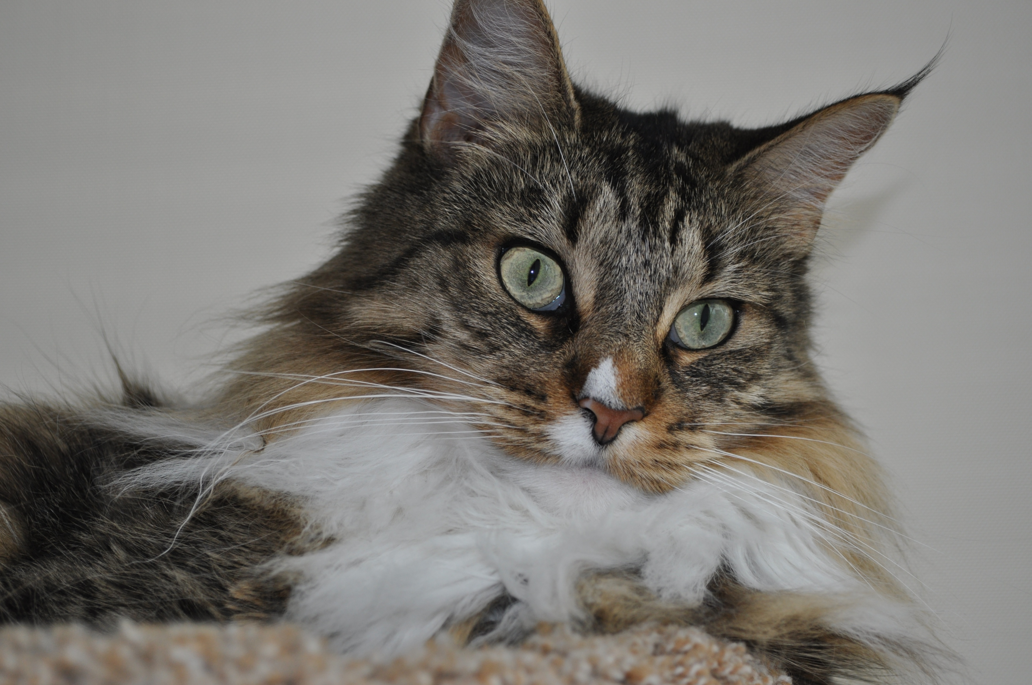

Slide 56
Most of our current programming languages are descended from Fortran and C. While they were important advancements in the 1950s and 1970s, they are crippled by the assumptions that were profoundly important at the time: memory was measured in kilobytes, and a program executed slowly in a single process in a single machine.
The descendant languages inherit this genetic weakness. We know that the languages we use are all deficient, so we keep adding features to them, but it seems there are never enough features. These languages will never be good enough.
In today's world, computers have literally a million times more memory than was available to C. That truth should excite us to consider designs that are free of the small memory constraint.
In today's world, programs are distributed. They run in many machines simultaneously, in various tiers and services and clients and servers, some under our immediate control, some we know are not under our control, and some that we think are under our control but are not. Our programming languages should be built specifically for this situation.
Our focus on bloating the old languages distracts us from the more fruitful path of migrating to new languages that are designed explicitly for networking, with fine grained security at the foundation.
You should not be limited by your grandfather's language. You deserve something better. This talk will suggest a possible way forward.

