Slide 1
Managing Eventuality

Slide 2
Sequential Programming

Slide 3
Sequential Programming
A function does not return until
the work is complete or failed.

Slide 4
Concurrent Programming
Allowing more than one thing
to happen at the same time.

Slide 5
Concurrent Programming
Pure Threads
Impure Threads
Eventuality

Slide 6
The Problems With Impure Threads
Races
Deadlocks
Reliability
Performance

Slide 7
Impure Threading
Pro
Con
No rethinking is necessary.
Blocking programs are ok.
Execution continues as long as any thread is not blocked.
Stack memory per thread.
If two threads use the same memory, a race may occur.

Slide 8
Two threads
my_array[my_array.length] = "a";
my_array[my_array.length] = "b";
["a", "b"]
["b", "a"]
["a"]
["b"]

Slide 9
Two threads
my_array[my_array.length] = "a";
my_array[my_array.length] = "b";
["a", "b"]
["b", "a"]
["a"]
["b"]

Slide 10
my_array[my_array.length] = "a"; my_array[my_array.length] = "b";
length_a = my_array.length;
my_array[length_a] = "a";
if (length_a >= my_array.length) {
my_array.length = length_a + 1;
}
length_b = my_array.length;
my_array[length_b] = "b";
if (length_b >= my_array.length) {
my_array.length = length_b + 1;
}

Slide 11
my_array[my_array.length] = "a"; my_array[my_array.length] = "b";
length_a = my_array.length;
my_array[length_a] = "a";
if (length_a >= my_array.length) {
my_array.length = length_a + 1;
}
length_b = my_array.length;
my_array[length_b] = "b";
if (length_b >= my_array.length) {
my_array.length = length_b + 1;
}

Slide 12
my_array[my_array.length] = "a"; my_array[my_array.length] = "b";
length_a = my_array.length;
length_b = my_array.length;
my_array[length_a] = "a";
my_array[length_b] = "b";
if (length_a >= my_array.length) {
my_array.length = length_a + 1;
}
if (length_b >= my_array.length) {
my_array.length = length_b + 1;
}

Slide 13
It is impossible to have application integrity when subject to race conditions.

Slide 14
Mutual Exclusion
semaphore
monitor
rendezvous
synchronization
This used to be operating system stuff.
It has leaked into applications because of networking and the multi-core problem.

Slide 15
Mutual Exclusion
Only one thread can be executing on a critical section at a time.
All other threads wanting to execute the critical section are blocked.
If threads don't interact, then the program runs at full speed.
If they do interact, then races will occur unless mutual exclusion is employed.

Slide 16
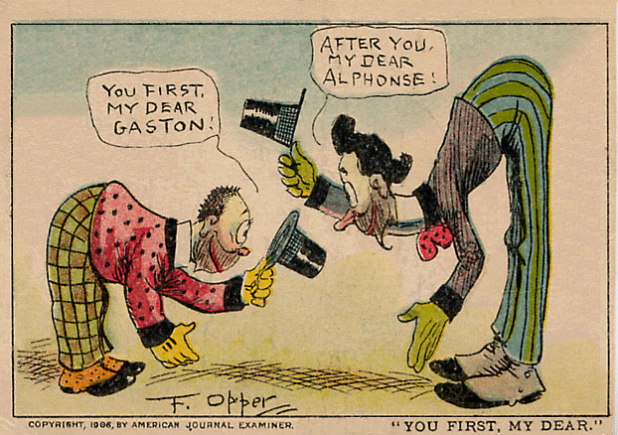
Deadlock

Slide 17
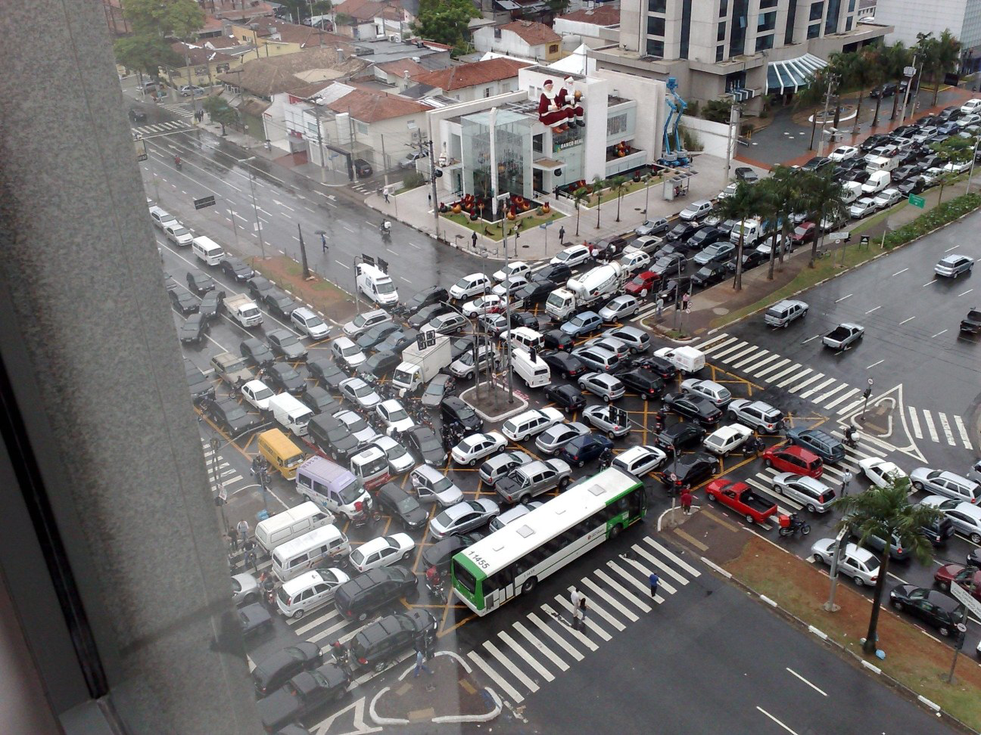
Deadlock

Slide 18
Eventual functions
Return immediately. Success or failure will be determined somehow in the future.

Slide 19
Turn
A turn is started by an external event, such as the delivery of a message, completion of an eventual request, a user action, or the ticking of the clock.
A callback function associated with the event is called. It runs to completion. When it returns, the turn ends.
No need for threads. No races. No deadlocks.

Slide 20
The Law of Turns
Never block.
Never wait.
Finish fast.

Slide 21
Event Loop
Pro
Con
Completely free of races and deadlocks.
Only one stack.
Very low overhead.
Resilient. If a turn fails, the program can still go on.
Programs must never block.
Turns must finish quickly.
Programs are inside out! Waa!

Slide 22
Event driven systems
Turn based. No pre-emption.
Associate events with actions.
Easy (beginners can do it).
User interfaces.

Slide 23
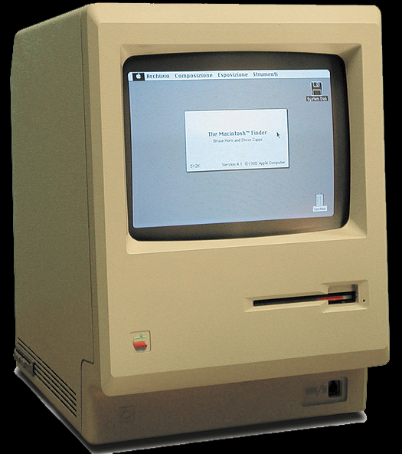

Slide 25
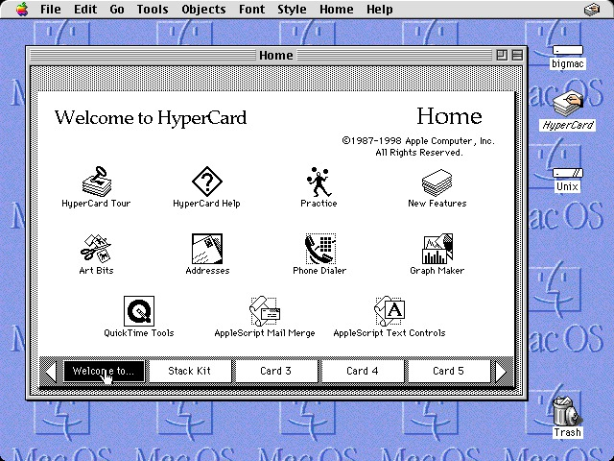

Slide 26
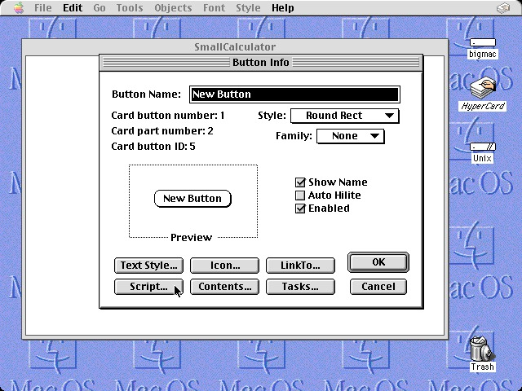

Slide 27
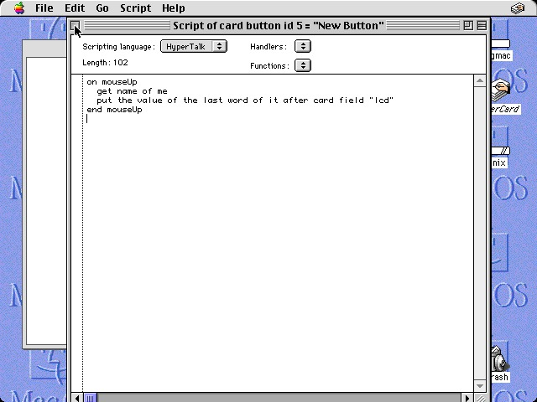

Slide 28
JavaScript is now on the server.
What servers do is quite different
from what browsers do.

Slide 29
node.js
A web server in a JavaScript event loop.
A high-performance event pump.
fs.readFile(
filename,
encoding,
function (err, data) {
...
}
)

Slide 30
node.js
Everything is (or should be) non-blocking.
Except:
  the -Sync functions
  require
Violations of the Law of Turns

Slide 31
Servers
Message driven, message queue
Actor-like
Simple events don’t fit:
  Sequential Processes
    A sequence of requests, each dependent on the result of the previous.
    Naïve approach: deeply nested callbacks
  Parallel Processes
    Do a bunch of independent things
    Naïve approach: wastes time, increases latency
  Limited time, cancellation

Slide 32
Four Popular Mistakes
Blocking code.
Nested event handlers.
Promises.
Async/await.

Slide 33
The universe is completely eventual, fully distributed, and highly parallel.
Our programming model should embrace this truth.

Slide 34
parseq
A JavaScript library for managing eventuality in server applications.

Slide 35
Parseq Methods
parseq.sequence(requestors)
parseq.parallel(requestors, optionals)
parseq.race(requestors)
parseq.fallback(requestors)

Slide 36
parseq.sequence
Takes an array of requestor functions, calls them one at a time, passing the result of the previous requestor to the next requestor.
getNav = parseq.sequence([
read_file(filename),
getPreference,
getCustomNav
]);

Slide 37
parseq.parallel
Takes an array of requestor functions, calls them all at once, and gives an array of results.
getStuff = parseq.parallel(
[getNav, getAds, getMessageOfTheDay]
);

Slide 38
parseq.parallel
Also takes an optional array of optional requestors. Their results will be included if they can be obtained before the required requestors finish.
getStuff = parseq.parallel(
[getNav, getAds, getMessageOfTheDay],
[getHoroscope, getGossip]
);

Slide 39
parseq.race
Takes an array of requestors, calls them all at once, and gives the result of the first success.
getAds = parseq.race([
getAd(adnet.klikHaus),
getAd(adnet.inUFace),
getAd(adnet.trackPipe)]
);

Slide 40
parseq.fallback
Takes an array of requestors, and gives the result of the first success.
getWeather = parseq.fallback([
fetch("weather", localCache),
fetch("weather", localDB),
fetch("weather", remoteDB)
]);

Slide 41
parseq
All at once
One at
a time
All
parallel
sequence
One
race
fallback

Slide 42
parseq.parallel([
widget("A"),
parseq.race([
widget("Race B1"),
widget("Race B2"),
widget("Race B3")
]),
parseq.sequence([
widget("Seq C1"),
widget("Seq C2"),
widget("Seq C3")
]),
parseq.sequence([
widget("Seq D1"),
widget("Seq D2"),
widget("Seq D3")
]),
parseq.fallback([
widget("Fall F1"),
widget("Fall F2"),
widget("Fall F3")
])
],
[
widget("Opt Q"),
parseq.race([
widget("Opt Race R1"),
widget("Opt Race R2"),
widget("Opt Race R3")
]),
parseq.sequence([
widget("Opt Seq S1"),
widget("Opt Seq S2"),
widget("Opt Seq S3")
]),
parseq.sequence([
widget("Opt Seq T1"),
widget("Opt Seq T2"),
widget("Opt Seq T3")
]),
parseq.fallback([
widget("Opt Fall V1"),
widget("Opt Fall V2"),
widget("Opt Fall V3")
])
])(show);

Slide 43
parseq.sequence([
widget("Seq S1"),
parseq.parallel([
widget("Par P1"),
widget("Par P2"),
widget("Par P3"),
]),
widget("Seq S3")
])

Slide 44
parseq.sequence([
function (callback) {
fs.readFile("./" + filename + ".cyc", function (error, data) {
if (error) {
console.log(error);
return callback(undefined, error);
}
return callback(data.toString());
});
},
function (callback, value) {
return include(callback, value, get_inclusion);
},
function (callback, value) {
return callback(cyc(value, onehtml));
},
function (callback, value) {
fs.writeFile("./" + filename + ".html", value, function
(error) {
if (error) {
console.log(error);
return callback(undefined, error);
}
return callback(true);
});
}
])(console.log);

Slide 45
parseq with timeouts
parseq.sequence(requestors, milliseconds)
parseq.parallel(requestors, optionals, milliseconds)
parseq.race(requestors, milliseconds)
parseq.fallback(requestors, milliseconds)
Notes:
milliseconds

Slide 46
Cancellation
Any requestor can optionally return a cancel function.
A cancel function, when called, will attempt to cancel a request.
There is no guarantee that the cancellation will happen before the request completes.
Cancellation is intended to stop unnecessary work. It does not undo.

Slide 47
Throttling
parseq can overwhelm some incompetently architected systems.
parallel and race can start all of their requestors are once, which can lead to resource exhaustion.
So parallel and race can each take a throttle argument that limits the number of requestors they will have going at a time.

Slide 48
parseq Types
requestor
  A function that can execute a request.
callback
  A continuation function that will be passed to a requestor.
factory
  A function that takes arguments and returns a requestor function.
cancel
  A function returned by a requestor that may be used to cancel a request.

Slide 49
parseq Types
factory(arguments…) →
requestor(
callback(value, error),
value
) → cancel(reason)

Slide 50
parseq Types
factory(arguments…) →
requestor(
callback(value, error),
value
) → cancel(reason)

Slide 51
parseq Types
factory(arguments…) →
requestor(
callback(value, error),
value
) → cancel(reason)

Slide 52
parseq Types
factory(arguments…) →
requestor(
callback(value, error),
value
) → cancel(reason)

Slide 53
Identity Requestor
function identity_requestor(
callback,
value
) {
return callback(value);
}

Slide 54
Fullname Requestor
function fullname_requestor(
callback,
value
) {
return callback(
value.firstname
+ " "
+ value.lastname
);
}

Slide 55
Wrapper Factory
function requestorize(unary) {
return function requestor(callback, value) {
try {
return callback(unary(value));
} catch (exception) {
return callback(undefined, exception);
}
};
}

Slide 56
Delay Requestor
function delay(milliseconds) {
function delay_requestor(callback, value) {
let timeout_id = setTimeout(
function () {
return callback(value);
},
1000
);
return function cancel(reason) {
return clearTimeout(timeout_id);
};
};

Slide 57
Delay Factory
function delay(milliseconds) {
return function delay_requestor(callback, value) {
let timeout_id = setTimeout(
function () {
return callback(value);
},
milliseconds
);
return function delay_cancel(reason) {
return clearTimeout(timeout_id);
};
};
}

Slide 58
Read File Factory
function read_file(directory, encoding = "utf-8") {
return function requestor(callback, value) {
return fs.readFile(
directory + value,
encoding,
function (err, data) {
return callback(
data,
err && undefined
);
}
);
};
}

Slide 59
function widget(name) {
return function widget_requestor(callback, value) {
let result = (value !== undefined)
? value + ">" + name
: name;
let demo = document.getElementById("demo");
let fieldset = document.createElement("fieldset");
let legend = document.createElement("legend");
let success = document.createElement("input");
let failure = document.createElement("input");
fieldset.appendChild(legend);
fieldset.appendChild(success);
fieldset.appendChild(failure);
legend.appendChild(document.createTextNode(name));
success.type = "button";
success.value = "success";
success.addEventListener(
"click",
function success_handler() {
fieldset.style.backgroundColor = "lightgreen";
return callback(result);
},
false
);
failure.type = "button";
failure.value = "failure";
failure.addEventListener(
"click",
function failure_handler() {
fieldset.style.backgroundColor = "pink";
return callback(undefined, result);
},
false
);
demo.appendChild(fieldset);
return function widget_cancel() {
fieldset.style.backgroundColor = "darkgray";
};
};
}
function widget(name) {
return function widget_requestor(callback, value) {
let result = (value !== undefined)
? value + ">" + name
: name;
let demo = document.getElementById("demo");
let fieldset = document.createElement("fieldset");
let legend = document.createElement("legend");
let success = document.createElement("input");
let failure = document.createElement("input");
fieldset.appendChild(legend);
fieldset.appendChild(success);
fieldset.appendChild(failure);
legend.appendChild(document.createTextNode(name));
success.type = "button";
success.value = "success";
success.addEventListener(
"click",
function success_handler() {
fieldset.style.backgroundColor = "lightgreen";
return callback(result);
},
false
);
failure.type = "button";
failure.value = "failure";
failure.addEventListener(
"click",
function failure_handler() {
fieldset.style.backgroundColor = "pink";
return callback(undefined, result);
},
false
);
demo.appendChild(fieldset);
return function widget_cancel() {
fieldset.style.backgroundColor = "darkgray";
};
};
}

Slide 60
function widget(name) {
return function widget_requestor(callback, value) {
function widget(name) {
return function widget_requestor(callback, value) {
let result = (value !== undefined)
? value + ">" + name
: name;
let demo = document.getElementById("demo");
let fieldset = document.createElement("fieldset");
let legend = document.createElement("legend");
let success = document.createElement("input");
let failure = document.createElement("input");
fieldset.appendChild(legend);
fieldset.appendChild(success);
fieldset.appendChild(failure);
legend.appendChild(document.createTextNode(name));
success.type = "button";
success.value = "success";
success.addEventListener(
"click",
function success_handler() {
fieldset.style.backgroundColor = "lightgreen";
return callback(result);
},
false
);
failure.type = "button";
failure.value = "failure";
failure.addEventListener(
"click",
function failure_handler() {
fieldset.style.backgroundColor = "pink";
return callback(undefined, result);
},
false
);
demo.appendChild(fieldset);
return function widget_cancel() {
fieldset.style.backgroundColor = "darkgray";
};
};
}

Slide 61
function widget(name) {
return function widget_requestor(callback, value) {
let result = (value !== undefined)
? value + ">" + name
: name;
let demo = document.getElementById("demo");
let fieldset = document.createElement("fieldset");
let legend = document.createElement("legend");
let success = document.createElement("input");
let failure = document.createElement("input");
fieldset.appendChild(legend);
fieldset.appendChild(success);
fieldset.appendChild(failure);
legend.appendChild(document.createTextNode(name));
success.type = "button";
success.value = "success";
success.addEventListener(
"click",
function success_handler() {
fieldset.style.backgroundColor = "lightgreen";
return callback(result);
},
false
);
failure.type = "button";
failure.value = "failure";
failure.addEventListener(
"click",
function failure_handler() {
fieldset.style.backgroundColor = "pink";
return callback(undefined, result);
},
false
);
demo.appendChild(fieldset);
return function widget_cancel() {
fieldset.style.backgroundColor = "darkgray";
};
};
}
success.addEventListener(
"click",
function success_handler() {
fieldset.style.backgroundColor = "lightgreen";
return callback(result);
},
false
);

Slide 62
function widget(name) {
return function widget_requestor(callback, value) {
let result = (value !== undefined)
? value + ">" + name
: name;
let demo = document.getElementById("demo");
let fieldset = document.createElement("fieldset");
let legend = document.createElement("legend");
let success = document.createElement("input");
let failure = document.createElement("input");
fieldset.appendChild(legend);
fieldset.appendChild(success);
fieldset.appendChild(failure);
legend.appendChild(document.createTextNode(name));
success.type = "button";
success.value = "success";
success.addEventListener(
"click",
function success_handler() {
fieldset.style.backgroundColor = "lightgreen";
return callback(result);
},
false
);
failure.type = "button";
failure.value = "failure";
failure.addEventListener(
"click",
function failure_handler() {
fieldset.style.backgroundColor = "pink";
return callback(undefined, result);
},
false
);
demo.appendChild(fieldset);
return function widget_cancel() {
fieldset.style.backgroundColor = "darkgray";
};
};
}
failure.addEventListener(
"click",
function failure_handler() {
fieldset.style.backgroundColor = "pink";
return callback(undefined, result);
},
false
);

Slide 63
function widget(name) {
return function widget_requestor(callback, value) {
let result = (value !== undefined)
? value + ">" + name
: name;
let demo = document.getElementById("demo");
let fieldset = document.createElement("fieldset");
let legend = document.createElement("legend");
let success = document.createElement("input");
let failure = document.createElement("input");
fieldset.appendChild(legend);
fieldset.appendChild(success);
fieldset.appendChild(failure);
legend.appendChild(document.createTextNode(name));
success.type = "button";
success.value = "success";
success.addEventListener(
"click",
function success_handler() {
fieldset.style.backgroundColor = "lightgreen";
return callback(result);
},
false
);
failure.type = "button";
failure.value = "failure";
failure.addEventListener(
"click",
function failure_handler() {
fieldset.style.backgroundColor = "pink";
return callback(undefined, result);
},
false
);
demo.appendChild(fieldset);
return function widget_cancel() {
fieldset.style.backgroundColor = "darkgray";
};
};
}
return function widget_cancel() {
fieldset.style.backgroundColor = "darkgray";
};

Slide 64
Testing
assertEquals(message, expected, actual)
does not work

Slide 65
QuickCheck
Koen Claessen
John Hughes
Chalmers University

Slide 66
jscheck
Case generation
Testing over turns
jsc.claim(name, predicate, signature)
jsc.check(milliseconds)
jsc.on_report(callback)
jsc.on_error(callback)

Slide 67
jsc.claim(name, predicate, signature)
name is a string
function predicate(verdict, et al…)
signature is an array of specifications,
one per et al…
jsc.claim(
"Compare the old code with the new code",
function predicate(verdict, a) {
return verdict(oldCode(a) === newCode(a));
},
[jsc.integer()]
);

Slide 68
Specifiers
jsc.any()
jsc.array()
jsc.boolean() jsc.character()
jsc.falsy()
jsc.integer()
jsc.literal()
jsc.number()
jsc.object()
jsc.one_of()
jsc.sequence()
jsc.string()

Slide 69
jsc.string(
3, jsc.character("0", "9"),
1, "-",
2, jsc.character("0", "9"),
1, "-",
4, jsc.character("0", "9")
)
"094-55-0695"
"571-63-9387"
"130-08-5751"
"296-55-3384"
"976-55-3359"

Slide 70
jsc.array([
jsc.integer(),
jsc.number(100),
jsc.string(8, jsc.character("A", "Z"))
])
[3, 21.228644298389554, "TJFJPLQA"]
[5, 57.05485427752137, "CWQDVXWY"]
[7, 91.98980208020657, "QVMGNVXK"]
[11, 87.07735128700733, "GXBSVLKJ"]

Slide 71
jsc.object({
left: jsc.integer(640),
top: jsc.integer(480),
color: jsc.wun_of([
"black", "white", "red",
"blue", "green", "gray"
])
})
{"left":104, "top":139, "color":"gray"}
{"left":62, "top":96, "color":"white"}
{"left":501, "top":164, "color":"red"}
{"left":584, "top":85, "color":"white"}

Slide 72
jsc.object(
jsc.array(
jsc.integer(3, 6),
jsc.string(4, jsc.character("a", "z"))
),
jsc.boolean()
)
{"jodo":true, "zhzm":false, "rcqz":true}
{"odcr":true, "azax":true, "bnfx":true, "hmmc":false}
{
"wjew":true, "kgqj":true, "abid":true,
"cjva":false, "qsgj":true, "wtsu":true
}
{
"qtbo":false, "vqzc":false, "zpij":true,
"ogss":false, "lxnp":false
}

Slide 73
verdict
When check calls a predicate, it passes in a verdict function.
Predicates deliver the result of each trial by calling the verdict function.
verdict is a continuation, allowing trials to extend over many turns.
Three outcomes:
pass fail lost

Slide 74
Closure and continuation.

Slide 75
https://github.com/douglascrockford/parseq https://github.com/douglascrockford/jscheck

