Slide 1
Go To There and
Back Again

Slide 2
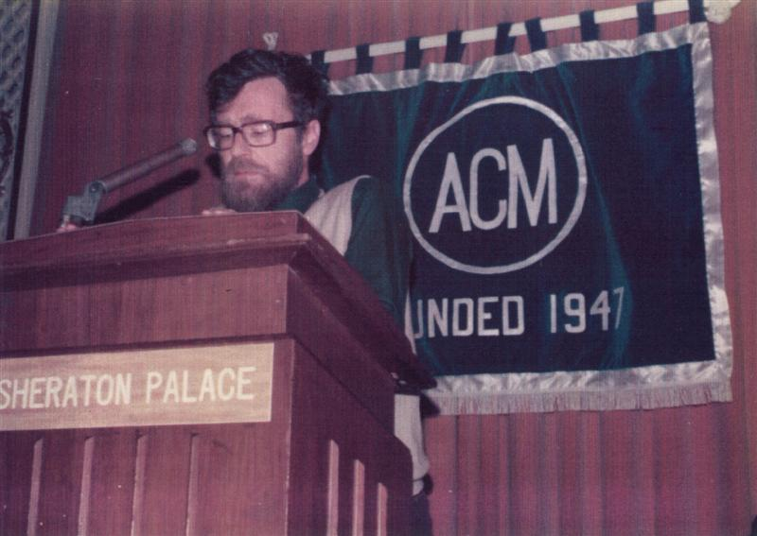
Edsger Wybe Dijkstra
Edsger Wybe Dijkstra

Slide 3
GOTO Statement Considered Harmful
For a number of years I have been familiar with the observation that the quality of programmers is a decreasing function of the density of go to statements in the programs they produce.

Slide 4
GOTO Statement Considered Harmful
For a number of years I have been familiar with the observation that the quality of programmers is a decreasing function of the density of go to statements in the programs they produce.
More recently I discovered why the use of the go to statement has such disastrous effects…, and I became convinced that the go to statement should be abolished from all "higher level" programming languages.

Slide 5
GOTO Statement Considered Harmful
For a number of years I have been familiar with the observation that the quality of programmers is a decreasing function of the density of go to statements in the programs they produce.
More recently I discovered why the use of the go to statement has such disastrous effects, and I became convinced that the go to statement should be abolished from all "higher level" programming languages.

Slide 6
Eliminate the GOTO Statement
Reactionaries
Performance.
Tradition.
Freedom.
Pride.
Majority.
Moderates
Avoid where possible, but it is sometimes useful.
Radicals
Disaster.

Slide 7
Eliminate the GOTO Statement
Reactionaries
Performance.
Tradition.
Freedom.
Pride.
Majority.
Moderates
Avoid where possible, but it is sometimes useful.
Radicals
Disaster.

Slide 8
Eliminate the GOTO Statement
Reactionaries
Performance.
Tradition.
Freedom.
Pride.
Majority.
Moderates
Avoid where possible, but it is sometimes useful.
Radicals
Disaster.

Slide 9
1968
1973
1985
1995
GOTO Considered Harmful
C
C++
Java

Slide 10
Progress does not wait for the next new idea.
It waits for consensus
on an old idea.

Slide 11
Bugs

Slide 12
As soon as we started programming, we found out to our surprise that it wasn't as easy to get programs right as we had thought. Debugging had to be discovered. I can remember the exact instant when I realized that a large part of my life from then on was going to be spent in finding mistakes in my own programs.
Maurice Wilkes

Slide 13
The Software Crisis
Over budget
Over time
Unreliable
Requirements not fully met
Unmaintainable
Failure

Slide 14
Proof of Correctness
Tests can only prove the existence of bugs, not their absence.

Slide 15
/*
Beware of bugs in the above code. I have only proved it correct, not tried it.
*/
Donald Knuth (1977)

Slide 16
Types
What do the bits mean?
Easier than Proofs of Correctness?

Slide 17
Well typed programs cannot go wrong.
Robin Milner (1978)

Slide 18
Static Type Checking
Reactionaries
Little extra effort.
It is helping you.
Moderates
Should be optional.
Taste.
Radicals
Not worth the freight.

Slide 19
Milner’s Promise
Will static typing ever
be worth the freight?

Slide 20
COME FROM Statement

Slide 21
COME FROM Statement
extends

Slide 22
ES6
Proper Tails Calls
return func();

Slide 23
Back Again
if ((err = SSLHashSHA1.update(
&hashCtx, &signedParams)) != 0)
goto fail;
goto fail;
fail:
return err;

Slide 24
Paradigm Shift
I have never ___
so I don't see why ___

Slide 25
Paradigm Shift
Bad Idea

Slide 26
Functional Programming

Slide 27
1958
1973
1975
1984
1990
1999
LISP
ML
Scheme
Common Lisp
Haskell
JavaScript

Slide 28
Code Reading
Dailies

Slide 29
And ﬁnally,
one piece of advice:
Don’t make bugs.

Slide 30
And ﬁnally,
one piece of advice:
Don’t make bugs.

Slide 32
Baseball

Slide 33
Moneyball:
The Art of Winning an Unfair Game
Michael Lewis

Slide 34
Bill James
Sabermetrics

Slide 35
Billy Beane
Oakland Athletics

Slide 36
Don't make outs.
90%

Slide 37
Stealing Bases

Slide 38
Getting on base

Slide 39
Getting on base
Walk

Slide 40
Programming

Slide 41
Don't make bugs

Slide 42
Team Building

