Slide 1
From Here To Lambda
And Back Again
Douglas Crockford

Slide 2
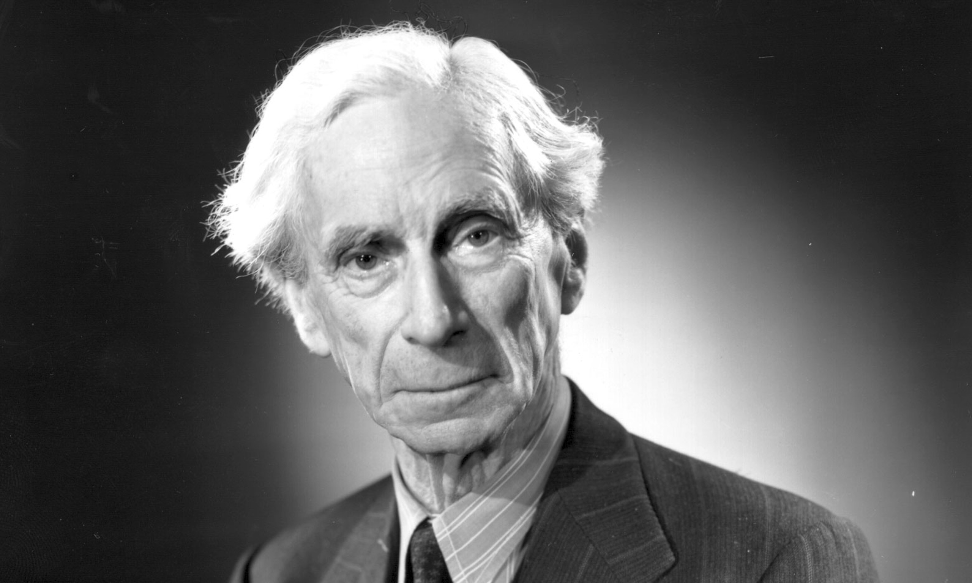
Bertrand Russell
Principia Mathematica
“function abstraction notation”
x
^

Slide 3
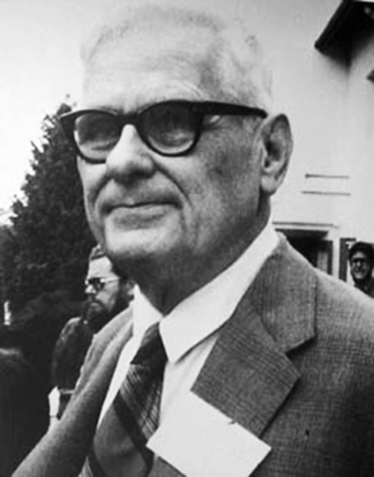
Alonzo Church
A set of postulates for the foundation of logic.
λ x

Slide 4
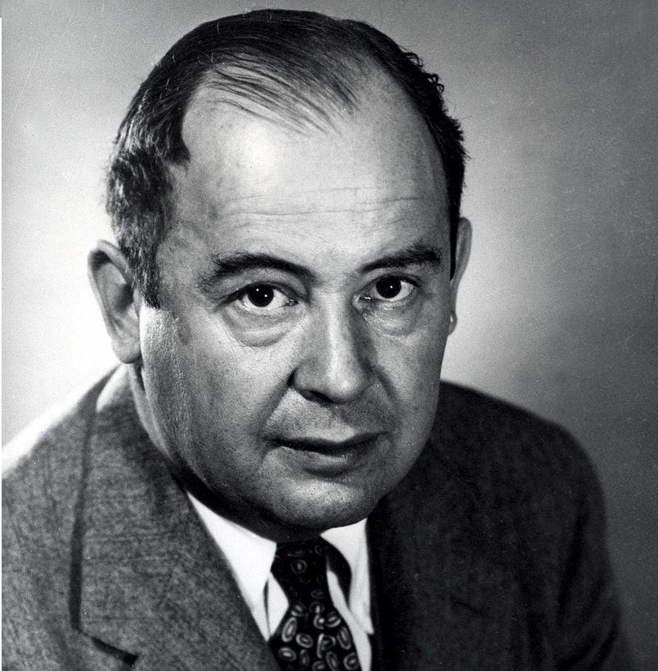
John Von Neumann
First Draft of a Report on the EDVAC

Slide 5
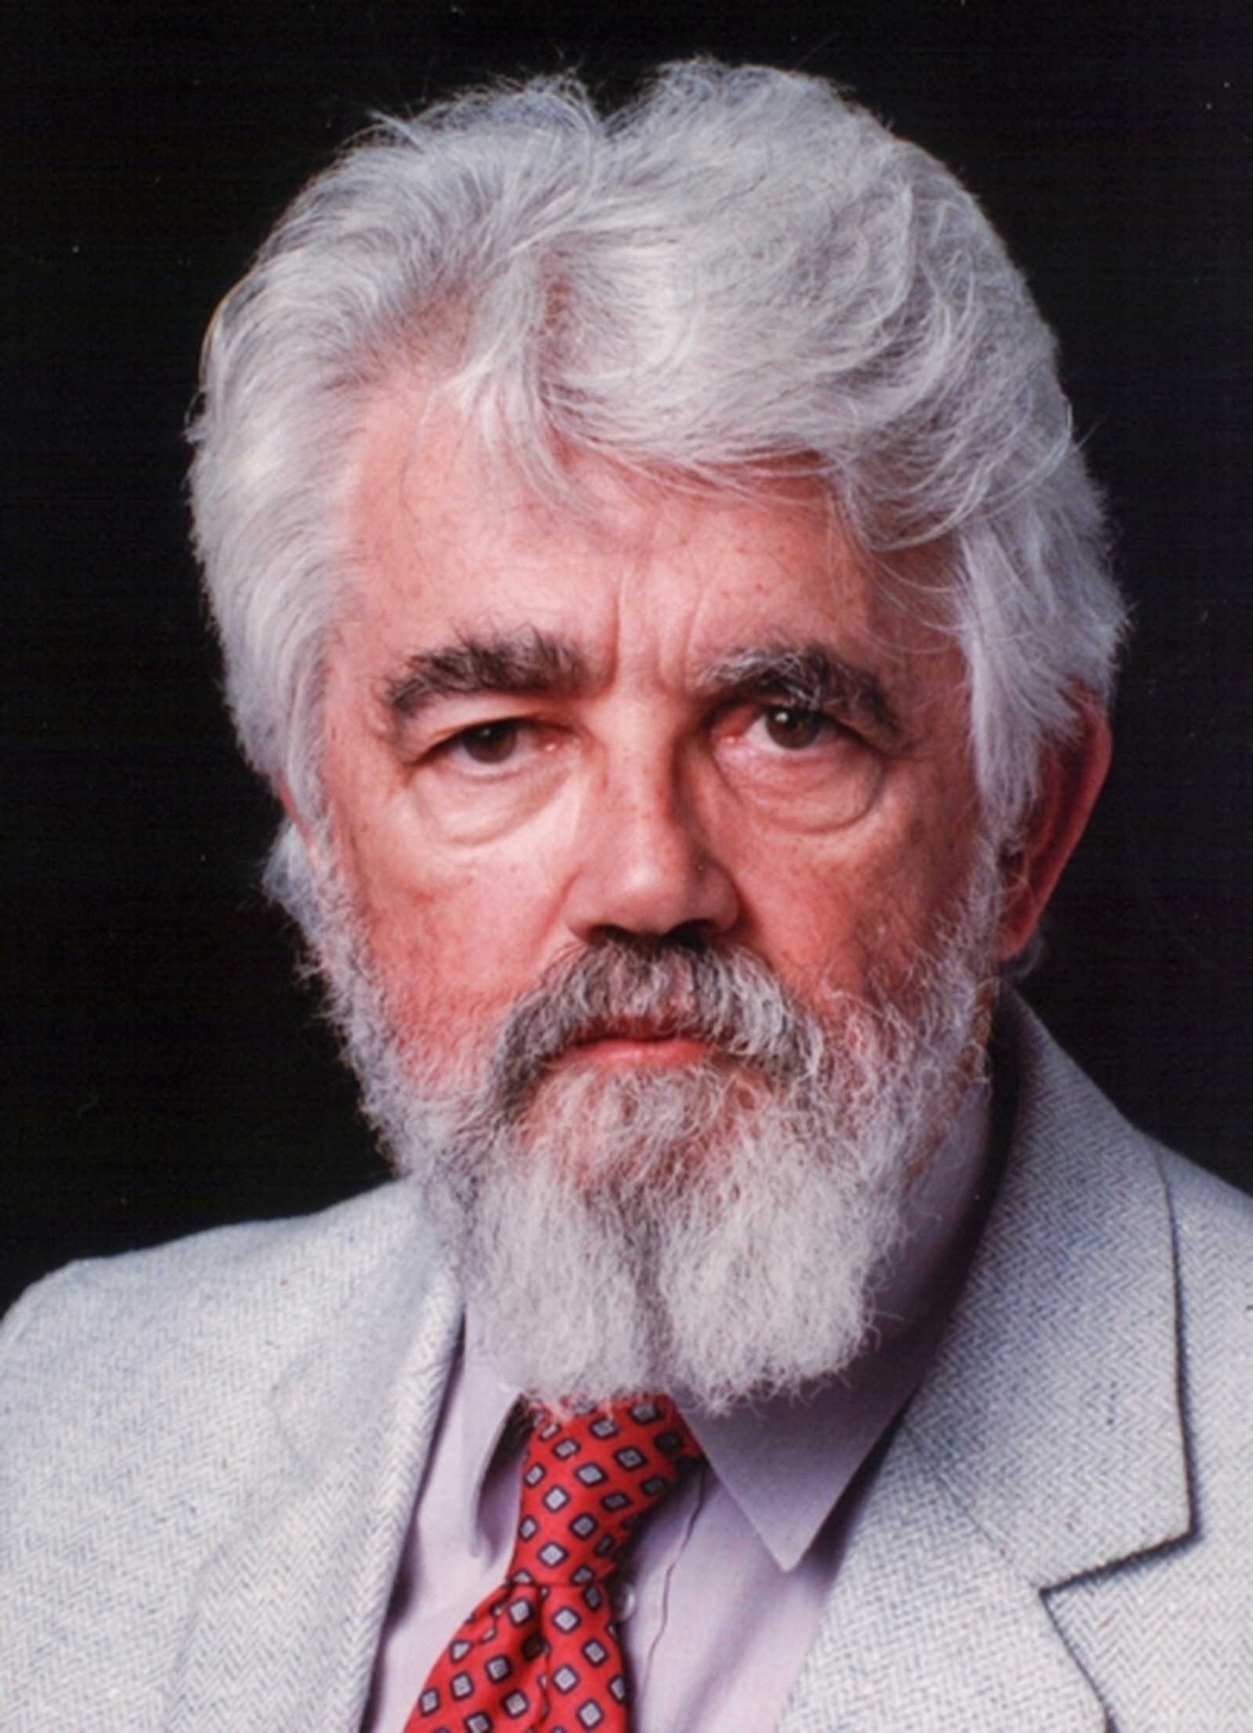
John McCarthy
LISP

Slide 6
LISP
List Processing
IBM 704
  36 bit words
    3 bit opcode field
    15 bit address field CAR
    3 bit tag field
    15 bit decrement field CDR
Minimal design
  Recursive functions
  Binary trees (cons cells)
  Common representation of programs and data
  Automatic memory reclamation

Slide 7
PROG
DEFINE ((
(LENGTH (LAMBDA (L)
(PROG (U V)
(SETQ V 0)
(SETQ U L)
A (COND ((NULL U) (RETURN V)))
(SETQ U (CDR U))
(SETQ V (ADD1 V))
(GO A) ))) ))

Slide 8
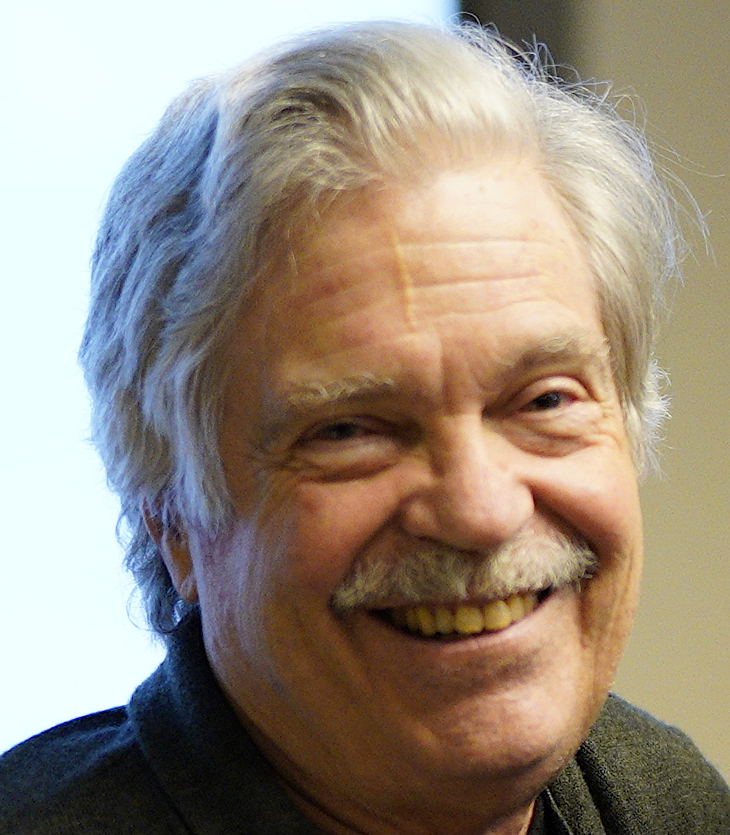
Alan Kay
Smalltalk 71
Smalltalk 72
Smalltalk 76
Smalltalk 80

Slide 9
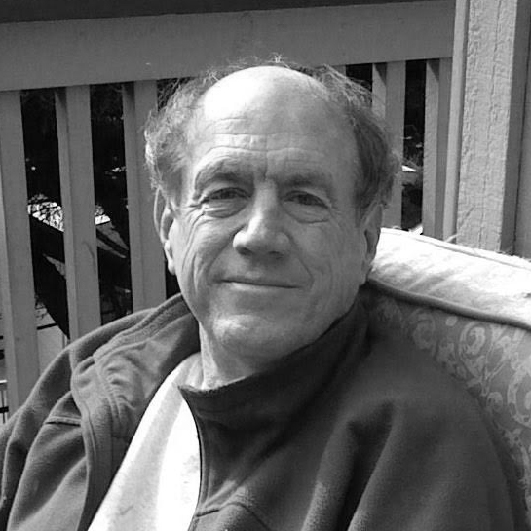
Carl Hewitt
The Actor Model

Slide 10
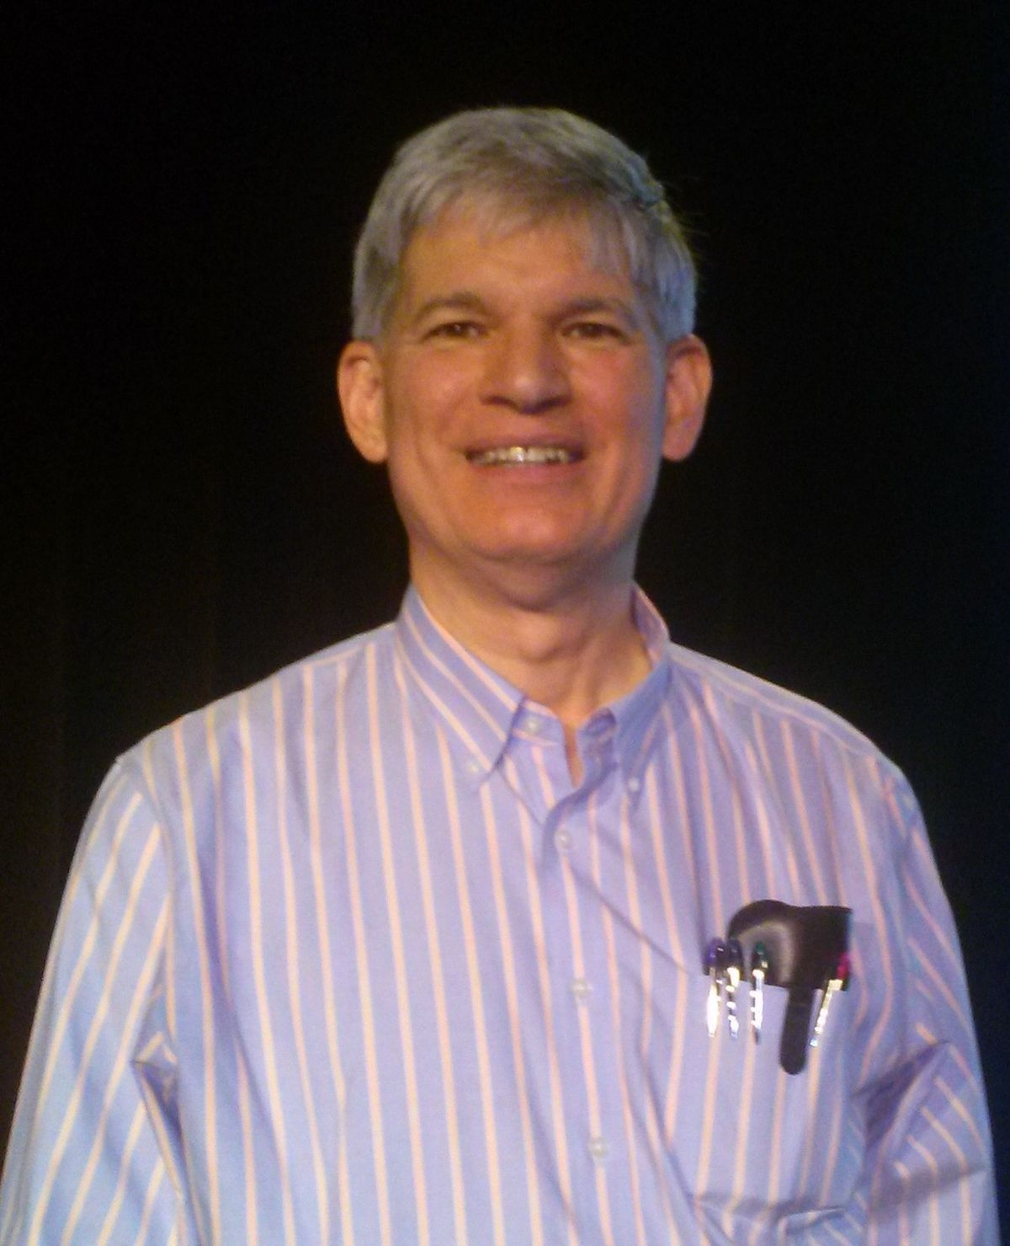
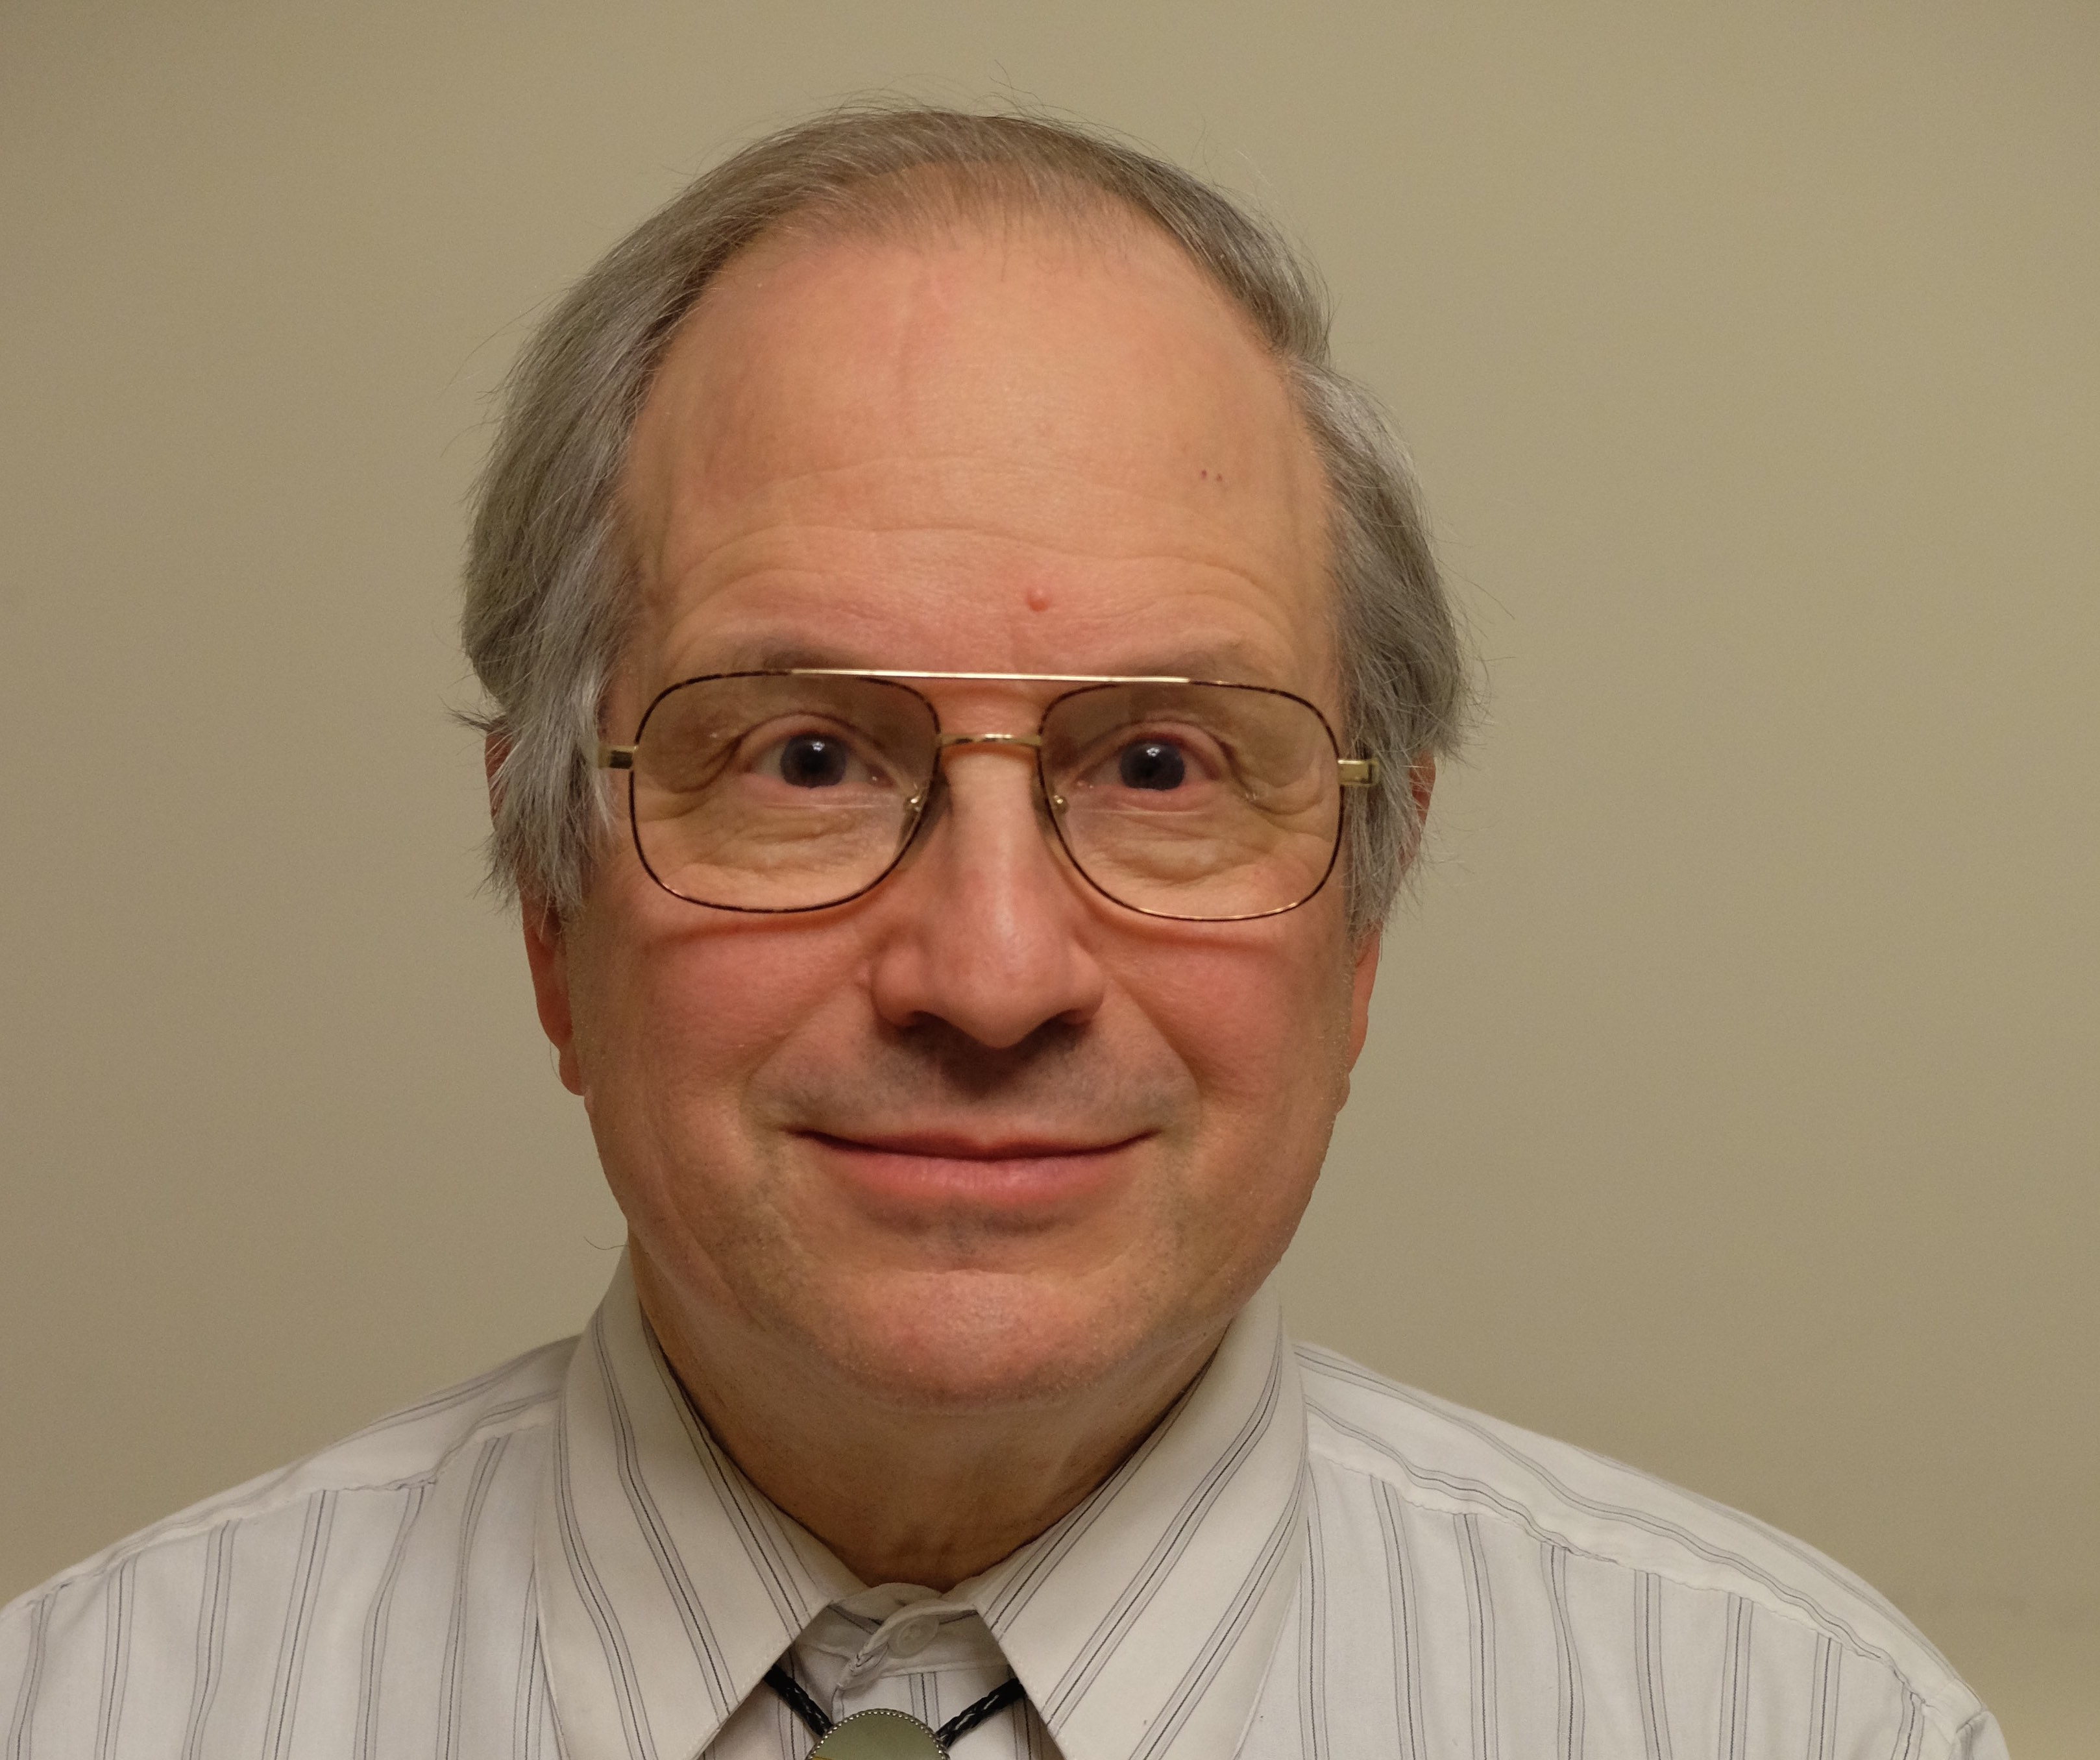
Guy Steele and Gerald Jay Sussman

Slide 11
Scheme!

Slide 12
JavaScript?

Slide 13
The Programming Paradigms
0. Von Neumann architecture
1. Symbolic programming
2. High level language
3. Structured programming
4. Object oriented programming
5. Functional programming
The program runs in a single machine.

Slide 14
The Lambda Calculus does not apply to distributed systems.

Slide 15
The Sixth Paradigm
Secure
Distributed
Programming

Slide 16
Carl Hewitt
The Actor Model

Slide 17
A Simple Model
The concurrency model...
The communication model...
The security model...
...all come from a single mechanism.

Slide 18
The Actor Model (required)
An actor is a program running in a single process in a machine.
An actor communicates with other actors only by message passing.
There is no shared memory, even between actors in the same machine.
An actor can create new actors in its own machine.
Every actor has a private address.
If you have an actor’s private address, you can send messages to that actor.
Messages can contain private addresses.
Actors can have state, which can change based on received messages.

Slide 19
The Actor Model (recommended)
Incoming messages are queued if necessary,
delivered in arrival order.
An actor will not be given another message until it is done.
Messages sent by an actor will be held until it is done.
An actor’s turn may be timesliced.

Slide 20
Acquiring private addresses
By creation:
  When an actor creates an new actor, it receives the new actor’s private address.
By construction:
  An actor can be endowed with private addresses when it is created.
By introduction:
  An actor can receive messages containing private addresses.

Slide 21
Actor Language
Strictly speaking, a new programming language is not needed to enjoy the new paradigm.
However, a new programming language can make it easier to think effectively in the new paradigm.

Slide 22
Actor Language
Promotes good design patterns
  Strong cohesion
  Loose coupling
  Conciseness
Robustness
Two approaches:
  Transitional
  Actors all the way down

Slide 23
Actors all the way down
Everything is an actor
Dale Schumacher
  uFork
  https://github.com/organix/uFork
Carl Hewitt
  ActorScript

Slide 24
Transitional
Industry likes little steps
Hopefully, the result will not be as crappy as C++
Take the best of current practice
Expansion kit of Actor functionality

Slide 25
JavaScript
Good Parts
  Flexible objects
  First class objects with lexical closure
  Optimized for event handling
Bad Parts
  Pretty much everything else
  Including most of the new parts
  Sequential illusion confusion

Slide 26
The Misty System
Start by correcting every
design mistake in JavaScript.

Slide 27
Misty Actor Extensions
send private_address: message
send private_address: message: callback
send received_message: message
send received_message: message: callback
Register a receiver function
Register a portal function (bootstrap)

Slide 28
Misty
Cleaner, modular, functional programming model
Message send and receive
Blobs
Failure management
No exceptions
See https://crockford.com/misty/

Slide 29
The Theater of Computation

Slide 30
Liaison
Worker

Slide 31
Agent
Liaison
Worker

Slide 32
Agent
Client
Minion
Worker

Slide 33
Agent
Client
Minion
Worker

Slide 34
Agent
Client
Liaison
Minion
Worker

Slide 35
Agent
Client
Liaison
Minion
Worker

Slide 36
Agent
Client
Liaison
Minion
Worker

Slide 37
Agent
Client
Liaison
Minion
Worker

Slide 38
Agent
Client
Liaison
Minion
Worker

Slide 39
Agent
Client
Liaison
Minion
Worker

Slide 40
Liaison
Minion
Agent
Client
Liaison
Minion
Worker

Slide 41
Agent
Client
Minion
Worker

Slide 42
Agent
Client
Minion
How did the Client get the private address of the Agent?
Worker

Slide 43
Agent
Client
Minion
Worker

Slide 44
Agent
Client
Portal
Minion
Worker

Slide 45
Agent
Client
Portal
Portal’s network address
Portal’s public key
Minion
Worker

Slide 46
Agent
Client
Portal
Minion
Worker

Slide 47
The
  concurrency &
  communication &
  security
models are the same.

Slide 48
Capability Security
Capability is not a synonym for good.
You can only communicate with actors that you have the addresses for. unguessable
Make stand-in actors that lack the power of star actors. attenuation
Private addresses can be sent to actors. transferable
Only give out addresses to actors that have the least power that can satisfy the intended objective. principle of least authority

Slide 49
Robustness
Distributed programs have many more potential points of failure than stand alone programs.

Slide 50
Reasoning About Reliability
It is easiest to reason about a program when it is starting up.
It is hardest to reason about a program when it is failing unexpectantly.

Slide 51
Death before confusion!

Slide 52
Worker

Slide 53
Worker

Slide 54
Worker

Slide 55
Worker

Slide 56
Worker

Slide 57
Worker

Slide 58
Worker

Slide 59
Worker

Slide 60
Worker

Slide 61
Worker

Slide 62
Worker

Slide 63
Worker

Slide 64
Worker

Slide 65
Worker

Slide 66
Worker

Slide 67
The Actor Protocol
Seif Protocol
https://www.crockford.com/seif.html

Slide 68

KEEP CALM
AND
JSON

Slide 69
nota
https://www.crockford.com/nota.html

Slide 70
The Theater of Computation
https://www.crockford.com/misty

Slide 71
My language research
Real
Vapor
Tilton
JSLint
ADsafe
Secure ECMAScript
Neo
from How JavaScript Works
Crocktran
Candy
Ply
Crockforth
Elemeno
Misty

Slide 72
Event loop
loop
set message: queue.take()
call deliver(message) # turn
call commit_outgoing_messages()

Slide 73
We call them computers, but they do a lot more communicating than computing.

Slide 74
Routines
Read some data
Do some computation
Output some results

Slide 75
Subroutines
Open
Closed
Libraries
Call
Assemble or compile a list of subroutine call numbers into a program
Return

Slide 76
Factory Template
function factory(parameter) {
return function requestor(callback, value) {
// Start an action, such as making a request of a system, providing a
// ‘callback’ function to take the result.
// If the request is cancellable, return a function that starts the
// cancellation if possible. This is optional.
return function cancel(reason) {
// Cancel action.
};
};
}

Slide 77
Delay Factory
function delay(milliseconds) {
return function delay_requestor(callback, value) {
let timeout_id = setTimeout(
function () {
return callback(value);
},
milliseconds
);
return function delay_cancel(reason) {
return clearTimeout(timeout_id);
};
};
}

Slide 78
Read File Factory
function read_file(directory, encoding = "utf-8") {
return function requestor(callback, value) {
return fs.readFile(
directory + value,
encoding,
function (err, data) {
return callback(
data,
err && undefined
);
}
);
};
}

Slide 79
Performance
Shared memory
State Machine
Robustness
Modularity
Trust Boundaries
Bootstrapping
Messages, not files
Versioning

Slide 80
Modularity
Effective reuse
Efficient communication
Comprehensible
Malleable
Strong cohesion
Loose coupling
Information hiding

Slide 81
Time

Slide 82
Temporality
Doing more than one thing at once.
Cooperating
Timeslicing
Multiprocessing

Slide 83
Data Race
Threads competing to alter the same memory
Really hard to debug
Really hard to test
Mitigation possible with mutual exclusion
but that can cause additional problems
(poor performance, deadlock)

Slide 84
Reliability
Eliminate one or more:
  multiple threads (real and virtual)
  mutation
  sharing of memory

Slide 85
Many Machines

Slide 86
Working with remote machines
Remote filesystem
Remote procedure call
Message passing

Slide 87
Message Passing
NLS Doug Engelbart 1968 SRI
RC 4000 Per Brinch Hansen 1969 Regnecentralen
Penny OS Rich Franczak 1979 Basic/Four Corporation
Navigator 2 Brendan Eich 1995 Netscape Corporation
Messages inside a single machine

Slide 88
Protocol Timing Diagram
A
B
Time

Slide 89
A: sequential(B, C, D)
A
B
C
D

Slide 90
A: flow(B, C, D)
A
B
C
D

Slide 91
A: parallel(B, C, D)
A
B
C
D

Slide 92
A: parallel(B, C, D)
A
B
C
Parseq
https://www.crockford.com/parseq.html
D

Slide 93
Performance
How hard the program is working
How long the program is waiting

Slide 94
Syntax
( . )
S-expressions
M-expressions
LISP 2
MLISP
CGOL
Clisp
Dylan

Slide 95
Racket!

