Slide 1
Managing Programmers

Slide 2
Douglas Crockford
Programmer
Manager of programmers
Manager of managers of programmers

Slide 3
Computer Programmer
Computer Scientist
Software Engineer
Software Developer
Coder
Hacker

Slide 4
Creative

Slide 5
Geek Gods
and yet
oddly human

Slide 6
Not like the other kids

Slide 7
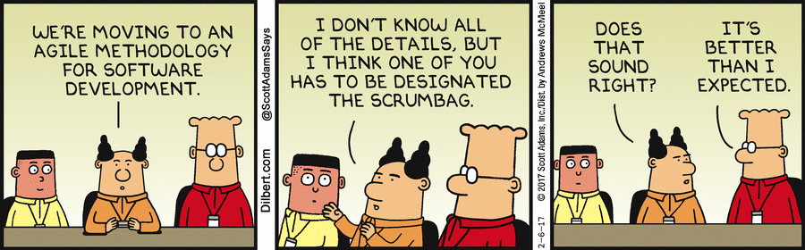
Dilbert

Slide 8
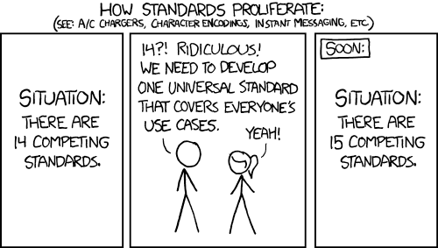
xkcd

Slide 9
If you can’t measure it, you can’t manage it.

Slide 10
Metrics

Slide 11
Ineffective metrics
Lines of code
Introduction of bugs
Fixing of bugs

Slide 12
Effective metrics
Number of actual defects
Total remaining effort to completion

Slide 13
Programming is not manufacturing

Slide 14
10 to 1

Slide 15


Slide 16
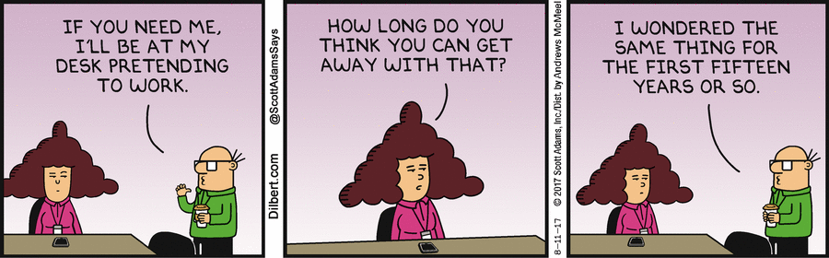

Slide 18
Discovery
Trial and error

Slide 19
No functional specification survives first contact with reality.

Slide 20
Waterfall
Requirements
Design
Implementation
Verication
Maintenance

Slide 21
Agile
Requirements Design Implementation Verication Maintenance

Slide 22
Directed Anarchy

Slide 23
How do you know?

Slide 24
Read the source

Slide 25
Code Reading
Dailies

Slide 26
Readability

Slide 27
Hiring

Slide 28
The Five Natural Enemies of Programmers

Slide 29
The Natural Enemies of Programmers
1: Complexity

Slide 30
Knowledge
Looking Busy
Good Attitude
Hard Work
Commitment
Passion

Slide 31
Continuing Education

Slide 32
The Natural Enemies of Programmers
2: Imperfection

Slide 33
Software can change instantly from asset to major liability.

Slide 34
Proof of Correctness

Slide 35
Testing

Slide 36
QA
Transfer responsibility for ultimate quality away from the programming teams

Slide 37
Bug Avoidance

Slide 38
Software Entomology

Slide 39
The Natural Enemies of Programmers
3: Time

Slide 40
Economics of Software

Slide 41
Time
Register
Memory
Storage
Network

Slide 42
Premature Optimization
Measure
Cut
Measure

Slide 43
Keyboarding

Slide 44
Decision making
The only thing worse than the wrong choice is no choice.

Slide 45
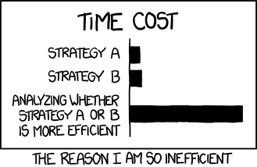
XKCD

Slide 46
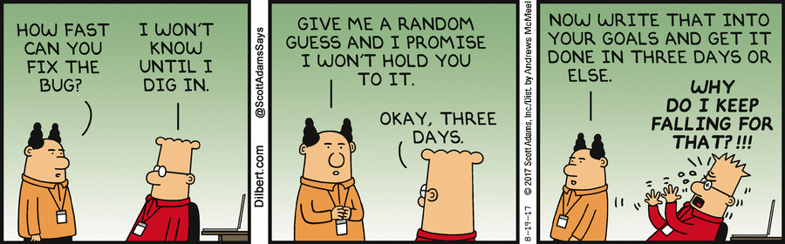
Scheduling

Slide 47
Quality of Estimates
Unreliable
Reliable
Routine
Unknown

Slide 48
Sleep

Slide 49
The Natural Enemies of Programmers
4: Mismangement

Slide 50
Lottery

Slide 51
Urgency

Slide 52
Most of the things you would do to make development go faster will instead make it go slower.

Slide 53
The things you do to make it done earlier will make it later
Add staff
Cancel continuing education
Hit intermediate milestones
Extend the workday
Panic mode

Slide 54
Talented staff
Clear, stable requirements
Minimal distractions
Focus on Quality
Sufcient time

Slide 55
Start Over

Slide 56
Protection
Running interference

Slide 57
Business Reality
“The Big Picture”

Slide 58
If it’s stupid, we won’t do it.

Slide 59
We won’t ship crap.

Slide 60
Sabotage
Unintentional
  Lack of empathy
  Security exploits
Intentional, without malice
Intentional, with malice

Slide 61
The Natural Enemies of Programmers
5: Themselves

Slide 62
They are smarter than they look
But not as smart as they think they are

Slide 63
Informed Ignorance

Slide 64
Cults and Fads

Slide 65
Teach them to be better people
Lead by example
Manners: please, thank you, sorry
Argue correctly
For the People

Slide 66
Office
Programmers are creatives,
not office workers.
Flow: private offices,
free of distraction (Microsoft)
Communication: bullpens (startups)
Worst possible: cubicles
Worst possible: open plan

Slide 67
Ideal
Large project rooms, whiteboards
Lots of meeting rooms, various sizes, round tables
Classrooms
Library
Padded cells
Diner, booths with power plugs with Food (Google)
Bunk room
Shower
Day care

Slide 68
Professionals should own their own machines.

Slide 69
Don't make bugs

Slide 70
Responsibility
The People
The Team
Management

