Slide 1
Numbers
Douglas Crockford

Slide 2
Fingers

Slide 3
Tools

Slide 4
Accounting
Writing

Slide 5
Accounting
Writing

Slide 6
Writing
Fertile Crescent
China
America

Slide 7
Egypt
1
10
100
1,000
10,000
100,000
1,000,000

Slide 8
Greece
Α 1 Ι 10 Ρ 100
Β 2 Κ 20 Σ 200
Γ 3 Λ 30 Τ 300
Δ 4 Μ 40 Υ 400
Ε 5 Ν 50 Φ 500
Ϛ 6 Ξ 60 Χ 600
Ζ 7 Ο 70 Ψ 700
Η 8 Π 80 Ω 800
Θ 9 Ϟ 90 Ϡ 900

Slide 9
Rome
I 1 X 10 C 100
II 2 XX 20 CC 200
III 3 XXX 30 CCC 300
IV 4 XL 40 CD 400
V 5 L 50 D 500
VI 6 LX 60 DC 600
VII 7 LXX 70 DCC 700
VIII 8 LXXX 80 DCCC 800
IX 9 XC 90 CM 900

Slide 10
Rome
I 1 X 10 C 100
II 2 XX 20 CC 200
III 3 XXX 30 CCC 300
IV 4 XL 40 CD 400
V 5 L 50 D 500
VI 6 LX 60 DC 600
VII 7 LXX 70 DCC 700
VIII 8 LXXX 80 DCCC 800
IX 9 XC 90 CM 900

Slide 11
Rome
I 1 X 10 C 100
II 2 XX 20 CC 200
III 3 XXX 30 CCC 300
IV 4 XL 40 CD 400
V 5 L 50 D 500
VI 6 LX 60 DC 600
VII 7 LXX 70 DCC 700
VIII 8 LXXX 80 DCCC 800
IX 9 XC 90 CM 900

Slide 12
China
一 1 十 10
二 2 百 100
三 3 千 1,000
四 4
五 5 萬 10,000
六 6 億 100,000,000
七 7 兆 1,000,000,000,000
八 8
九 9

Slide 13
India
0 Zero
1 Positional
2
3
4
5
6
7
8
9

Slide 14
ΧϠ
DCIX
六百九
609

Slide 15
-Whole Numbers
... 4 3 2 1 0 -1 -2 -3 -4 ...
-60998
.
(6 * 10↑2 + 0 * 10↑1 + 9 * 10↑0)

Slide 16
Integers
... 4 3 2 1 0 -1 -2 -3 -4 ...
-60998
(0 - 1) *
(6 * 10↑2 + 0 * 10↑1 + 9 * 10↑0)

Slide 17
Real
... 4 3 2 1 0 -1 -2 -3 -4 ...
-60902
.
(0 - 1) *
(6 * 10↑2 + 0 * 10↑1 + 9 * 10↑0)
+ 0 * 10↑-1 + 2 * 10↑-2)

Slide 18
Decimal Point
_
60902
60902
.
60902
,

Slide 19
Decimal Point
_
2,048
60902
60902
.
60902
,

Slide 20
Decimal Point
_
60902
60902
.
60902
,

Slide 21
Base
10

Slide 22
Base
10
20

Slide 23
Base
10
20
12

Slide 24
Base
10
20
12
60

Slide 25
Binary
... 4 3 2 1 0 -1 -2 -3 -4 ...
110098
.
(1 * 2↑3 + 1 * 2↑2 +
0 * 2↑1 + 0 * 2↑0)

Slide 26
Sign bit
Signed magnitude
  Two zeros: 0 and -0
One’s complement
  -n = not n
  End around carry
  Two zeros: 0 and -0
Two’s complement
  -n = (not n) + 1
  The only zero is 0
  Extra negative

Slide 27
Sign bit
Signed magnitude
  Two zeros: 0 and -0
One’s complement
  -n = not n
  End around carry
  Two zeros: 0 and -0
Two’s complement
  -n = (not n) + 1
  The only zero is 0
  Extra negative
Or we could use the extra value to represent null.

Slide 28
indexOf
"abc".indexOf("z")
-1
null

Slide 29
int
int32 + int32

Slide 30
int
Java Correct
int32 + int32 int32 int33

Slide 31
int
Java Correct
int32 + int32 int32 int33
int32 * int32

Slide 32
int
Java Correct
int32 + int32 int32 int33
int32 * int32 int32 int63

Slide 33
int
Overow
Java Correct
int32 + int32 int32 int33
int32 * int32 int32 int63

Slide 34
Overow:
What should happen?
Store a null value.
Store the largest possible (saturation).
Fault.
To maximize creation of error:
Discard the most signicant bits without notication.

Slide 35
Scaled Arithmetic
scaled value ← integer value * scale factor
Values can be added only if they have the same scale factor.
product ←
(multiplicand * scaled value) /
scale factor
quotient ←
(dividend * scale factor) /
scaled value
In some applications, it may be difficult to find an optimal
scale factor.

Slide 36
Floating Point
Approximately real.
More convenient and accurate
than scaled arithmetic.

Slide 37
Decimal Floating Point
significand * 10^log₁₀(scale factor)

Slide 38
Binary Floating Point
(sign * significand) * 2 ** exponent
biased
exponent
biased
exponent
significand
significand
sign

Slide 39
0.1 + 0.2
=
0.30000000000000004

Slide 40
0.1
...
4
3
2
1
0
-1
-2
-3
-4
-5
-6
-7
-8
-9
-10
-11
-12
-13
-14
-15
-16
-17
-18
-19
-20
-21
-22
-23
-24
-25
-26
-27
-28
-29
...
.
000011001100110011001100110011…
.
0000110011001100110011001100110
too small!
1/16
.
= 0.09375
too big!
+ 1/32

Slide 41
0.1
...
4
3
2
1
0
-1
-2
-3
-4
-5
-6
-7
-8
-9
-10
-11
-12
-13
-14
-15
-16
-17
-18
-19
-20
-21
-22
-23
-24
-25
-26
-27
-28
-29
...
.
000011001100110011001100110011…
.
0000110011001100110011001100110
too small!
.
0000110011001100110011001101010
too big!

Slide 42
0.1
...
4
3
2
1
0
-1
-2
-3
-4
-5
-6
-7
-8
-9
-10
-11
-12
-13
-14
-15
-16
-17
-18
-19
-20
-21
-22
-23
-24
-25
-26
-27
-28
-29
...
.
000011001100110011001100110011…
.
0000110011001100110011001100110
too small!
.
0000110011001100110011001101010
too big!

Slide 43
0.1
...
4
3
2
1
0
-1
-2
-3
-4
-5
-6
-7
-8
-9
-10
-11
-12
-13
-14
-15
-16
-17
-18
-19
-20
-21
-22
-23
-24
-25
-26
-27
-28
-29
...
.
000011001100110011001100110011…
.
0000110011001100110011001100110
too small!
.
0000110011001100110011010001010
too big!

Slide 44
The Associative Law holds only if all of the inputs, outputs, and intermediate results can all be represented exactly.
(a + b) + c
a + (b + c)

Slide 45
Business could not use binary floating point.
Scientic
Fortran
Binary Floating Point
Business
Cobol
BCD

Slide 46
Binary Coded Decimal
0000 0 0101 5
0001 1 0110 6
0010 2 0111 7
0011 3 1000 8
0100 4 1001 9

Slide 47
Binary Floating Point
Text Conversion
Needs to be
  Correct
  Optimal
  Unsurprising
Computationally expensive

Slide 48
Most modern programming languages are a confusion of faulty number types.
byte char short int long float double

Slide 49
The Ariane 5 Failure
bh = (short)dbHorizontalBias;

Slide 50
JavaScript has only one number type.
This avoids a large class of errors.

Slide 51
JavaScript has only one number type.
This avoids a large class of errors.
Unfortunately, it is the wrong type.

Slide 52
DEC64
A modern decimal floating point type.
I recommend that DEC64 is the only number type in well designed application programming languages.
If there is only one number type, you cannot make an error by choosing the wrong type.
In a hardware implementation, DEC64 integers can be added in a single cycle, eliminating the performance justification for int.

Slide 53
DEC64
Numbers work the way humans think numbers work.
Elimination numeric confusion reduces errors.
Conversion of DEC64 numbers to text and back is simple, efficient, correct, and unsurprising.
DEC64 can exactly represent decimal fractions. 16 digits.
1.0E-127 3.6028797018963967E+143

Slide 54
DEC64
56
8
Coefficient
Coefficient
Exponent
Number ← Coefficient * 10↑Exponent

Slide 55
dec64.com
56
8
Coefficient
Coefficient
Exponent
https://github.com/douglascrockford/DEC64/

Slide 56
0 / 0
Undened.
Catch re!
null
0
1
2

Slide 57
0 * n

Slide 58
0 * n
0
NaN

Slide 59
0 * n
0
NaN

Slide 60
0 * n
Code generators
Macro processors
Partial evaluators
Non-conditional idioms

Slide 61
0 / n
0 * n n * 0
0 modulo n
0

Slide 62
Thanks

Slide 63
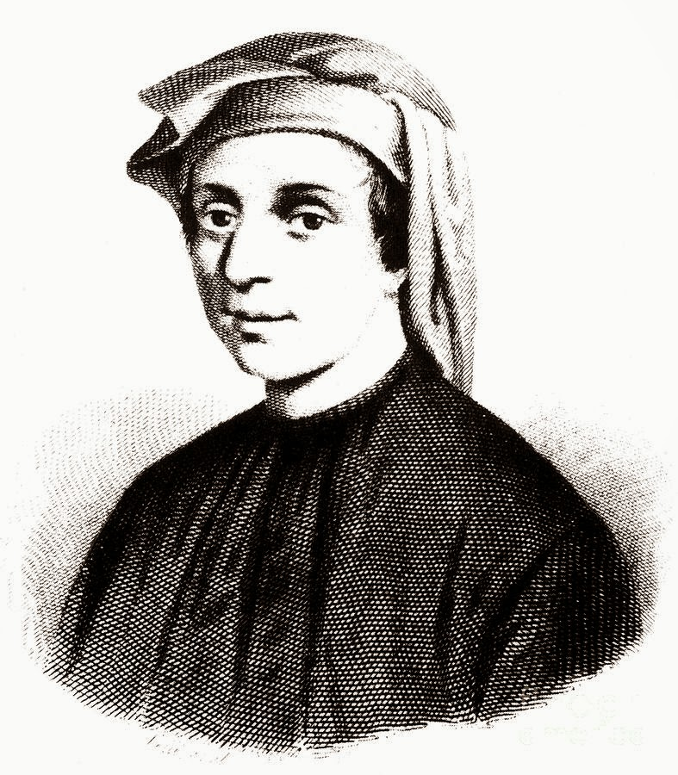
Leonardo Fibonacci of Pisa

Slide 64
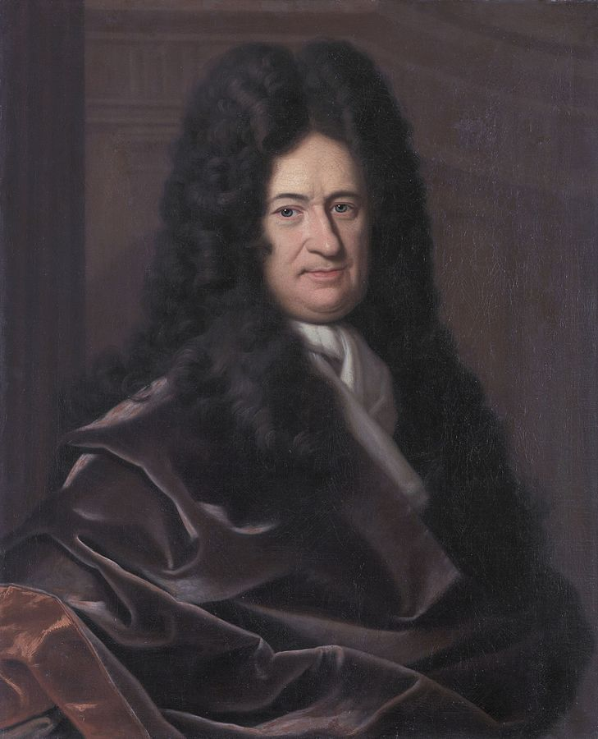
Gottried Wilhelm Leibniz

Slide 65
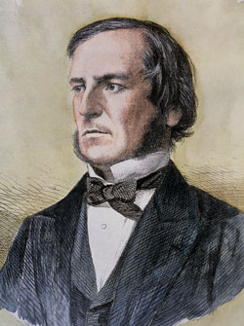
George Boole

Slide 66
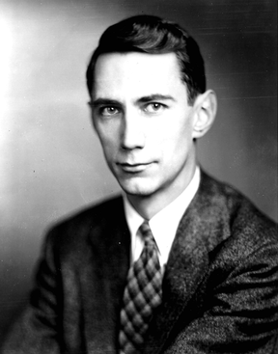
Claude Shannon

Slide 67
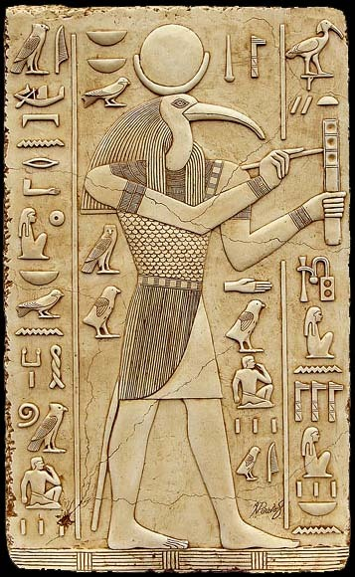
Tehuti

