Slide 1
The
Post
JavaScript Apocalypse

Slide 2
The
Put
JavaScript Apocalypse

Slide 3
The
Patch
JavaScript Apocalypse

Slide 4
The
Post Put Patch
JavaScript Apocalypse

Slide 5
Post Put Patch
Clutter

Slide 6

KonMari
Marie Kondo

Slide 7
KonMari
tokimeku

Slide 8
KonMari
tokimeku
Spark Joy!

Slide 9
Clutter in Programming
Notes:
Intended to be a document delivery system. It performs poorly as an application delivery system.

Slide 10
ASCII
American Standard Code for Information Interchange

Slide 11
TAB
SPACE

Slide 12


Slide 13
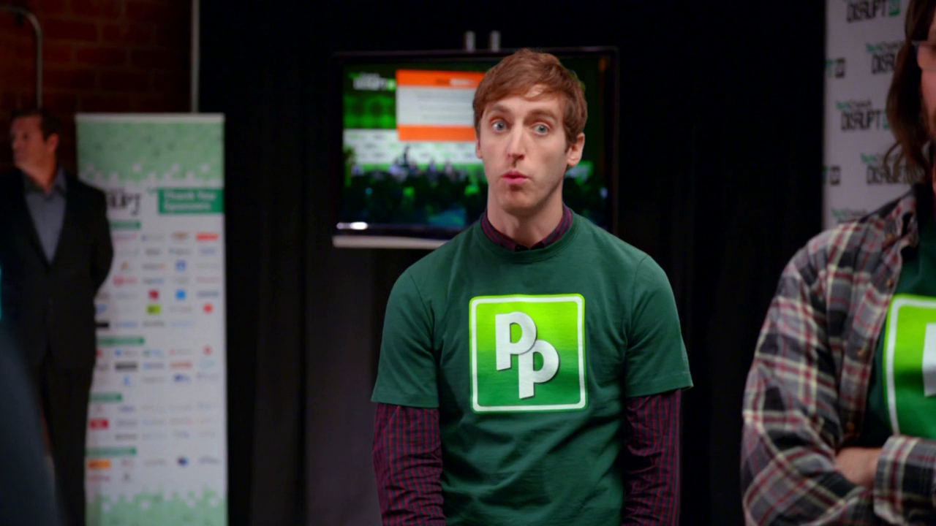

Slide 14


Slide 15
TAB
SPACE

Slide 16
TAB
SPACE

Slide 17
Quoted string literals
' "

Slide 18
Quoted string literals
' "
'Don't try this!'

Slide 19
let var

Slide 20
let var

Slide 21
let const

Slide 22
null undefined

Slide 23
null undefined

Slide 24
null
C. A. R. Hoare
Notes:
A billion dollar mistake

Slide 25
null
C. A. R. Hoare
Billion dollar mistake
Notes:
A billion dollar mistake

Slide 26
null
An immutable, empty object

Slide 27
An immutable, empty object
const null = Object.freeze(
Object.create()
);

Slide 28
Pure functions
Analogous to mathematical functions.
A given input will always yield exactly the same output.
No mutation. No side effects.
Testability.
Composability.
Parallelism.

Slide 29
Remove Impurities
Date
Math.random
delete
Object.assign
Array.splice
Array.sort
RegExp.exec
assignment
var
let
  const is ok
for
user interaction
network

Slide 30
The Universe is mutating.
Use purity when you can.

Slide 31
Generators

Slide 32
Generators
function factory(...) {
// The generator's state variables
return function generator() {
// compute the new value
// and update the state variables
return value;
};
}

Slide 33
function element(array) { let i = 0; return function generator() { if (i < array.length) { let value = array[i]; i += 1; return value;
}
};
}

Slide 34
Callbacks

Slide 35
Does the continuation argument go first or last?
function first(callback, a) {
return callback(a);
}
function last(a, callback) {
return callback(a);
}

Slide 36
The continuation argument goes first.
function first(callback, ...a) {
return callback(...a);
}

Slide 37
Syntax

Slide 38
FORTRAN
IF(A.EQ.0)A=B
BCPL
IF A = 0 {A := B;}
JavaScript if (a === 0) a = b;

Slide 39
FORTRAN
IF(A.EQ.0)A=B
BCPL
IF A = 0 {A := B;}
JavaScript if (a === 0) {a = b;}

Slide 40
ALGOL 68 if a = 0 then a := b; fi
Next? if a = 0 let a : b

Slide 41
ALGOL 68 if a = 0 then a := b; fi
Next? if a = 0 let a : b

Slide 42
try
try {
// code that might fail
} catch (Mistake e1) {
// first failure case
} catch (Screwup e2) {
// second failure case
} catch (Oopsy e3) {
// third failure case
} finally {
// implied function
}

Slide 43
implied function
try {
// code that might fail
} catch (Mistake e1) {
// first failure case
} catch (Screwup e2) {
// second failure case
} catch (Oopsy e3) {
// third failure case
} finally {
// implied function
}

Slide 44
assigned goto
try {
// code that might fail
} catch (Mistake e1) {
// first failure case
} catch (Screwup e2) {
// second failure case
} catch (Oopsy e3) {
// third failure case
} finally {
// implied function
}

Slide 45
try
try {
// plan a
} catch (ignore) {
// plan b
}
// clean up

Slide 46
indexOf
"abc".indexOf("z") // -1

Slide 47
int
Java Correct
int32 + int32 int32 int33
int32 * int32 int32 int63

Slide 48
int
Java Correct
int32 + int32 int32 int33
int32 * int32 int32 int63

Slide 49
int
Java Correct
int32 + int32 int32 int33
int32 * int32 int32 int63

Slide 50
int
Java Correct
int32 + int32 int32 int33
int32 * int32 int32 int63

Slide 51
0.1 + 0.2 === 0.3 false

Slide 52
(0.1 + 0.2) + 0.3
===
0.1 + (0.2 + 0.3) false

Slide 53
DEC64
Coefficient
Coefficient
Exponent
Number = Coefficient * 10^{Exponent}

Slide 54
dec64.com
Coefficient
Coefficient
Exponent
https://github.com/douglascrockford/DEC64/

Slide 55
0 / 0
Undened.
Catch re!
NaN
0
1
2

Slide 56
0 * n

Slide 57
0 * n
0
NaN

Slide 58
0 * n
0
NaN

Slide 59
0 * n
Code generators
Macro processors
Partial evaluators
Non-conditional idioms

Slide 60
0 / n
0 * n n * 0
0 modulo n
0

Slide 61
Reserved Words
Make things easier for compilers in low memory situations
Hazard for programmers
Hazard for language maintainers
  throw instead of raise

Slide 62
Reserved Words
In any function, a word may be used as a language keyword (if) or as a name (variable) but not both.
This is good for programmers because they will not trip over features they don't use.
This is good for language maintainers because they can introduce new features without breaking existing programs.

Slide 63
camelCase under_bar

Slide 64
camelCase under_bar names with spaces

Slide 65
names with spaces
A name is composed of one or more text atoms, separated by spaces.
Starting with an initial text atom, combine making the longest name that makes sense.
A name makes sense if it is a name in the current scope or a keyword.
If nothing makes sense, then use the first text atom only.

Slide 66
Contracts

Slide 67
Security

Slide 68
Distributed Programming

Slide 69
Be careful out there.

Slide 70
Be careful out there.
The web is cluttered and full of errors.
Notes:
Remove some clutter and make it better.

