Slide 1
The Next Programming Language Paradigm
Douglas Crockford

Slide 2
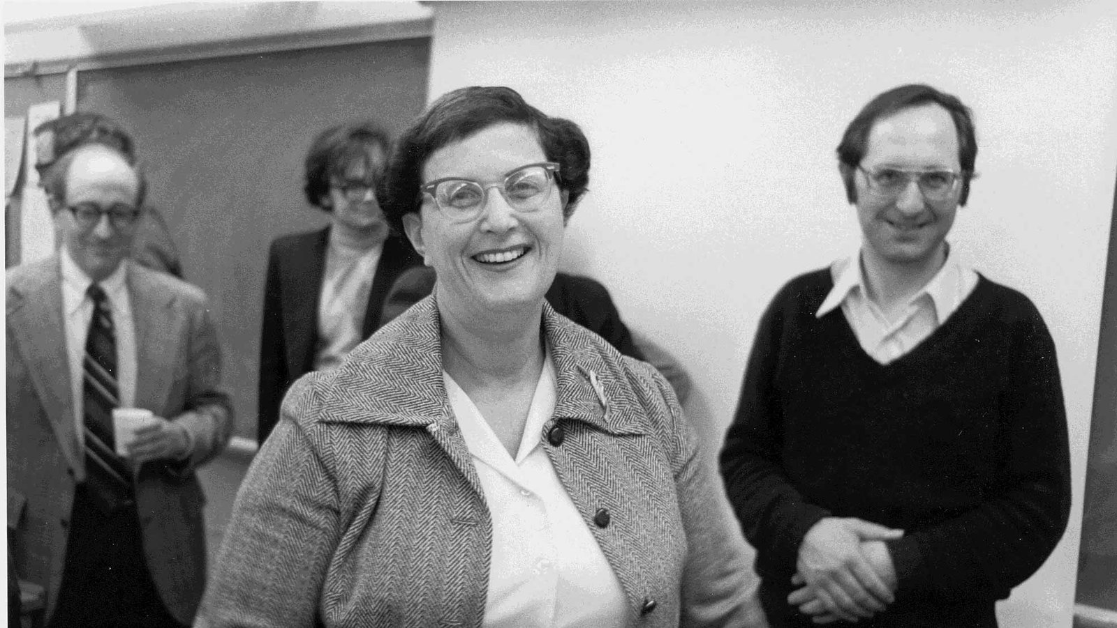
Jean Sammet

Slide 3
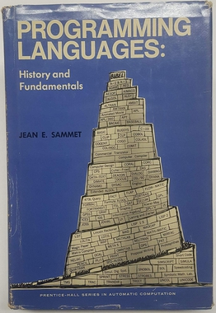
Programming Languages:
History and Fundamentals

Slide 4
So many languages
They are easy to make.
Most new languages offer little real value over their predecessors.
It requires extraordinary luck to get adoption.
One clever programmer can make a new language. It will take an army of coders to maintain it.
Some languages do not become popular, except with other language designers: ALGOL, BCPL, SmallTalk, Scheme, Haskell.
The next language should promote a new paradigm that allows better solutions to current and future problems.

Slide 5
JavaScript
Good Parts
  Flexible objects
  First class objects with lexical closure
  Optimized for event handling
Bad Parts
  Pretty much everything else
  Including most of the new parts
  Sequential illusion confusion

Slide 6
JavaScript should not be the last programming language.

Slide 7
WTF Operator
?.

Slide 8
The Old Paradigms
Von Neumann architecture
Symbolic programming
High level language
Structured programming
Object oriented programming
Functional programming
The program runs in a single machine.

Slide 9
Our World
Many processes per machine.
Many machines interconnected.
Machines are very fast.
Machines have very large memories.
Reliability requirements get increasing strict.
Insecurity is our biggest problem.
We need a programming paradigm that fits our distributed world.

Slide 10
The Actor Model

Slide 11
The Actor Model
The concurrency model...
The communication model...
The security model...
...all come from a single mechanism:
Message Passing

Slide 12
The Actor Model
An actor is a program running in a single process in a machine.
An actor communicates with other actors only by message passing.
There is no sharing, even between actors in the same machine.
An actor can create new actors in its own machine.
Every actor has a private address.
If you have an actor’s private address, you can send messages to that actor.
Messages can contain private addresses.
Actors can have state, which can change based on received messages.

Slide 13
Actors At Work
Incoming messages are queued if necessary, delivered in arrival order.
An actor runs when it receives a message.
An actor will not be given another message until it is done.
Messages sent by an actor will be held until it is done.
An actor’s turn may be timesliced.

Slide 14
Acquiring private addresses
By creation:
  When an actor creates an new actor, it receives the new actor’s private address.
By construction:
  An actor can be endowed with private addresses when it is created.
By introduction:
  An actor can receive messages containing private addresses.

Slide 15
Neo
Every bad part removed.

Slide 16
Misty = Neo + Actors
send private_address: message
send private_address: message: callback
send received_message: message
Register a receiver function
Register a portal function
Cleaner, more modular programming model
Connection management
Failure management

Slide 17
Liaison
Worker

Slide 18
Agent
Liaison
Worker

Slide 19
Agent
Client
Minion
Worker

Slide 20
Agent
Client
Minion
Worker

Slide 21
Agent
Client
Liaison
Minion
Worker

Slide 22
Agent
Client
Liaison
Minion
Worker

Slide 23
Agent
Client
Liaison
Minion
Worker

Slide 24
Agent
Client
Liaison
Minion
Worker

Slide 25
Agent
Client
Liaison
Minion
Worker

Slide 26
Agent
Client
Liaison
Minion
Worker

Slide 27
Minion
Agent
Client
Liaison
Minion
Worker

Slide 28
Liaison
Minion
Agent
Client
Liaison
Minion
Worker

Slide 29
Agent
Client
Minion
Worker

Slide 30
Agent
Client
Portal
Minion
Worker

Slide 31
Agent
Client
Portal
Portal’s network address
Portal’s public key
Minion
Worker

Slide 32
Agent
Client
Portal
Minion
Worker

Slide 39
Death before confusion!
Coping effectively with multiple opportunities for failure.

Slide 40
The Actor Protocol
On the network, an actor should not care what language another actor is written in.
We need an Actor Protocol, based on the Seif Protocol, to replace HTTPS in actor systems.
And a JSON-like format that adds blobs and private addresses.

Slide 41
Strictly speaking, a new programming language is not needed to enjoy the new paradigm.
However, a new programming language will make it easier to think effectively in the new paradigm.

Slide 42
Three Ways Forward
Augment existing languages to support the new secure actor protocol.
Misty, a transitional actor language built on top of Neo/JavaScript.
Actors all the way down.

Slide 43
I will be launching a project
I want to launch an open source project to build:
The Actor Protocol.
A secure, language-independent message transport
based on the Seif Protocol
The Misty Programming Language.
A transitional language the adds actors to Neo
in a high performance implementation
Actor bindings for your grandfather’s languages.

Slide 44
The Theater of Computation Project
Please write to me at
email: douglas@crockford.com
or
mastodon: https://layer8.space/@douglascrockford
See https://www.crockford.com/misty
See https://www.crockford.com/dec64.html
See https://github.com/paypal/seif-protocol
Thank you.

