Slide 1
Typing
Douglas Crockford

Slide 2
Language
Notes:
Intended to be a document delivery system. It performs poorly as an application delivery system.

Slide 3
Writing
Notes:
Intended to be a document delivery system. It performs poorly as an application delivery system.

Slide 4

Rebus Principle
belief

Slide 5
Rebus Principle
Middle East
China
America
Notes:
Intended to be a document delivery system. It performs poorly as an application delivery system.

Slide 6
Phoenicia

Slide 7
Greece

Slide 8
Rome

Slide 9
Alphabet
ABCDEFZHIKLMNOPQRSTVX

Slide 10
Alphabet
ABCDEFGHIKLMNOPQRSTVX

Slide 11
Alphabet
ABCDEFGHIKLMNOPQRSTVXYZ

Slide 12
Alphabet
ABCDEFGHIJKLMNOPQRSTUVXYZ

Slide 13
Alphabet
ABCDEFGHIJKLMNOPQRSTUVWXYZ

Slide 14
Alphabet
ABCDEFGHIJKLMNOPQRSTUVWXYZ
&

Slide 15
Alphabet
ABCDEFGHIJKLMNOPQRSTUVWXYZ abcdefghijklmnopqrstuvwxyz

Slide 16
ß

Slide 17
Technology
Marks on media
Printing
Typing
Digital Media
Notes:
Intended to be a document delivery system. It performs poorly as an application delivery system.

Slide 18
Typing
Christopher Latham Sholes
1867

Slide 19
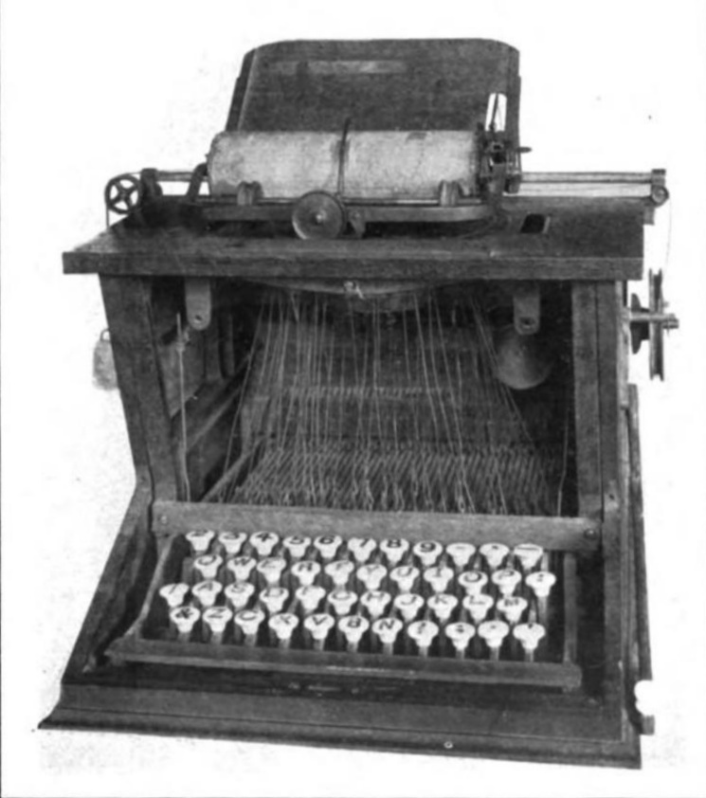

Slide 20
23456789
QWERTYUIOP
ASDFGHJKL
ZXCVBNM,.

Slide 21
23456789
QWERTYUIOP
ASDFGHJKL
ZXCVBNM,.

Slide 22
23456789
QWERTYUIOP
ASDFGHJKL
ZXCVBNM,.

Slide 23
23456789
QWERTYUIOP
ASDFGHJKL
ZXCVBNM,.

Slide 24
23456789
QWERTYUIOP
ASDFGHJKL
ZXCVBNM,.

Slide 25
23456789
QWERTYUIOP
ASDFGHJKL
ZXCVBNM,.

Slide 26
1234567890

Slide 27
1234567890
' " -

Slide 28
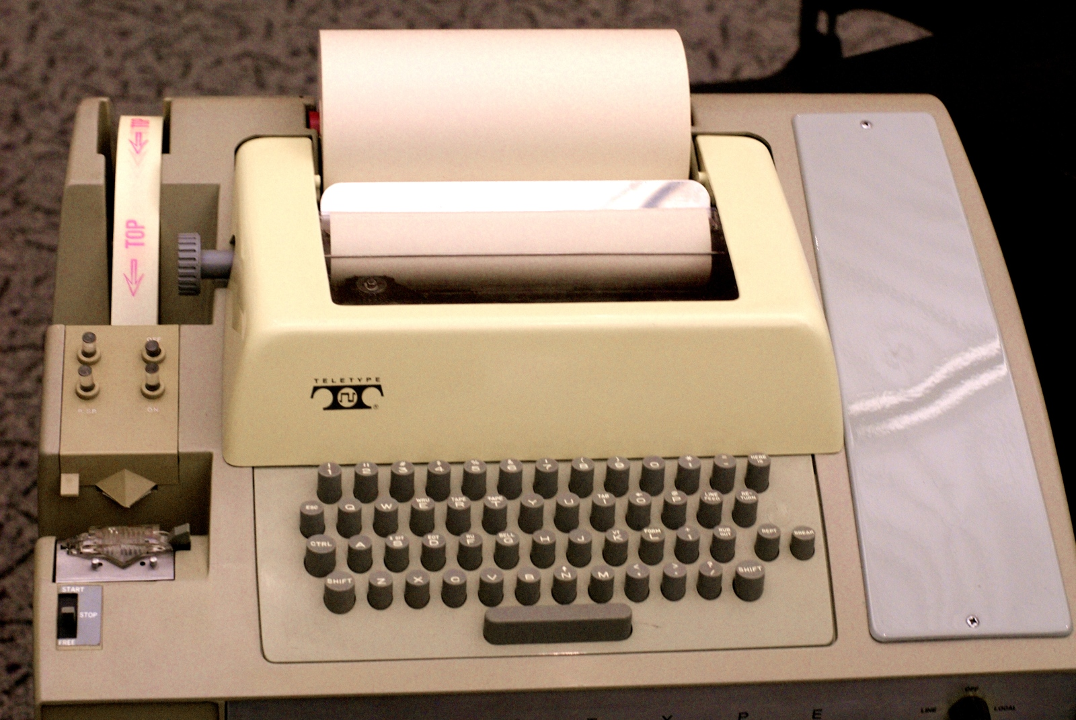

Slide 29
ASCII

Slide 39
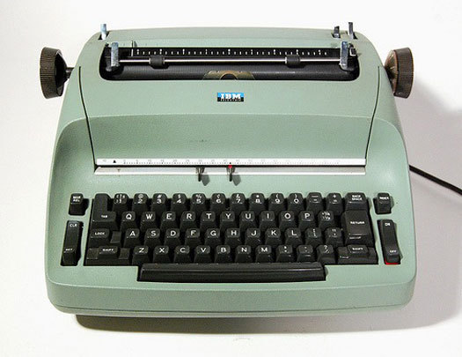

Slide 40
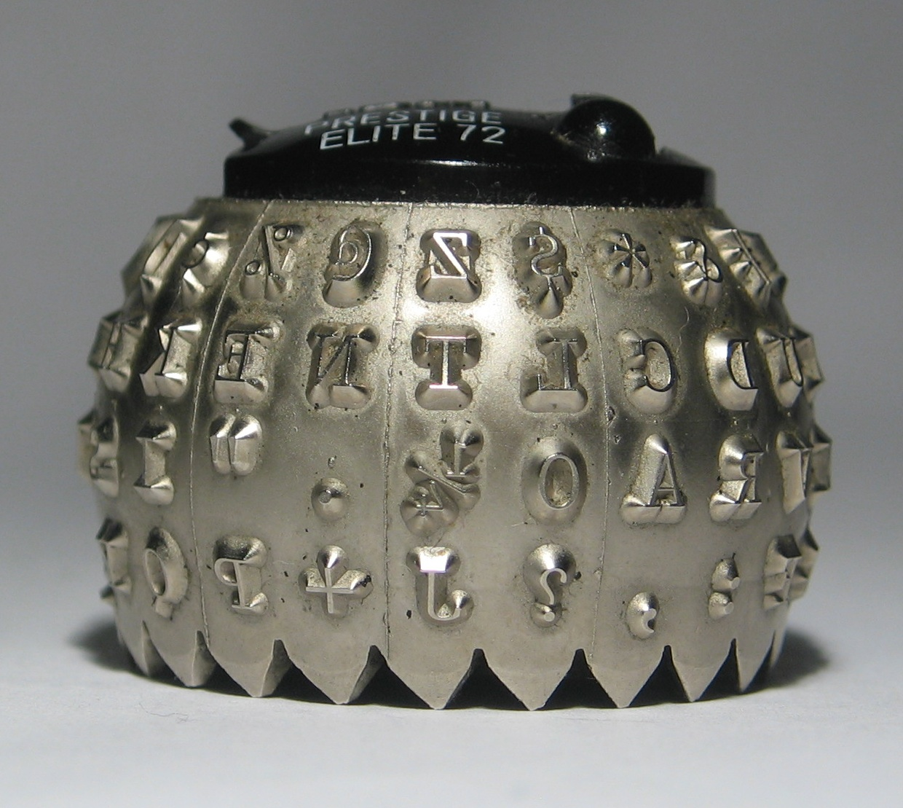

Slide 41
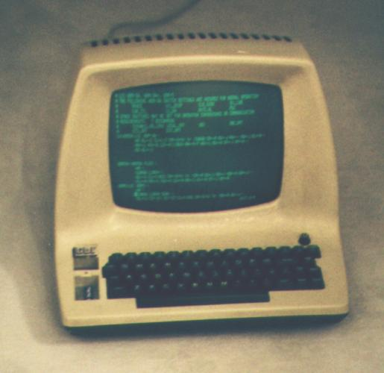

Slide 42
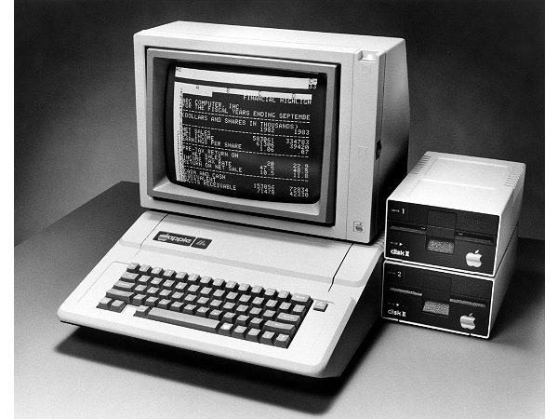

Slide 43
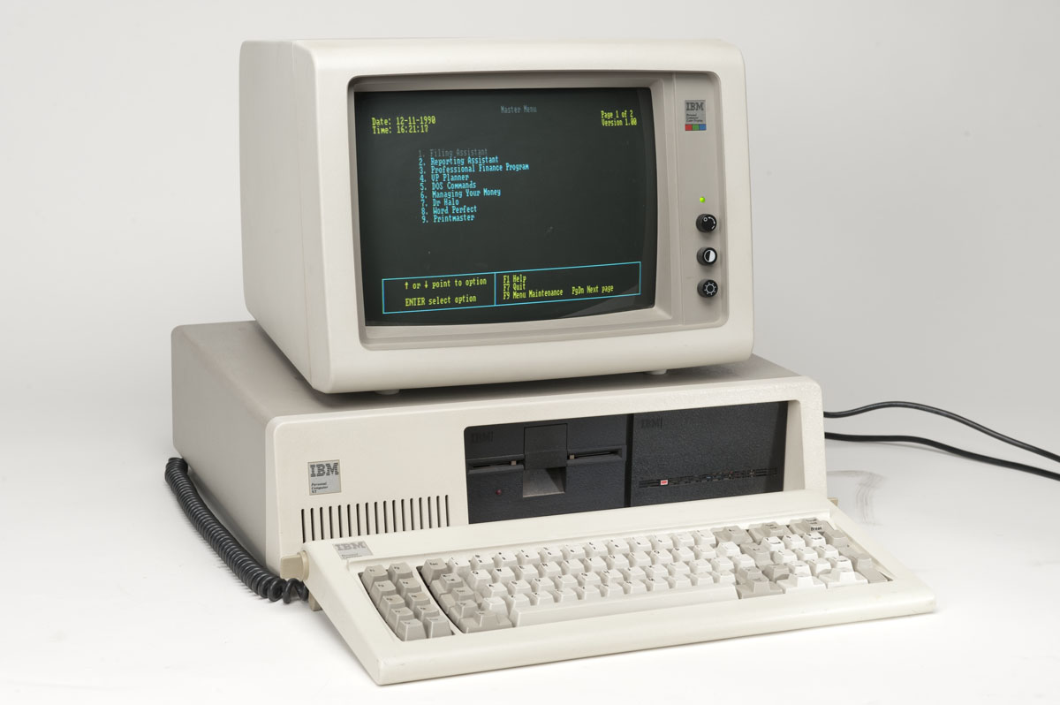

Slide 44
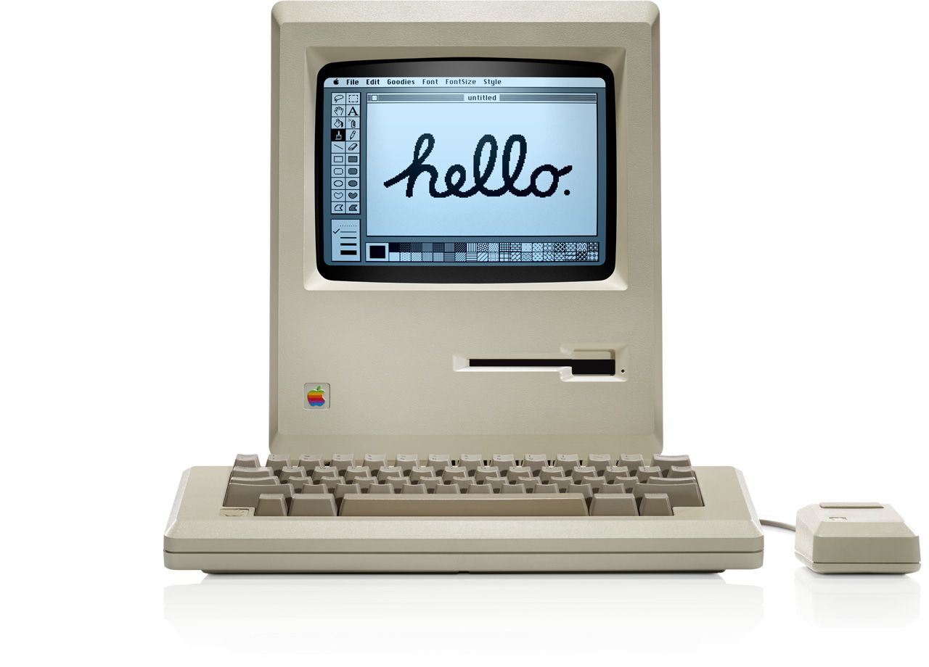

Slide 45
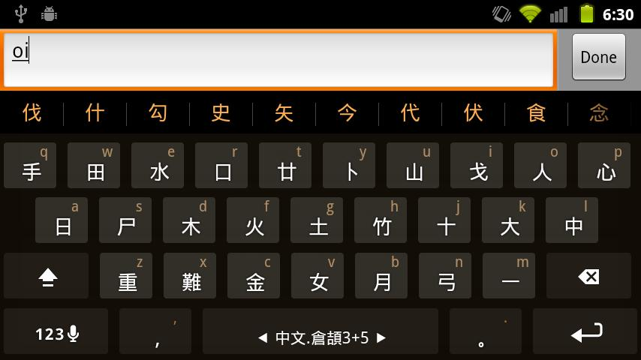

Slide 46
Crockford Keyboard
delete
euro
special
shift
done
a | b | c | d
e | f | g | h
i | j | k | l | m | n
o | p | q | r | s | t
u | v | w | x | y | z
7 | 8 | 9
4 | 5 | 6
1 | 2 | 3
, | 0 | .
space

Slide 47
Crockford Keyboard
delete
euro
special
shift
done
A | B | C | D
E | F | G | H
I | J | K | L | M | N
O | P | Q | R | S | T
U | V | W | X | Y | Z
7 | 8 | 9
4 | 5 | 6
1 | 2 | 3
, | 0 | .
space

Slide 48
Crockford Keyboard
delete
euro
special
shift
done
( | ) | \ | / | % | *
[ | ] | ! | ? | ; | :
{ | } | & | # | - | ~
< | > | | | _ | $ | +
` | ' | ^ | " | @ | =
7 | 8 | 9
4 | 5 | 6
1 | 2 | 3
, | 0 | .
space

Slide 49
Crockford Keyboard
delete
euro
special
shift
done
° | • | © | ÷
€ | ₣ | ¡ | ¿
“ | ” | ¹ | £ | µ | ·
« | » | ² | ® | § | ™
` | ´ | ³ | ¢ | ¥ | ≠
7 | 8 | 9
4 | 5 | 6
1 | 2 | 3
, | 0 | .
space

Slide 50
Crockford Keyboard
delete
euro
special
shift
done
à | á | â | ä | å | ã
è | é | ê | ë | ç | æ
ì | í | î | ï | ß | ñ
ò | ó | ô | ö | ø | õ
ù | ú | û | ü | ý | ÿ
7 | 8 | 9
4 | 5 | 6
1 | 2 | 3
, | 0 | .
space

Slide 51
Crockford Keyboard
delete
euro
special
shift
done
À | Á | Â | Ä | Å | Ã
È | É | Ê | Ë | Ç | Æ
Ì | Í | Î | Ï | ß | Ñ
Ò | Ó | Ô | Ö | Ø | Õ
Ù | Ú | Û | Ü | Ý | Ÿ
7 | 8 | 9
4 | 5 | 6
1 | 2 | 3
, | 0 | .
space

Slide 52
Crockford Keyboard
delete
euro
special
shift
done
a | b | c | d
e | f | g | h
i | j | k | l | m | n
o | p | q | r | s | t
u | v | w | x | y | z
7 | 8 | 9
4 | 5 | 6
1 | 2 | 3
, | 0 | .
space

Slide 53
Programma

Slide 54
Programma
0123456789

Slide 55
Programma
l
l

Slide 56
Programma
Ll
l
l

Slide 57
Programma
closuvwxz

Slide 58
Programma
:= += ->

Slide 59
Programma
(x) [y] {z}

Slide 60
Programma
f() <> /\ \/

